Slide 1
Lecture 7
Neural Networks

Slide 2
7. Introduction to Deep Learning
Brief history
Basic formulation (hierarchical processing)
Optimization via gradient descent
Layer types (Linear, Pointwise non-linearity)
Everything is a tensor
Deep nets as data transformers

Slide 3
Deep learning
Modeling the visual world is incredibly complicated. We need high capacity models.
In the past, we didn’t have enough data to fit these models. But now we do!
We want a class of high capacity models that are easy to optimize.
Deep neural networks!

Slide 4
A brief history of Neural Networks
enthusiasm
time

Slide 5
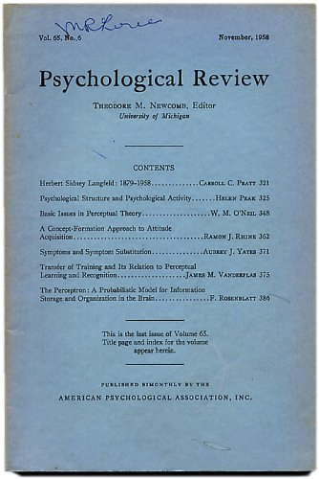
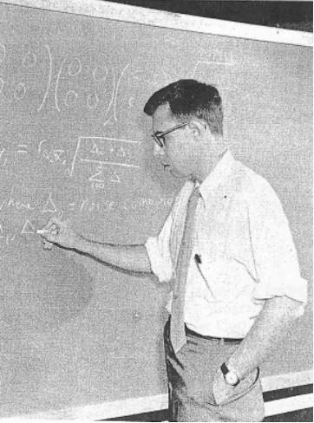
Perceptrons, 1958
Rosenblatt
http://www.ecse.rpi.edu/homepages/nagy/PDF_chrono/2011_Nagy_Pace_FR.pdf. Photo by George Nagy
http://citeseerx.ist.psu.edu/viewdoc/download?doi=10.1.1.335.3398&rep=rep1&type=pdf

Slide 6
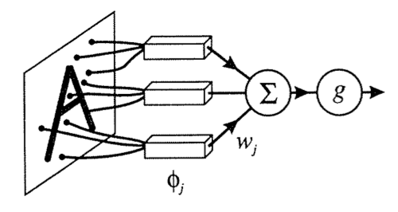
Perceptrons, 1958

Slide 7
Perceptrons,
1958
enthusiasm
time

Slide 8
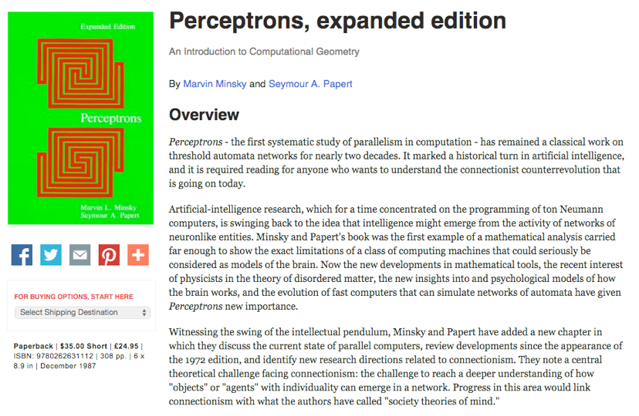
Minsky and Papert, Perceptrons, 1972

Slide 9
Perceptrons,
1958
enthusiasm
Minsky and Papert,
1972
time

Slide 10
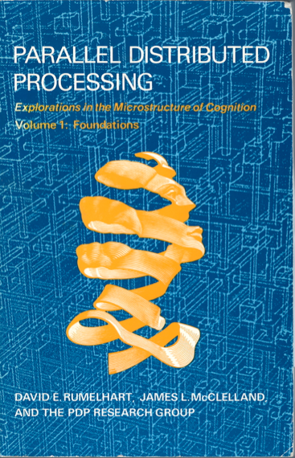
Parallel Distributed Processing (PDP), 1986

Slide 11
XOR problem
Output
Inputs
0 0 0
1 0 1
0 1 1
1 1 0
0 1
0 1
PDP authors pointed to the backpropagation algorithm
as a breakthrough, allowing multi-layer neural networks to be
trained. Among the functions that a multi-layer network can represent but a single-layer network cannot: the XOR function.

Slide 12
Perceptrons,
1958
PDP book,
1986
enthusiasm
Minsky and Papert,
1972
time

Slide 13
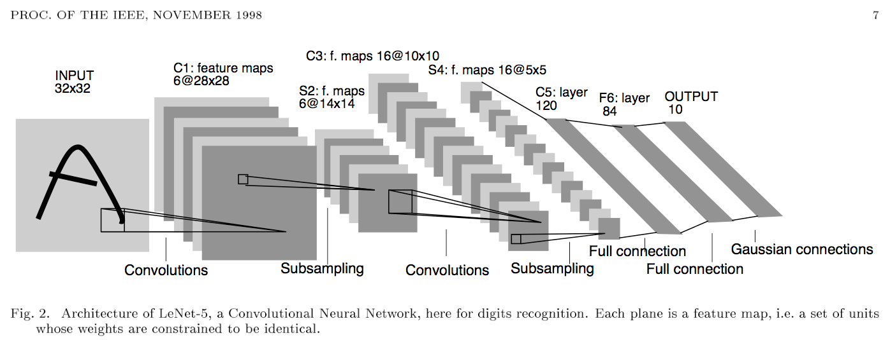
LeCun conv nets, 1998
Demos:
http://yann.lecun.com/exdb/lenet/index.html

Slide 14
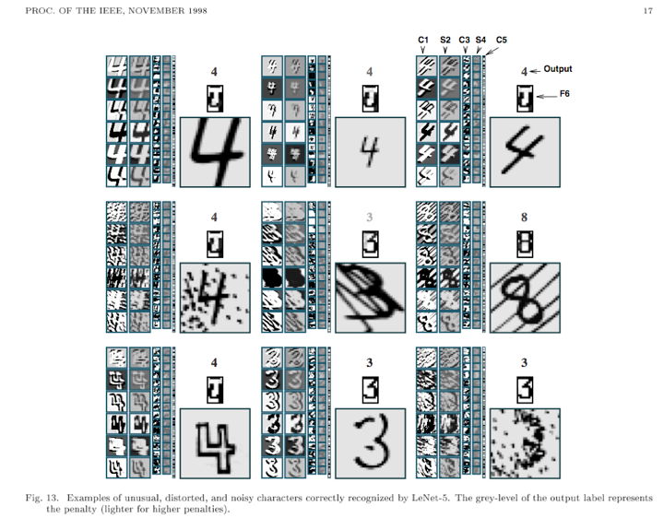

Slide 15
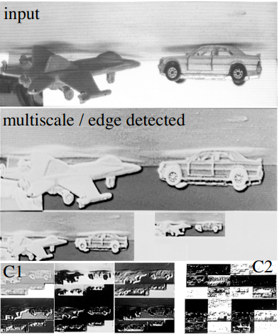
Neural networks to recognize handwritten digits? yes
Neural networks for tougher problems? not really
http://pub.clement.farabet.net/ecvw09.pdf

Slide 16
Neural Information Processing Systems 2000
Neural Information Processing Systems, is the premier conference on machine learning. Evolved from an interdisciplinary conference to a machine learning conference.
For the 2000 conference:
title words predictive of paper acceptance: “Belief Propagation” and “Gaussian”.
title words predictive of paper rejection: “Neural” and “Network”.

Slide 17
Perceptrons,
1958
PDP book,
1986
enthusiasm
Minsky and Papert,
1972
AI winter,
2000
time

Slide 18
Krizhevsky, Sutskever, and Hinton, NeurIPS 2012
“Alexnet”

Slide 19
Slide from Rob Fergus, NYU

Slide 20
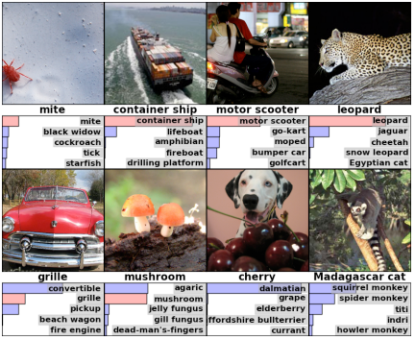
Krizhevsky, Sutskever, and Hinton, NeurIPS 2012

Slide 21
28 years
28 years
Krizhevsky, Sutskever,
Hinton, 2012
Perceptrons,
1958
PDP book,
1986
enthusiasm
Minsky and Papert,
1972
AI winter,
2000
time

Slide 22
What comes next?
Krizhevsky, Sutskever,
Hinton, 2012
Perceptrons,
1958
PDP book,
1986
enthusiasm
Minsky and Papert,
1972
AI winter,
2000
28 years
28 years
2028 ?
time

Slide 23
What comes next?
Krizhevsky, Sutskever,
Hinton, 2012
Perceptrons,
1958
PDP book,
1986
enthusiasm
Minsky and Papert,
1972
AI winter,
2000
2028 ?
time
28 years
28 years

Slide 24
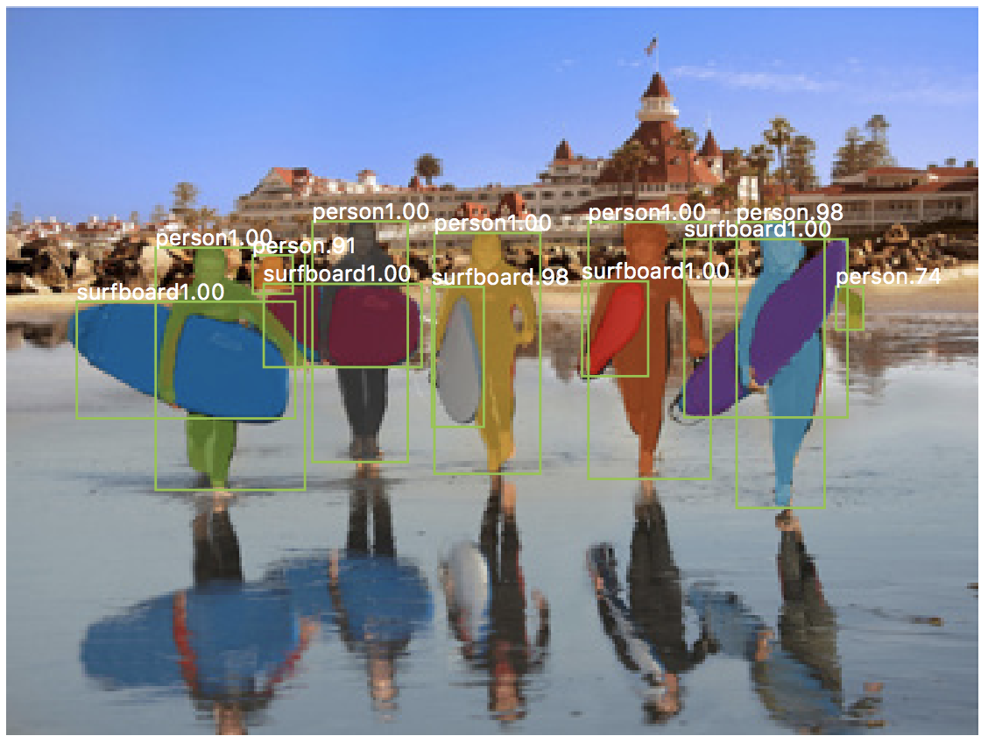
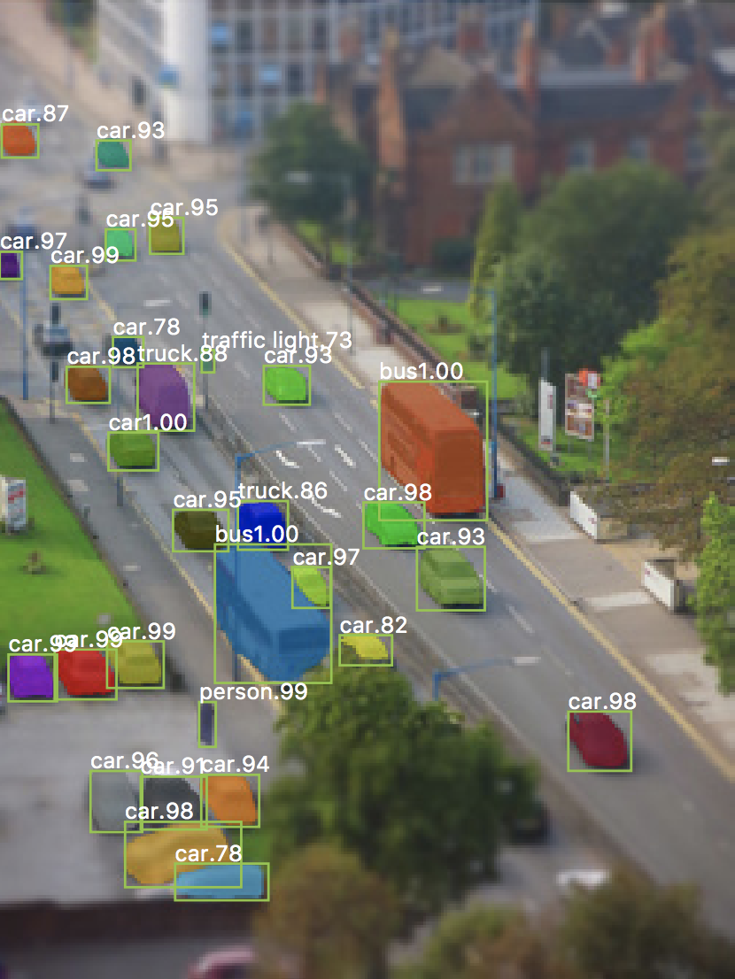
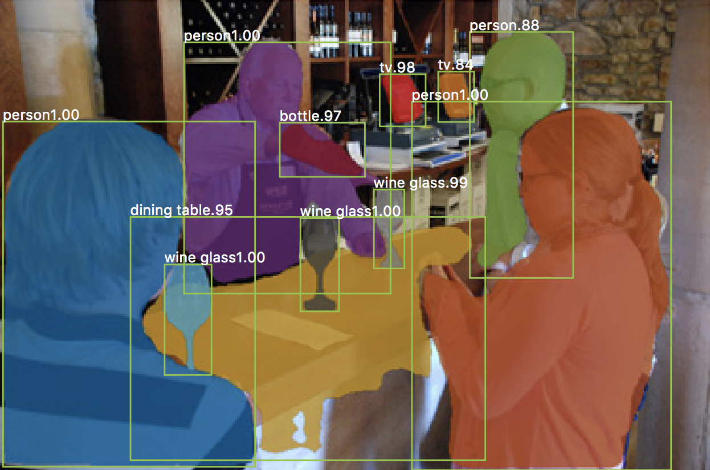
[“Mask RCNN”, He et al. 2017]

Slide 25
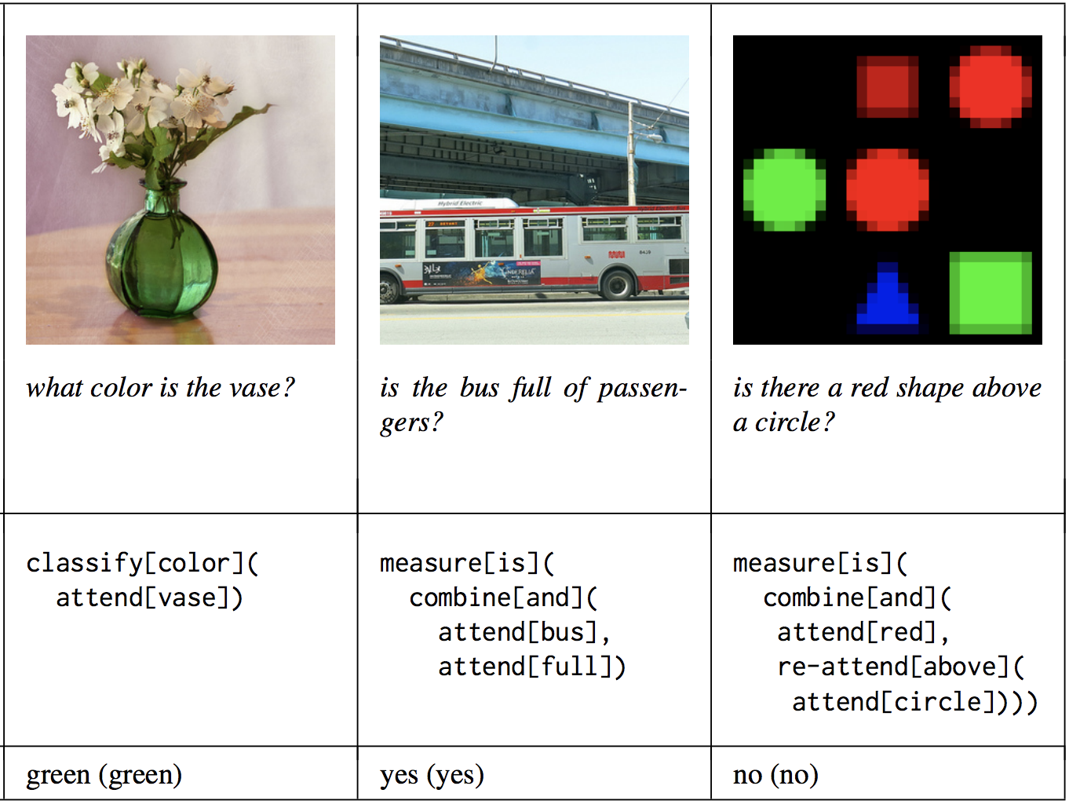
[“Neural module networks”, Andreas et al. 2017]

Slide 26
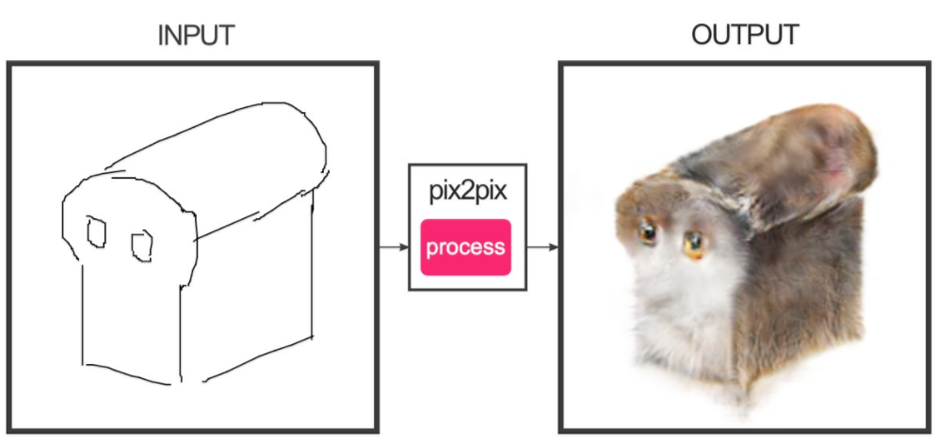
Ivy Tasi @ivymyt
Vitaly Vidmirov @vvid
[“pix2pix”, Isola et al. 2017]

Slide 27
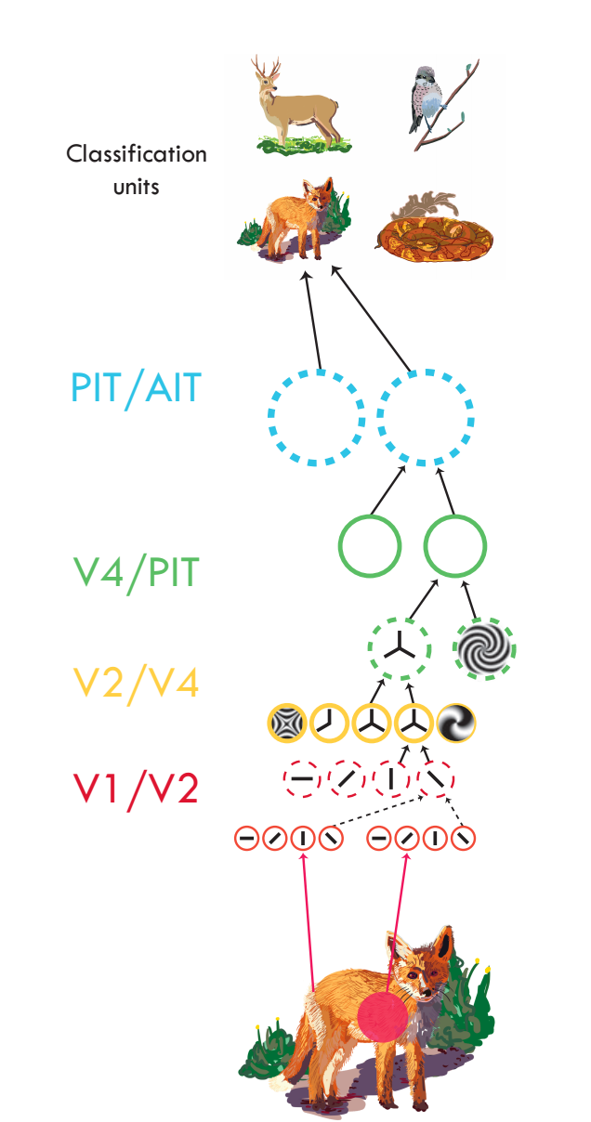
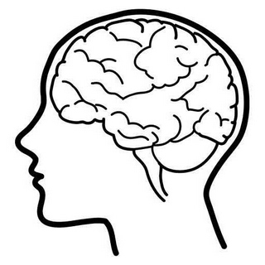
Serre, 2014
Notes:
Now we introduce deep nets as a more compact way of representing the knowledge in all that data. Rather than recording all the pixels, we compress the information into an abstracted representation, that can be quickly queried.
The previous methods we saw were basically lookup tables. Lookup tables are learned functions. They tell us what to output by matching to a memory. There are other and better ways to learn a mapping between input and output. These other methods basically assume the world has some simple structure that can be exploited. For example, neural nets factor the world into a hierarchy of parts, so that search can be done much faster. E.g., a T detector is the composition of two line detectors, at orthogonal angles. So we don’t need to make the T detector from scratch but can instead reuse our line detectors.

Slide 28
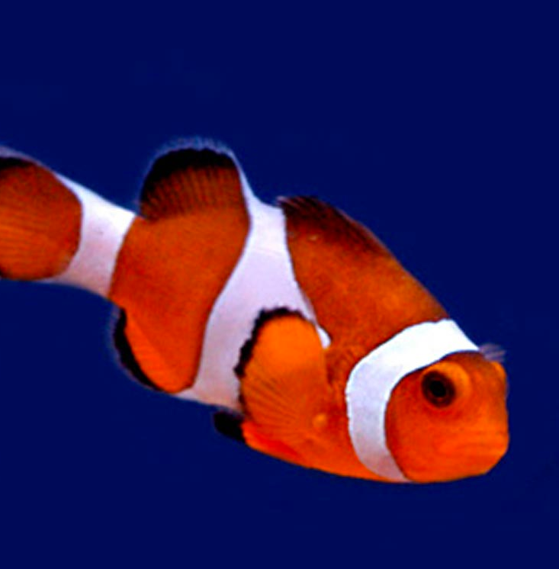
Image classification
Edges
Segments
“clown fish”
Texture
Parts
Colors
Notes:
Take some data input. Process it through a hierarchy of simple computational units. Units are reused in stereotyped fashion. Produce some output.

Slide 29
Image classification
Learned
Edges
Segments
“clown fish”
“clown fish”
Texture
Parts
Colors
Classifier
Notes:
Take some data input. Process it through a hierarchy of simple computational units. Units are reused in stereotyped fashion. Produce some output.

Slide 30
Image classification
Learned
“clown fish”
Notes:
Take some data input. Process it through a hierarchy of simple computational units. Units are reused in stereotyped fashion. Produce some output.

Slide 31
Image classification
Learned
“clown fish”
Neural net
Notes:
Take some data input. Process it through a hierarchy of simple computational units. Units are reused in stereotyped fashion. Produce some output.

Slide 32
Image classification
Learned
“clown fish”
Deep neural net
Notes:
Take some data input. Process it through a hierarchy of simple computational units. Units are reused in stereotyped fashion. Produce some output.

Slide 33
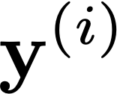
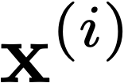
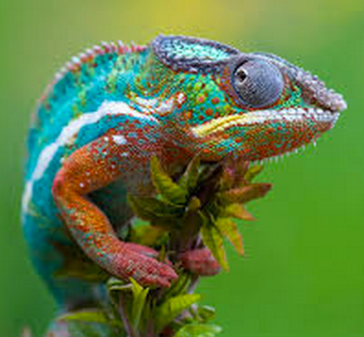
Deep learning
Learned
“clown fish”
Training data
“Fish”
Loss
“Grizzly”
“Chameleon”
…
Notes:
The basic idea is that you fiddle all the weights until you match the desired output.
\mathbf{\theta}^* = \argmin_{\theta} \sum_{i=1}^N \mathcal{L}(f_{\theta}(\mathbf{x}^{(i)}), \mathbf{y}^{(i)})
\mathcal{L}(f_{\theta}(\mathbf{x}^{(i)}), \mathbf{y}^{(i)})

Slide 34
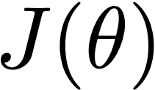
Gradient descent
Notes:
\theta^* = \argmin_{\theta} J(\theta)

Slide 35
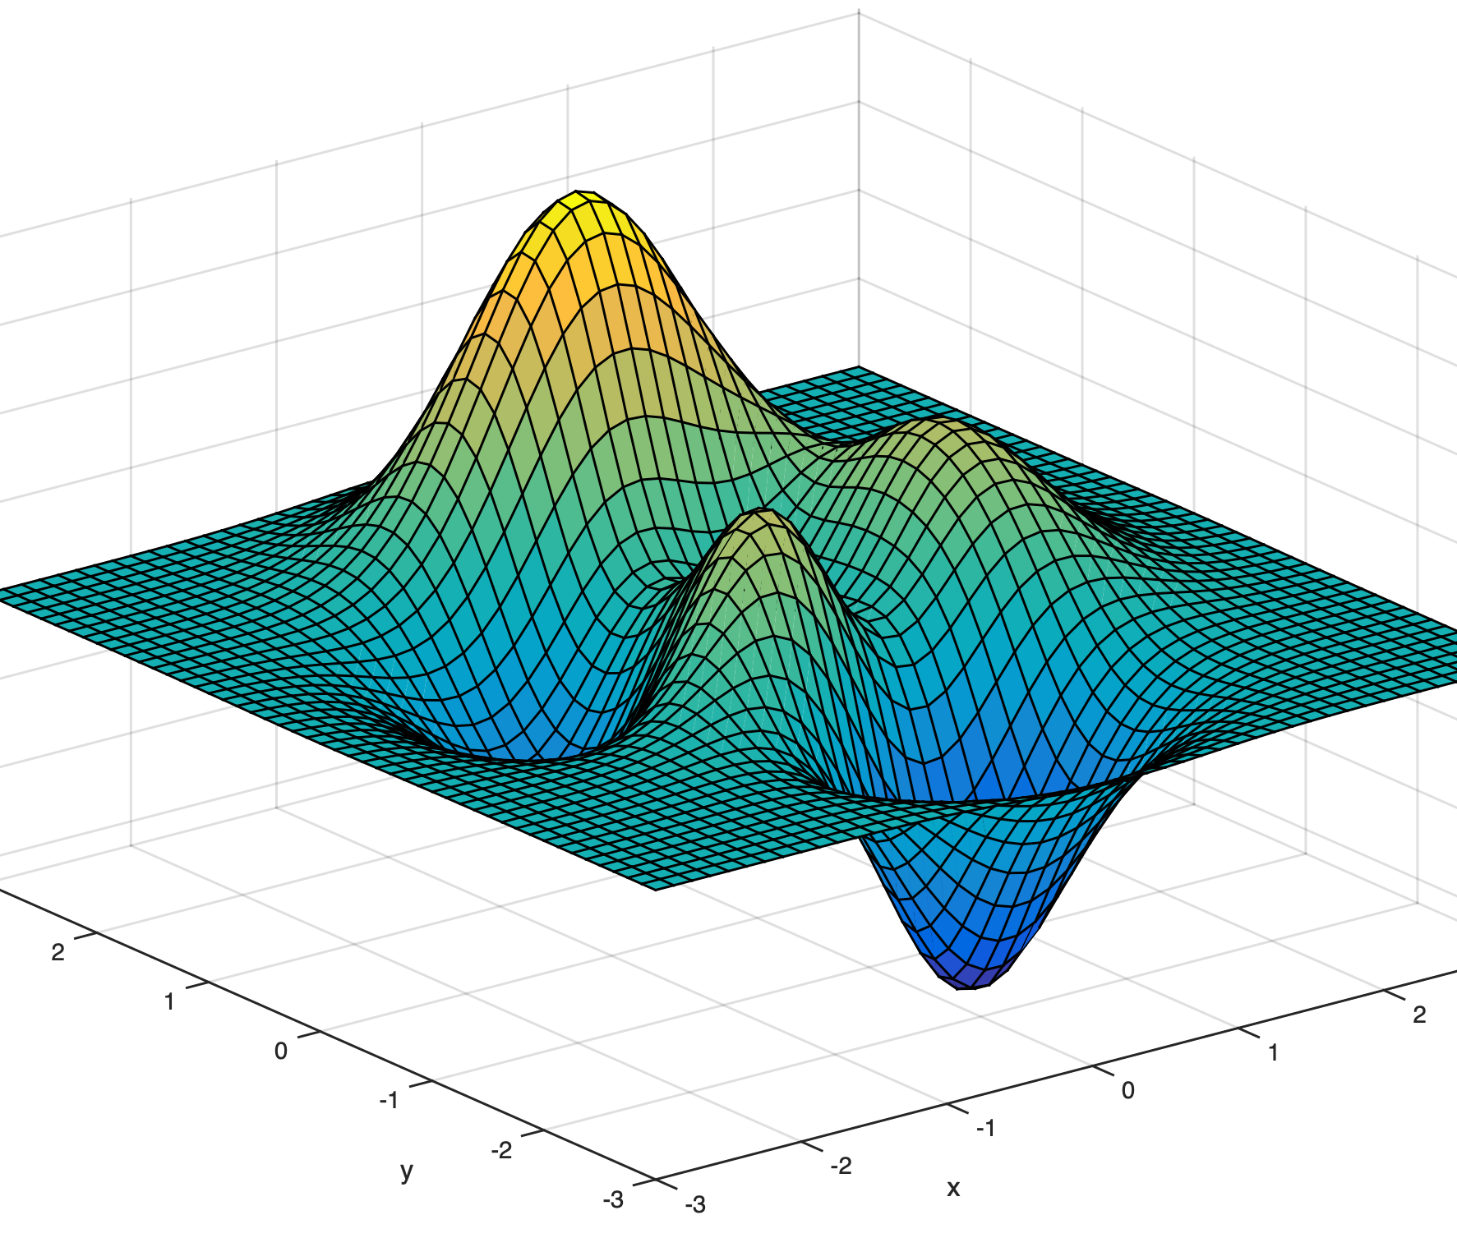
Gradient descent
x

Slide 36
Gradient descent
One iteration of gradient descent:
learning rate
Notes:
\theta^{t+1} = \theta^t - \eta_t \frac{\partial J(\theta)}{\partial \theta}\bigg\rvert_{\theta = \theta^t}

Slide 37
Stochastic gradient descent (SGD)
Want to minimize overall loss function J, which is sum of individual losses over each example.
In Stochastic gradient descent, compute gradient on sub-set (batch) of data.
If batchsize=1 then θ is updated after each example.
If batchsize=N (full set) then this is standard gradient descent.
Gradient direction is noisy, relative to average over all examples (standard gradient descent).
Advantages
Faster: approximate total gradient with small sample
Implicit regularizer
Disadvantages
High variance, unstable updates

Slide 38
Computation in a neural net
Input representation
Output representation
Notes:
Vector in, vector out. What do the arrows mean? What computation do they do? A cool thing about neural nets is they reuse the same simple computational units over and over again. So the arrows here are all mostly doing the same kind of computation.

Slide 39
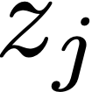
Computation in a neural net
Linear layer
Input representation
Output representation
Notes:
z_j = \sum_i w_{ij}x_i

Slide 40
Computation in a neural net
Linear layer
Input representation
Output representation
weights
bias
Notes:
z_j = \sum_i w_{ij}x_i + b_j

Slide 41
Computation in a neural net
Linear layer
Input representation
Output representation
weights
bias
parameters of the model
Notes:
z_j = \mathbf{x}^T \mathbf{w}_{j} + b_j

Slide 42
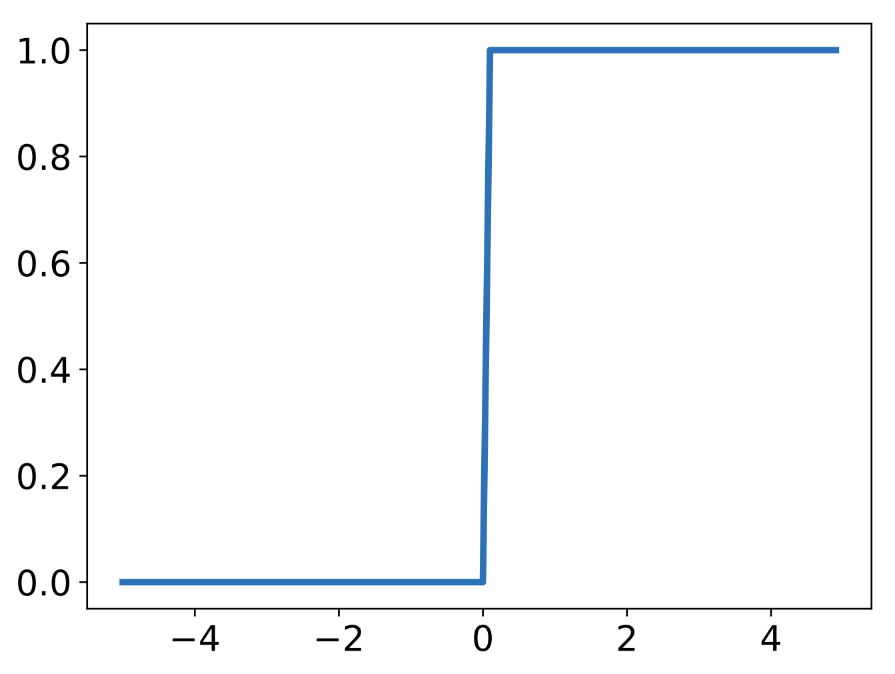
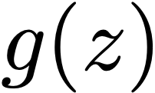
Computation in a neural net
“Perceptron”
Input representation
Output representation
Pointwise
Non-linearity
Notes:
g(z)=
\begin{cases}
1, &\text{if} \quad z > 0\\
0, & \text{otherwise}
\end{cases}

Slide 43
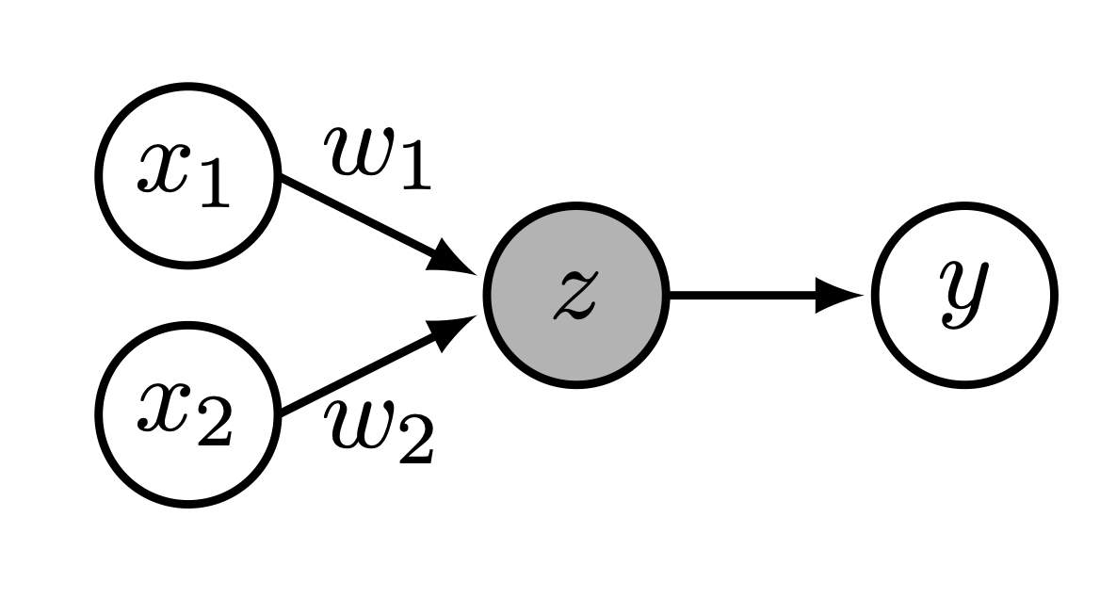
Example: linear classification with a perceptron
One layer neural net (perceptron) can
perform linear classification!

Slide 44
Training data

Slide 45
Computation in a neural net
Input representation
Output representation
Notes:
g(y)=
\begin{cases}
1, &\text{if} \quad y > 0\\
0, & \text{otherwise}
\end{cases}

Slide 46
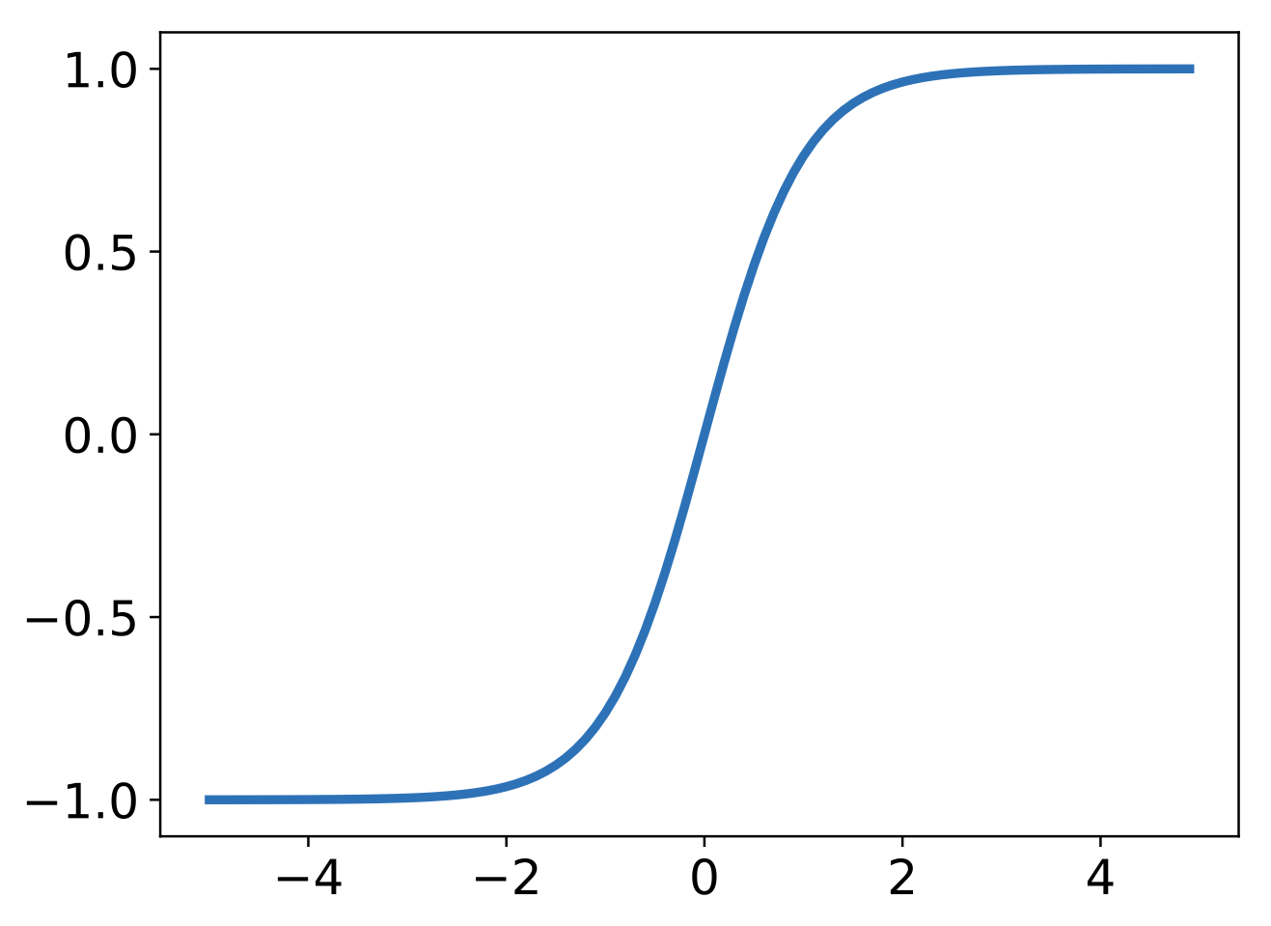
Computation in a neural net — nonlinearity
Tanh
Input representation
Output representation
Notes:
g(z) = \frac{1}{1+e^{-h}}

Slide 47
Computation in a neural net — nonlinearity
Tanh
Bounded between [-1,+1]
Saturation for large +/- inputs
Gradients go to zero
Outputs centered at 0
tanh(z) = 2 sigmoid(2z) −1
Notes:
g(z) = \frac{e^z - e^{-z}}{e^z+e^{-z}}

Slide 48
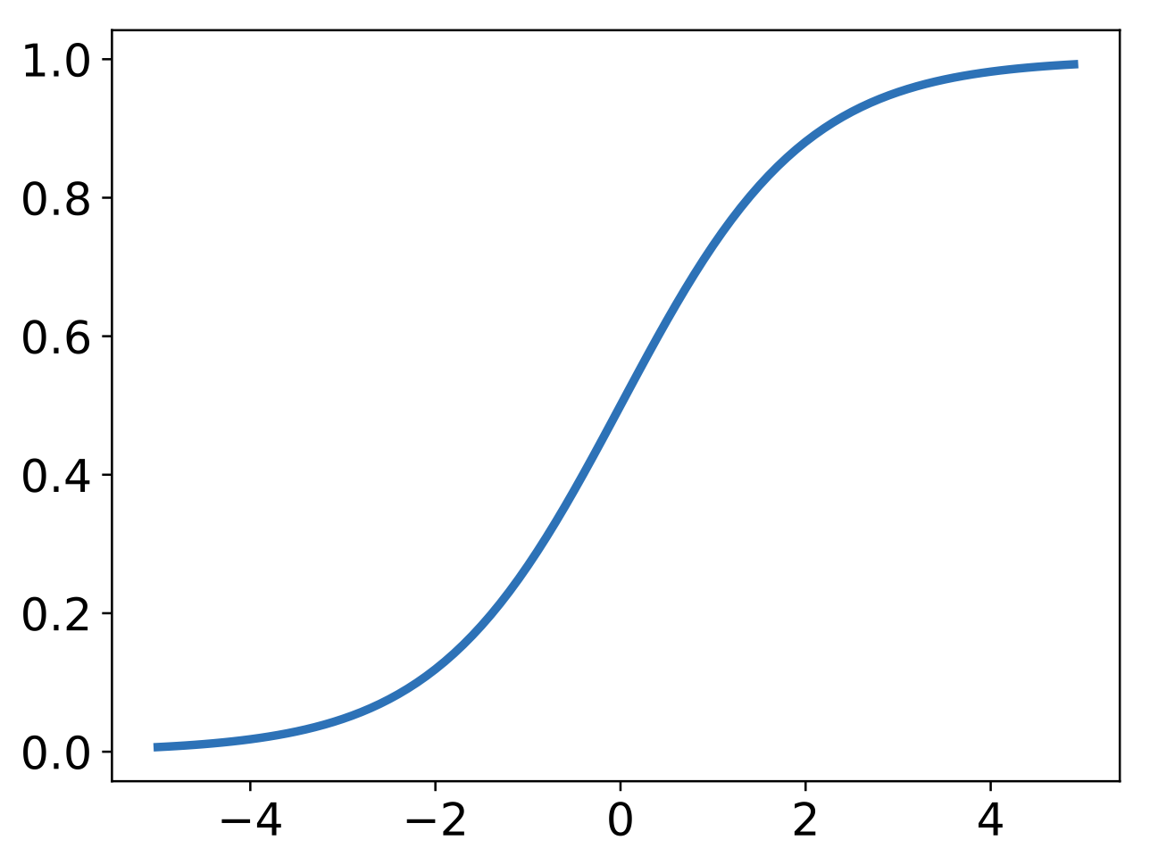
Computation in a neural net — nonlinearity
Interpretation as firing rate of neuron
Bounded between [0,1]
Saturation for large +/- inputs
Gradients go to zero
Outputs centered at 0.5 (poor conditioning)
Not used in practice
Sigmoid

Slide 49
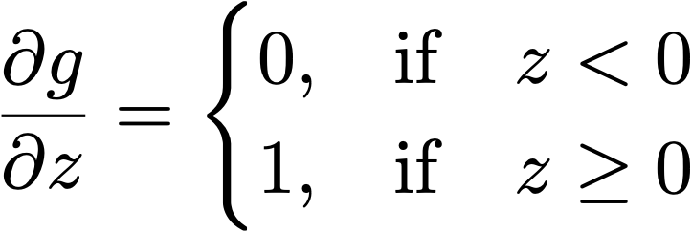
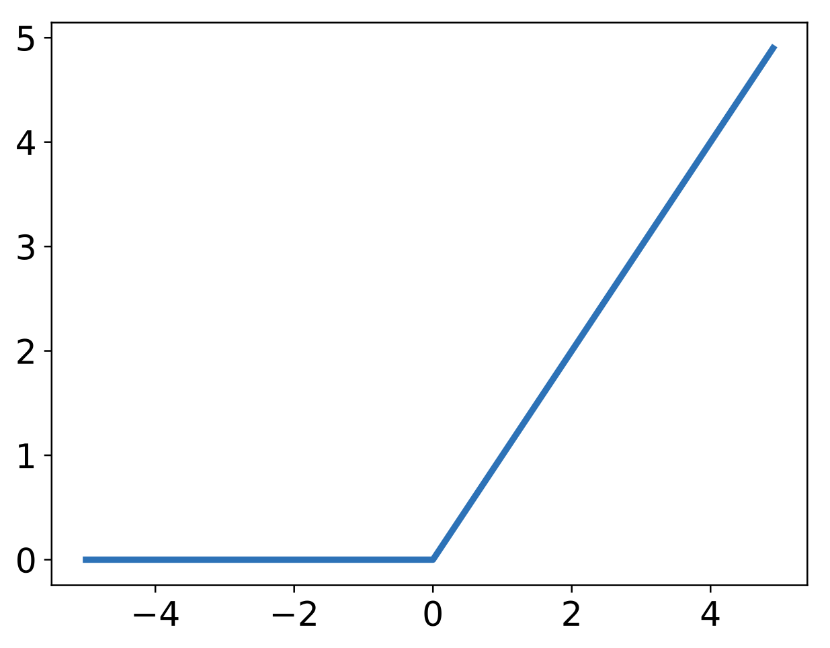
Computation in a neural net — nonlinearity
Unbounded output (on positive side)
Efficient to implement:
Also seems to help convergence (see 6x speedup vs tanh in [Krizhevsky et al.])
Drawback: if strongly in negative region, unit is dead forever (no gradient).
Default choice: widely used in current models.
Rectified linear unit (ReLU)
Notes:
\frac{\partial g}{\partial z} =
\begin{cases}
0, & \text{if} \quad z < 0\\
1, & \text{if} \quad z \geq 0
\end{cases}
g(z) = \max(0,z)

Slide 50
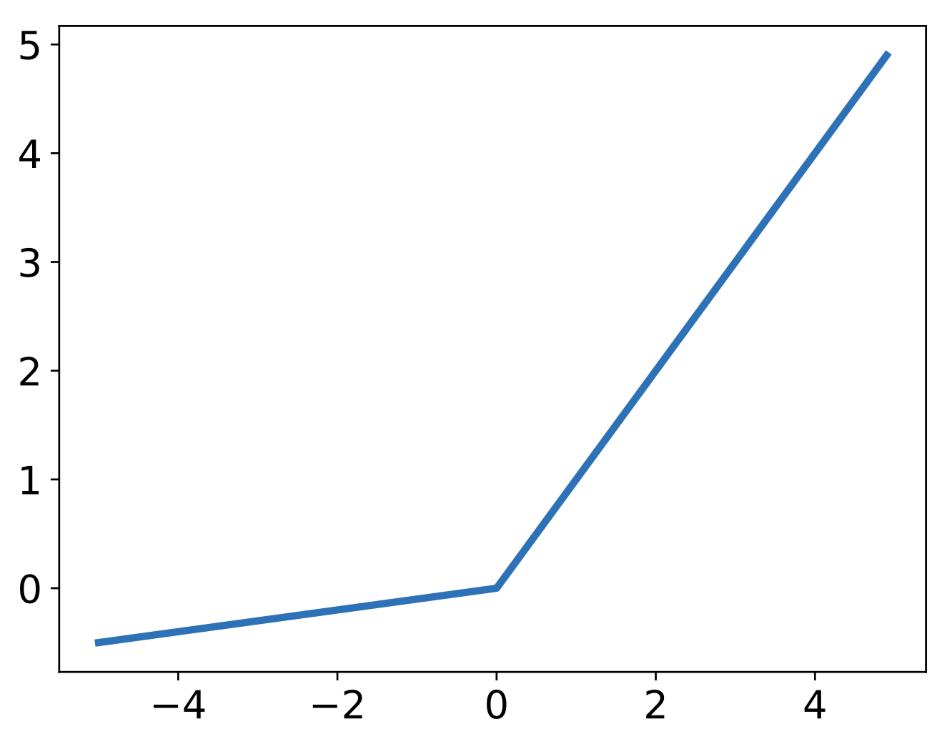
Computation in a neural net — nonlinearity
Leaky ReLU
where α is small (e.g. 0.02)
Efficient to implement:
Also known as probabilistic ReLU (PReLU)
Has non-zero gradients everywhere (unlike ReLU)
α can also be learned (see Kaiming He et al. 2015).
Notes:
g(z)=
\begin{cases}
\max(0,z), &\text{if} \quad z \geq 0\\
a\min(0,z), &\text{if} \quad z < 0
\end{cases}
\frac{\partial g}{\partial z} =
\begin{cases}
-a, & \text{if} \quad z < 0\\
1, & \text{if} \quad z \geq 0
\end{cases}

Slide 51
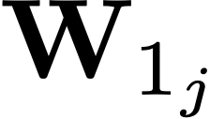
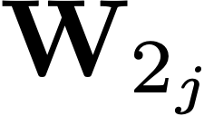
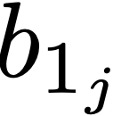
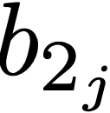
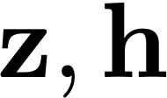
Stacking layers
Input representation
Intermediate representation
Output representation
= “hidden units”
Notes:
\mathbf{W}_{1_j}

Slide 52
Stacking layers
Input representation
Intermediate representation
Output representation
Notes:
\mathbf{h} = g(\mathbf{W}_1\mathbf{x} + \mathbf{b}_1)
\mathbf{y} = g(\mathbf{W}_2\mathbf{h} + \mathbf{b}_2)
\theta = \{\mathbf{W}_1, \ldots, \mathbf{W}_L, \mathbf{b}_1, \ldots, \mathbf{b}_L\}

Slide 53
Stacking layers
Input representation
Intermediate representation
Output representation
positive
negative
Notes:
\theta = \{\mathbf{W}_1, \ldots, \mathbf{W}_L, \mathbf{b}_1, \ldots, \mathbf{b}_L\}

Slide 54
Stacking layers
Input representation
Intermediate representation
Output representation
positive
negative
Notes:
\theta = \{\mathbf{W}_1, \ldots, \mathbf{W}_L, \mathbf{b}_1, \ldots, \mathbf{b}_L\}

Slide 55
Stacking layers
Input representation
Intermediate representation
Output representation
positive
negative
Notes:
\theta = \{\mathbf{W}_1, \ldots, \mathbf{W}_L, \mathbf{b}_1, \ldots, \mathbf{b}_L\}

Slide 56
Stacking layers
Input representation
Intermediate representation
Output representation
positive
negative
Notes:
\theta = \{\mathbf{W}_1, \ldots, \mathbf{W}_L, \mathbf{b}_1, \ldots, \mathbf{b}_L\}

Slide 57
Connectivity patterns
Input representation
Output representation
Input representation
Output representation
Fully connected layer
Locally connected layer
(Sparse W)

Slide 58
Deep nets
Non-linearity
Linear
Classify
“clown fish”
…
Notes:
Cascade of repeated simple computations. With each increasing layer we get more abstracted representations, we get a higher capacity model. This means it can perform more complex and abstract calculations. A shallow network can only efficiently compute simple things, like finding edges. A deep network can efficiently compute harder things like recognizing a clown fish or translating English to Chinese.
f(\mathbf{x}) = f_{L}(f_{L-1}(\ldots f_2(f_1(\mathbf{x}))))

Slide 59
Example: linear classification with a perceptron
One layer neural net (perceptron) can
perform linear classification!

Slide 60
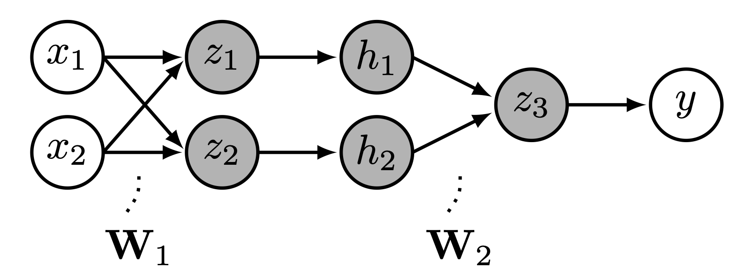
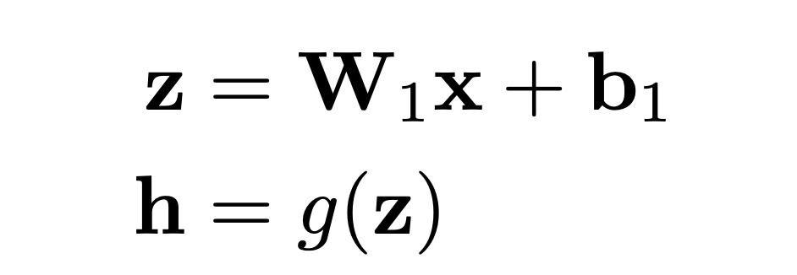
Example: nonlinear classification with a deep net net

Slide 61
Representational power
1 layer? Linear decision surface.
2+ layers? In theory, can represent any function. Assuming non-trivial non-linearity.
Bengio 2009,
http://www.iro.umontreal.ca/~bengioy/papers/ftml.pdf
Bengio, Courville, Goodfellow book
http://www.deeplearningbook.org/contents/mlp.html
Simple proof by M. Neilsen
http://neuralnetworksanddeeplearning.com/chap4.html
D. Mackay book
http://www.inference.phy.cam.ac.uk/mackay/itprnn/ps/482.491.pdf
But issue is efficiency: very wide two layers vs narrow deep model? In practice, more layers helps.

Slide 62
Deep nets
Non-linearity
Linear
Classify
“clown fish”
…
Notes:
Cascade of repeated simple computations. With each increasing layer we get more abstracted representations, we get a higher capacity model. This means it can perform more complex and abstract calculations. A shallow network can only efficiently compute simple things, like finding edges. A deep network can efficiently compute harder things like recognizing a clown fish or translating English to Chinese.
f(\mathbf{x}) = f_{L}(f_{L-1}(\ldots f_2(f_1(\mathbf{x}))))

Slide 63
Classifier layer
Last layer
dolphin
cat
grizzly bear
angel fish
“clown fish”
…
argmax
chameleon
clown fish
iguana
elephant
…

Slide 64
Loss function
Network output
Ground truth label
“clown fish”
dolphin
cat
grizzly bear
angel fish
Loss
error
…
chameleon
clown fish
iguana
elephant
…

Slide 65
Loss function
Network output
Ground truth label
“clown fish”
dolphin
cat
grizzly bear
angel fish
Loss
small
…
chameleon
clown fish
iguana
elephant
…

Slide 66
Loss function
Network output
Ground truth label
“grizzly bear”
dolphin
cat
grizzly bear
angel fish
Loss
large
…
chameleon
clown fish
iguana
elephant
…

Slide 67
Network output
Ground truth label
dolphin
Probability of the observed data under the model
cat
grizzly bear
angel fish
chameleon
clown fish
iguana
elephant
…
…
Notes:
H(\hat{\mathbf{z}},\mathbf{z}) = -\sum_c \hat{\mathbf{z}}_c \log \mathbf{z}_c
When the net output is a normalized vector, we can think of it as a probability distribution over possible object classes. This loss function on the right tells the network to maximize the probability of the training data, which forces the output to be a good probability model of object class given image.

Slide 68
Prediction
Ground truth label
dolphin
cat
grizzly bear
angel fish
chameleon
clown fish
iguana
…
dolphin
cat
grizzly bear
angel fish
chameleon
clown fish
iguana
elephant
elephant
…
0
1
0
1

Slide 69
Prediction
Ground truth label
Loss
dolphin
cat
grizzly bear
angel fish
chameleon
clown fish
iguana
…
dolphin
cat
grizzly bear
angel fish
chameleon
clown fish
iguana
elephant
elephant
…
0
1
0
1
0
1

Slide 70
Likelihood of observed true data under predictive model
Prediction
Ground truth label
Likelihood
dolphin
cat
grizzly bear
angel fish
chameleon
clown fish
iguana
…
dolphin
cat
grizzly bear
angel fish
chameleon
clown fish
iguana
elephant
elephant
…
0
1
0
1
0
1

Slide 71
Prediction
Ground truth label
Loss
dolphin
cat
grizzly bear
angel fish
chameleon
clown fish
iguana
…
dolphin
cat
grizzly bear
angel fish
chameleon
clown fish
iguana
elephant
elephant
…
0
1
0
1
0
1

Slide 72
Prediction
Ground truth label
Loss
dolphin
cat
grizzly bear
angel fish
chameleon
clown fish
iguana
…
dolphin
cat
grizzly bear
angel fish
chameleon
clown fish
iguana
elephant
elephant
…
0
1
0
1
0
1

Slide 73
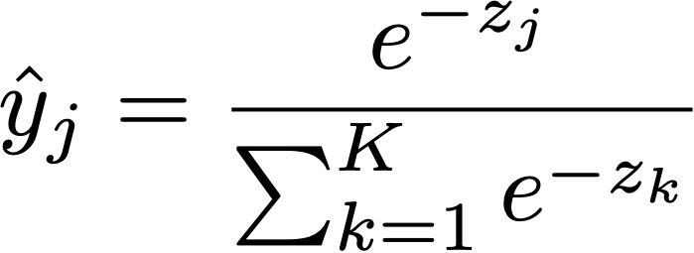
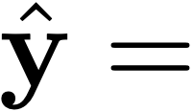
Softmax regression (a.k.a. multinomial logistic regression)
logits: vector of K scores, one for each class
squash into a non-negative vector that sums to 1 — i.e. a probability mass function!
dolphin
cat
grizzly bear
angel fish
chameleon
clown fish
iguana
elephant
…
…
0
1
Notes:
\mathbf{z} = f_{\theta}(\mathbf{x})
\equiv \texttt{softmax}(\mathbf{z})_j
\mathcal{L}(\mathbf{x}, \mathbf{y}) = H(\mathbf{y}, \texttt{softmax}(f_{\theta}(\mathbf{x})))

Slide 74
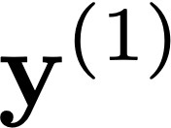
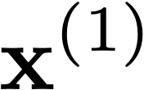
Deep learning
Learned
“clown fish”
Loss
Notes:
The basic idea is that you fiddle all the weights until you match the desired output.
\mathbf{\theta}^* = \argmin_{\theta} \sum_{i=1}^N \mathcal{L}(f_{\theta}(\mathbf{x}^{(i)}), \mathbf{y}^{(i)})
\mathcal{L}(f_{\theta}(\mathbf{x}^{(1)}), \mathbf{y}^{(1)})

Slide 75
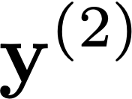
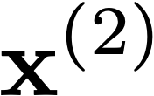
Deep learning
Learned
“grizzly bear”
Loss
Notes:
The basic idea is that you fiddle all the weights until you match the desired output.
\mathbf{\theta}^* = \argmin_{\theta} \sum_{i=1}^N \mathcal{L}(f_{\theta}(\mathbf{x}^{(i)}), \mathbf{y}^{(i)})
\mathcal{L}(f_{\theta}(\mathbf{x}^{(2)}), \mathbf{y}^{(2)})

Slide 76
Deep learning
Learned
“chameleon”
Loss
Notes:
The basic idea is that you fiddle all the weights until you match the desired output.
\mathbf{\theta}^* = \argmin_{\theta} \sum_{i=1}^N \mathcal{L}(f_{\theta}(\mathbf{x}^{(i)}), \mathbf{y}^{(i)})
\mathcal{L}(f_{\theta}(\mathbf{x}^{(i)}), \mathbf{y}^{(i)})

Slide 77
Batch (parallel) processing
Features
Loss
Images
Loss
Loss
…
Notes:
The basic idea is that you fiddle all the weights until you match the desired output.
\mathbf{\theta}^* = \argmin_{\theta} \sum_{i=1}^N \mathcal{L}(f_{\theta}(\mathbf{x}_i), \mathbf{y}_i)
\mathcal{L}(f_{\theta}(\mathbf{x}_i), \mathbf{y}_i)

Slide 78
Tensors
(multi-dimensional arrays)
Furry?
Is a fish?
# Stripes
…
Size
…
Each layer is a representation of the data
Notes:
\mathbf{h}^{(1)} \in \mathbb{R}^{N_{\texttt{batch}} \times C^{(1)}}

Slide 79
Tensors
(multi-dimensional arrays)
# neurons
# features
# units
# “channels”
…
Notes:
\mathbf{h}_1 \in \mathbb{R}^{N_{\texttt{batch}} \times C_1}

Slide 80
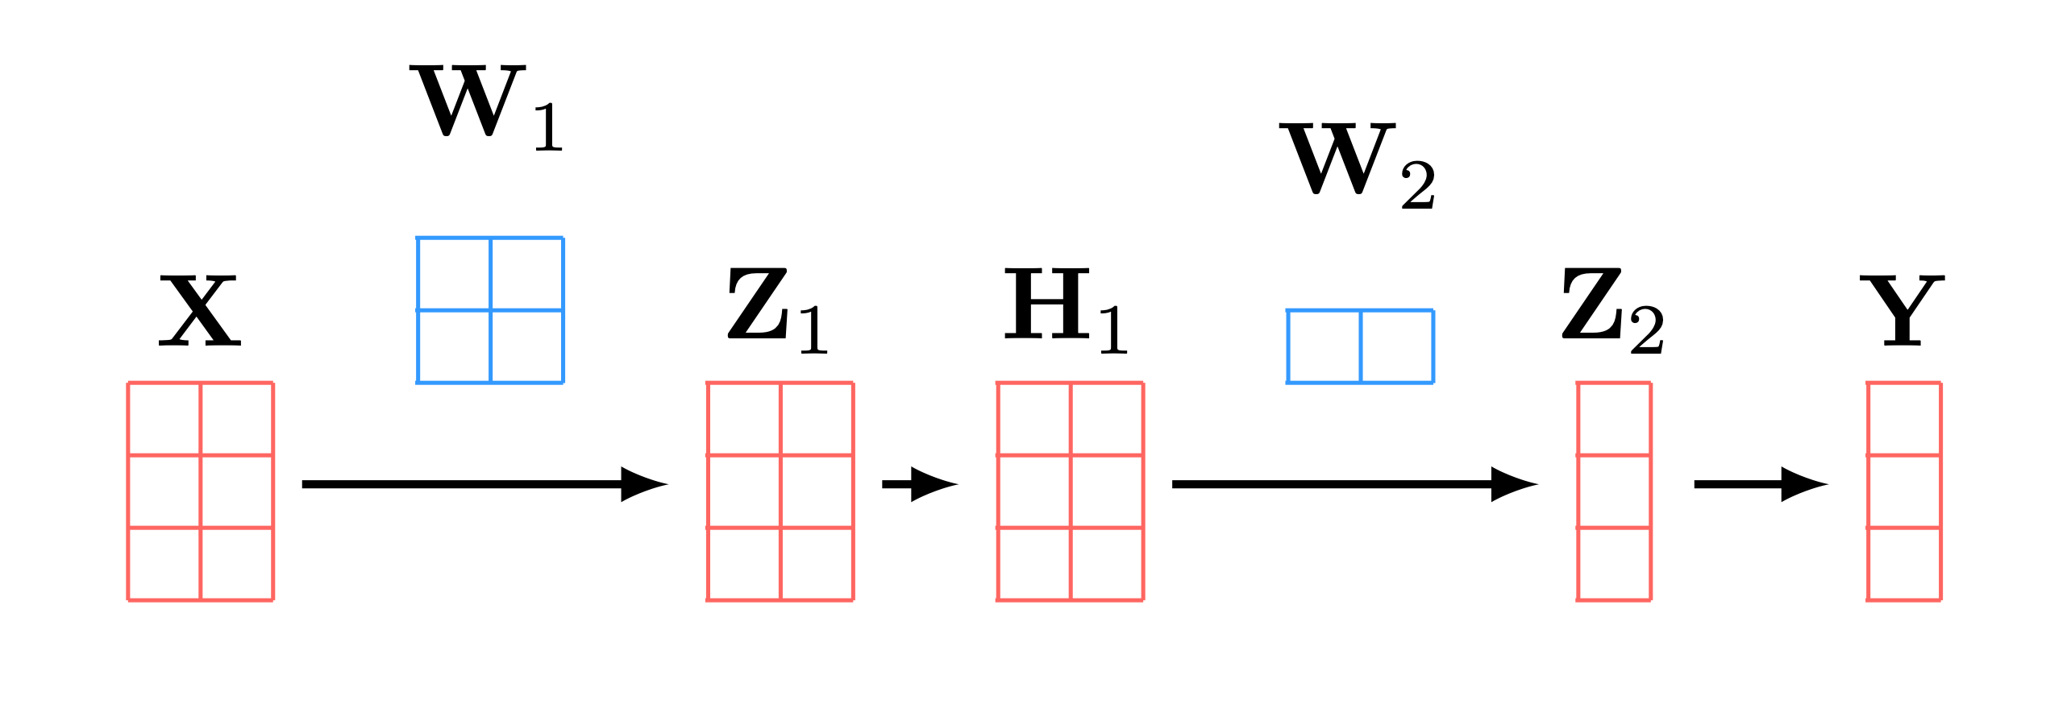
Everything is a tensor
Tensor processing with batch size = 3:

Slide 81
Regularizing deep nets
Deep nets have millions of parameters!
On many datasets, it is easy to overfit — we may have more free parameters than data points to constrain them.
How can we prevent the network from overfitting?
Fewer neurons, fewer layers
Weight decay and other regularizers
Normalization layers
…

Slide 82
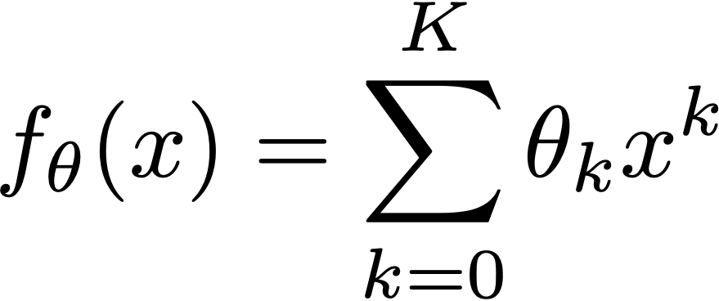
Recall: regularized least squares
Only use polynomial terms if you really need them! Most terms should be zero
ridge regression, a.k.a., Tikhonov regularization

Slide 83
Regularizing the weights in a neural net
weight decay
“We prefer to keep weights small.”
Notes:
R(\mathbf{w}) = \lambda\mathbf{w}^T\mathbf{w} = \lambda\norm{\mathbf{w}}_2^2

Slide 84
Dropout
Input representation
Intermediate representation
Output representation

Slide 85
Dropout
Input representation
Intermediate representation
Output representation

Slide 86
Dropout
Input representation
Intermediate representation
Output representation

Slide 87
Dropout
Input representation
Intermediate representation
Output representation

Slide 88
Dropout
Randomly zero out hidden units.
Prevents network from relying too much on spurious correlations between different hidden units.
Can be understood as averaging over an exponential ensemble of subnetworks. This averaging smooths the function, thereby reducing the effective capacity of the network.

Slide 89
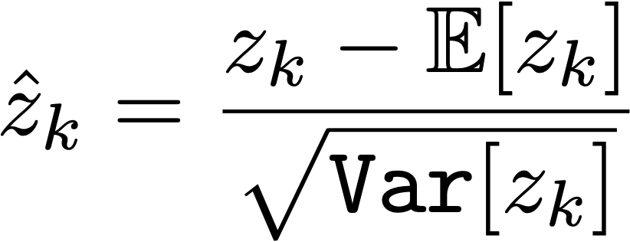
Normalization layers
Norm
ReLU
Notes:
\hat{z}_k = \frac{z_k - \mathbb{E}[z_k]}{\sqrt{\texttt{Var}[z_k]}}

Slide 90
Normalization layers
Norm
ReLU
Notes:
\hat{h}_k = \frac{h_k - \mathbb{E}[h_k]}{\sqrt{\texttt{Var}[h_k]}}

Slide 91
Normalization layers
Norm
ReLU
Notes:
\hat{h}_k = \frac{h_k - \mathbb{E}[h_k]}{\sqrt{\texttt{Var}[h_k]}}

Slide 92
Normalization layers
Norm
ReLU
Notes:
\hat{h}_k = \frac{h_k - \mathbb{E}[h_k]}{\sqrt{\texttt{Var}[h_k]}}

Slide 93
Normalization layers
Keep track of mean and variance of a unit (or a population of units) over time.
Standardize unit activations by subtracting mean and dividing by variance.
Squashes units into a standard range, avoiding overflow.
Also achieves invariance to mean and variance of the training signal.
Both these properties reduce the effective capacity of the model, i.e. regularize the model.

Slide 94
Why do deep nets generalize?
Deep nets have so many parameters they could just act like look up tables, regurgitating their training data
Instead, they learn rules that generalize
Defies classical theory!

Slide 95
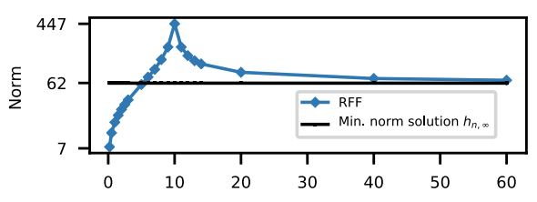
The more parameters, the simpler the learned function
More features —> smoother solutions
[Double-descent: Belkin, Hsu, Ma, Mandal, PNAS 2019]

Slide 96
The simplicity hypothesis
Classical theory:
big models learn complicated functions, and overfit the data
Emerging theory:
deep nets learn simple functions that fit the data
Notes:
and simple functions are ones that generalize

Slide 97
Tensors
(multi-dimensional arrays)
# neurons
# features
# units
# “channels”
Notes:
\mathbf{h}_1 \in \mathbb{R}^{N_{\texttt{batch}} \times C_1}

Slide 98
“Tensor flow”
Notes:
\mathbf{h}_1 \in \mathbb{R}^{N_{\texttt{batch}} \times C_1}
\mathbf{h}_2 \in \mathbb{R}^{N_{\texttt{batch}} \times C_2}

Slide 99
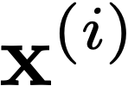
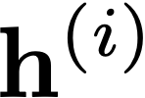
Notes:
\{\mathbf{x}^{(i)}, \mathbf{y}^{(i)}\}_{i=1}^N

Slide 100
Deep nets are data transformers
z
Layer L
Deep nets transform datapoints, layer by layer
Each layer is a different representation of the data
We call these representations embeddings
z
Input

Slide 101
Two different ways to represent a function

Slide 102
Two different ways to represent a function

Slide 103
Data transformations for a variety of neural net layers

Slide 104
Activations
Parameters
Wiring graph
Equation
Mapping 1D
Mapping 2D
Notes:
for fc layers, there are more parameters than activations!

Slide 105
Activations
Parameters
Wiring graph
Equation
Mapping
Matrix
N+1
M
Notes:
for fc layers, there are more parameters than activations!

Slide 106
logits
class probabilites
relu
softmax
z
Training iteration

Slide 107
logits
class probabilites
relu
softmax
Training data
z
Training iteration

Slide 108
logits
class probabilites
relu
softmax
z
Training iteration

Slide 109
z
Training iteration

Slide 110
z

Slide 116
Training iteration

Slide 118
Layer 1 representation
Layer 6 representation
[DeCAF, Donahue, Jia, et al. 2013]
[Visualization technique : t-sne, van der Maaten & Hinton, 2008]

Slide 119
7. Introduction to Deep Learning
Brief history
Basic formulation (hierarchical processing)
Optimization via gradient descent
Layer types (Linear, Pointwise non-linearity)
Everything is a tensor
Deep nets as data transformers

