Slide 1
Lecture 5
Multi-Scale Pyramids

Slide 2
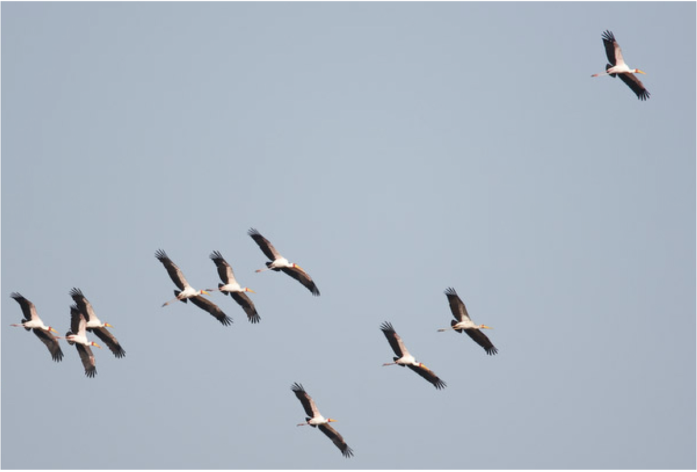
We need translation invariance

Slide 3
Input patch
Template matching
No mach
“Training” example
Input patch
Template matching
Mach
“Training” example
Input patch
Template matching
No mach
“Training” example

Slide 4
“Training” example
Mach
No mach
No mach
No mach
…
We need translation and scale invariance

Slide 5
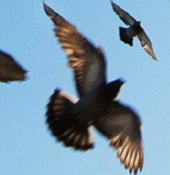
“Training” example
Mach
No mach
No mach
…
Downsample
Mach
Consider all patch location and sizes

Slide 6
Multi-Scale Pyramids
Template

Slide 7
Multi-Scale Pyramids
Multiscale image pyramid
Template
A multiscale image pyramid provides an alternative image representation to achieve translation and scale invariance

Slide 8
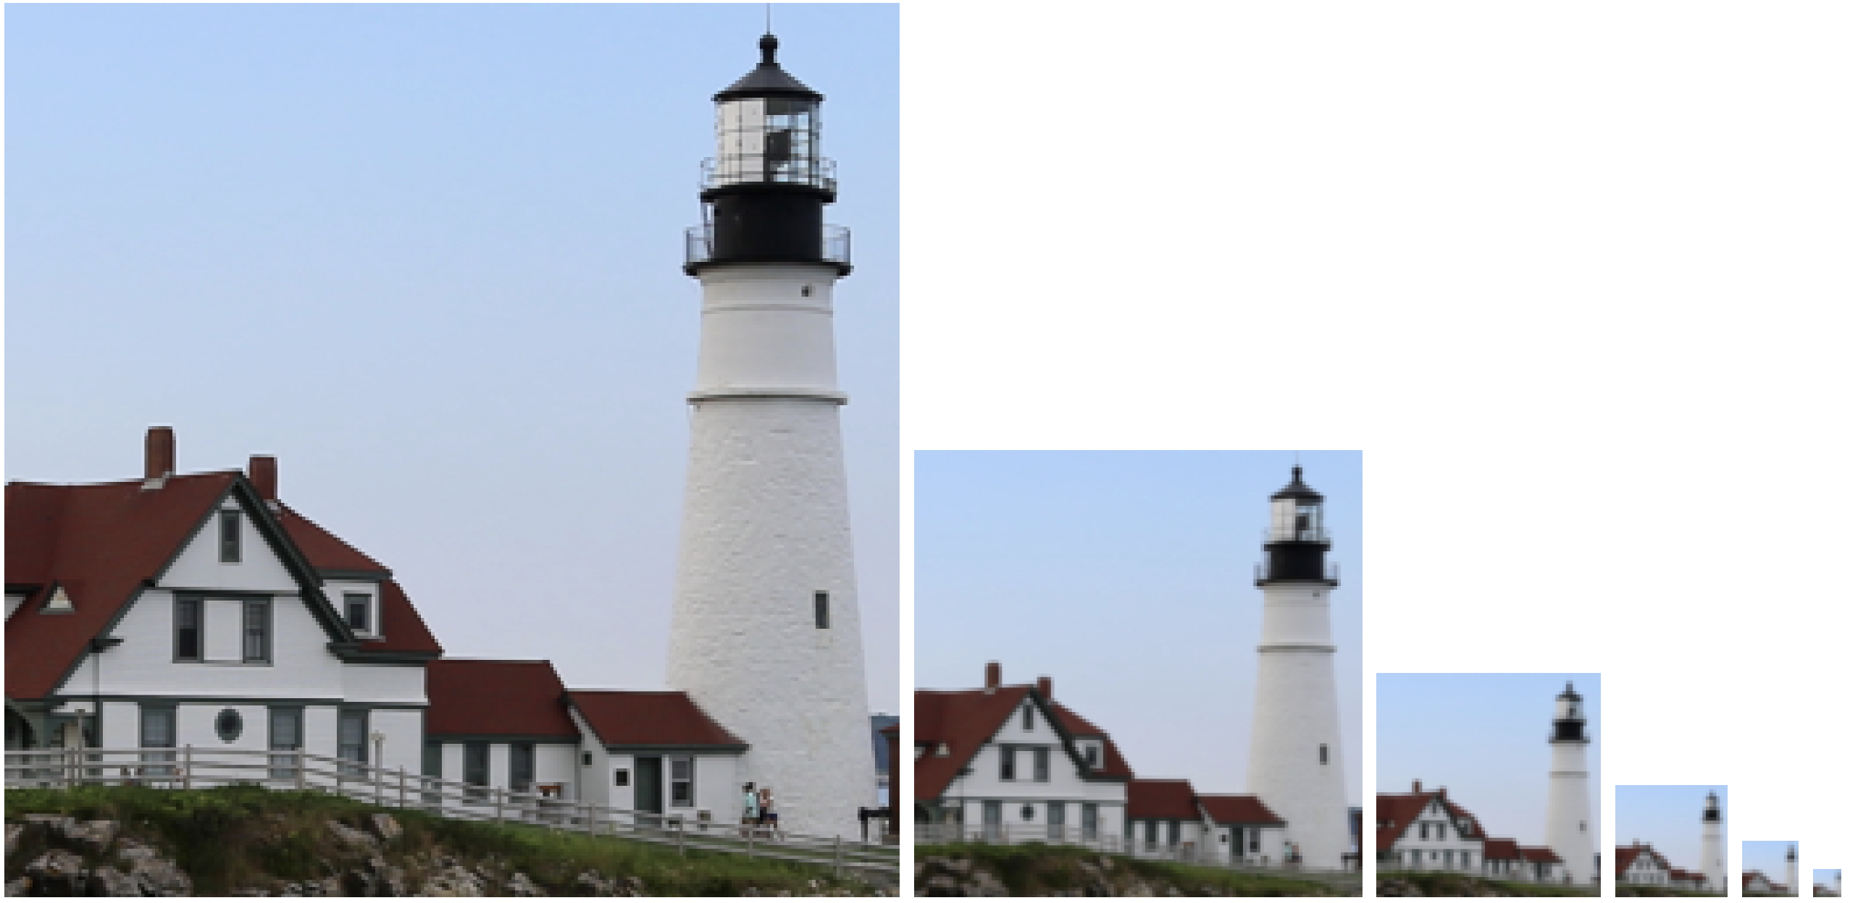
Gaussian Pyramid
1/2
1/2
1/2
1/2

Slide 9
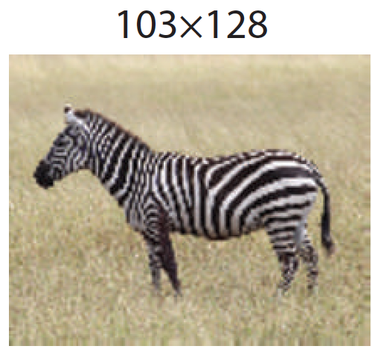
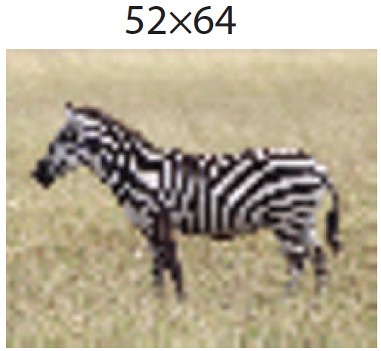
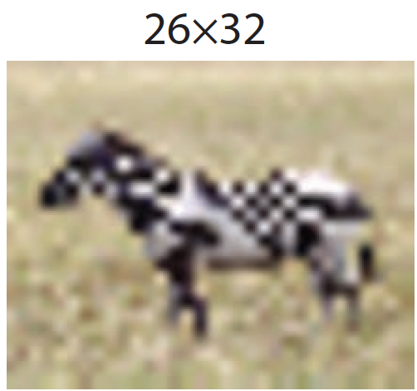
Subsampling and aliasing
1/2
1/2

Slide 10
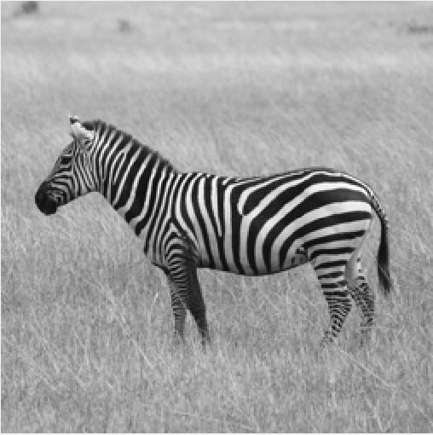
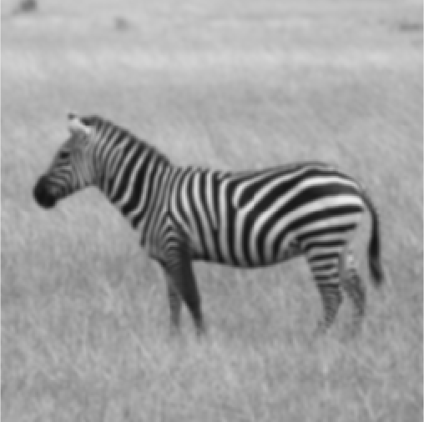
The Gaussian pyramid
For each level
1. Blur input image with a Gaussian filter
[1, 4, 6, 4, 1]
[1
4
6
4
1]
[1, 4, 6, 4, 1]
(The Gaussian filter is approximated with a binomial filter)

Slide 11
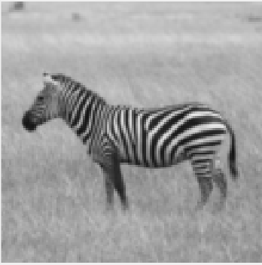
The Gaussian pyramid
For each level
1. Blur input image with a Gaussian filter
2. Downsample image
[1
4
6
4
1]
[1, 4, 6, 4, 1]

Slide 12
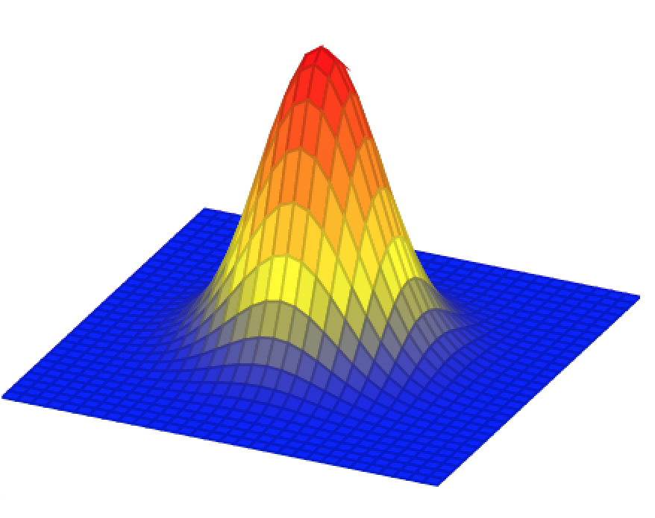
The Gaussian pyramid
256×256
128×128
64×64
32×32
2
2
2

Slide 13
The Gaussian pyramid
512×512
256×256
128×128
64×64
32×32
(original image)

Slide 14
Convolution as matrix multiplication
In the 1D case, it helps to make explicit the structure of the matrix:
O
/3
/3
/3
=
0
30
60
90
90
90
60
30
In the 1D case, it helps to make explicit the structure of the matrix:
0
30
60
90
90
90
60
30
1/3 | 1/3 | 1/3
 | 1/3 | 1/3 | 1/3
0
0
0
90
90
90
90
90
0
0
Reminder from Lecture 3

Slide 15
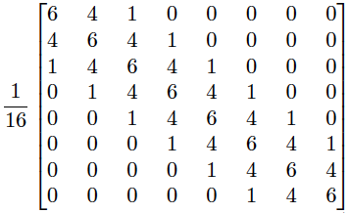
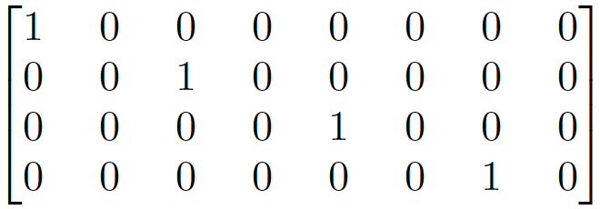
The Gaussian pyramid
[1, 4, 6, 4, 1]
$$g_{2}$$
$$g_{1}$$
[1, 4, 6, 4, 1]
$$g_{0}$$
$$g_{1}=G_{0}g_{0}$$
(The arrays shown here are for 1D signals)

Slide 16
The Gaussian pyramid
[1, 4, 6, 4, 1]
$$g_{2}$$
$$g_{1}$$
[1, 4, 6, 4, 1]
$$g_{0}$$
$$g_{1}=G_{0}g_{0}$$

Slide 17
The Gaussian pyramid
[1, 4, 6, 4, 1]
$$g_{2}$$
$$g_{1}$$
[1, 4, 6, 4, 1]
$$g_{0}$$
$$g_{2}=G_{1}g_{1}$$
$$I$$
$$g_{1}=G_{0}g_{0}$$
$$g_{0}$$
$$x$$
=
$$g_{2}=G_{1}G_{0}g_{0}$$
$$G_{0}$$
$$g_{1}$$
$$g_{2}$$
$$G_{1}G_{0}$$

Slide 18
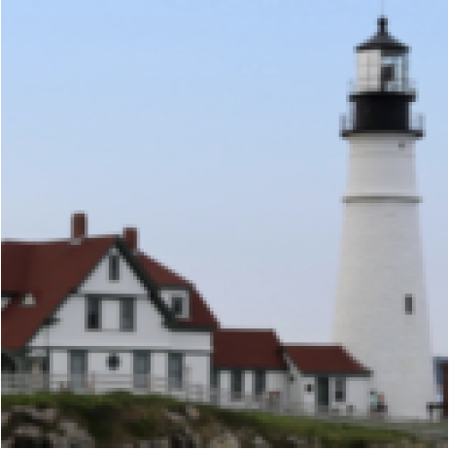
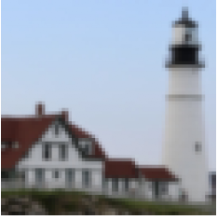
The Gaussian pyramid
For each level
1. Blur input image with a Gaussian filter
2. Downsample image

Slide 19
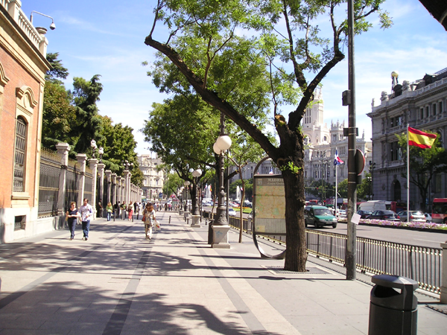
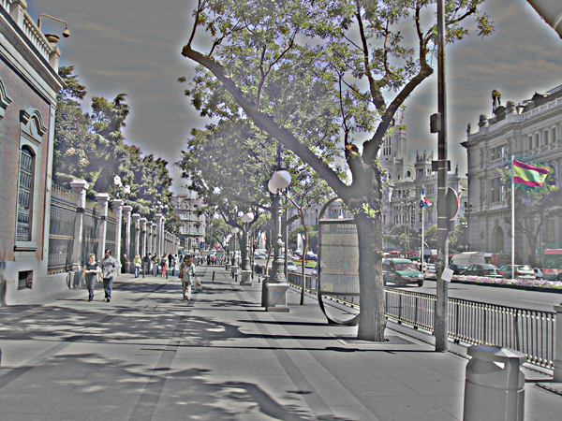
What about the opposite of blurring?
Gaussian filter
Laplacian filter
+
-
-

Slide 20
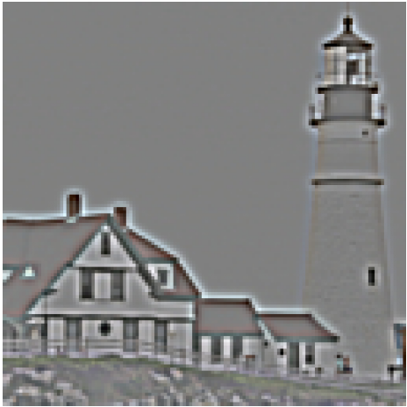
The Laplacian Pyramid
Compute the difference between upsampled Gaussian pyramid level k+1 and Gaussian pyramid level k.
+
-

Slide 21
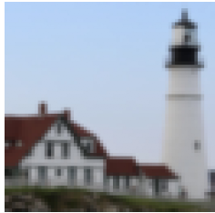
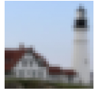
The Laplacian Pyramid
Gaussian pyramid

Slide 22
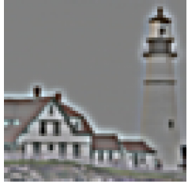
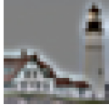
The Laplacian Pyramid
Gaussian pyramid
Laplacian pyramid

Slide 23
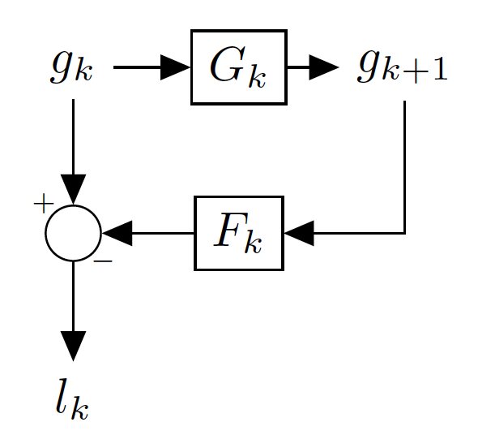
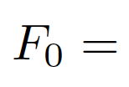
The Laplacian Pyramid
Blurring and downsampling:
(Downsampling by 2)
Upsampling and blurring:
(blur)

Slide 24
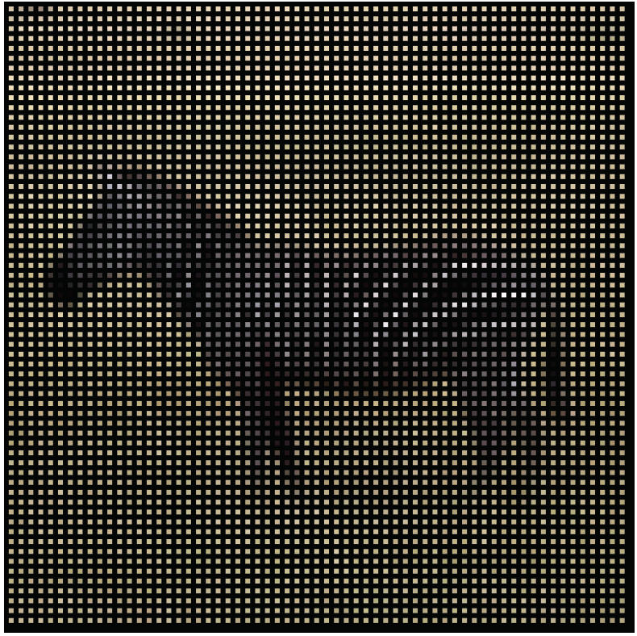
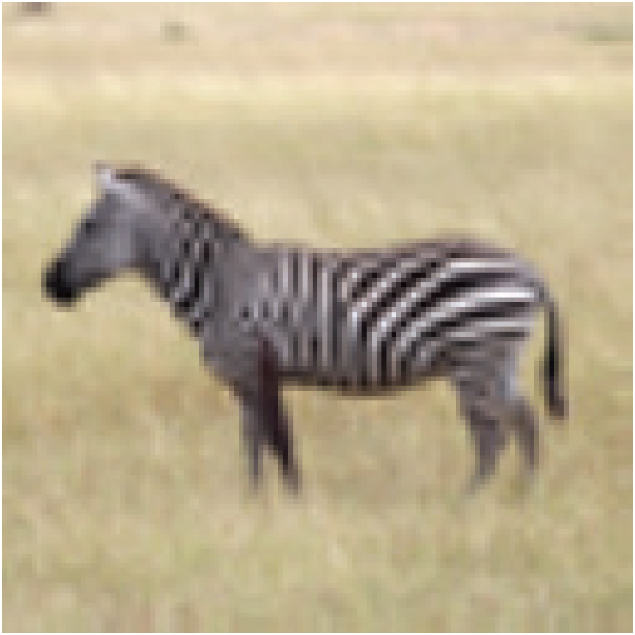
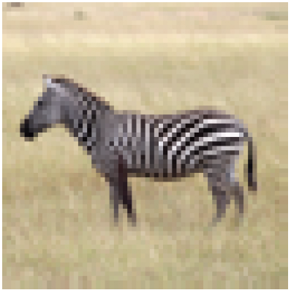
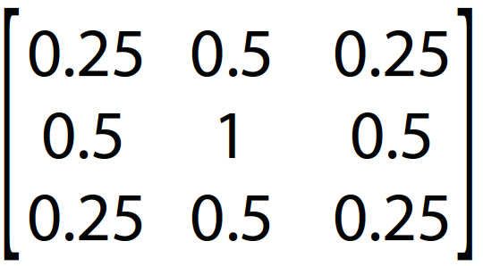
Upsampling
128x128
128x128
64x64
Insert zeros
=

Slide 25
Upsampling
1 | 0 | 1 | 0 | 1
0 | 0 | 0 | 0 | 0
1 | 0 | 1 | 0 | 1
0 | 0 | 0 | 0 | 0
1 | 0 | 1 | 0 | 1
= ?

Slide 26
Upsampling
1 | 0 | 1 | 0 | 1
0 | 0 | 0 | 0 | 0
1 | 0 | 1 | 0 | 1
0 | 0 | 0 | 0 | 0
1 | 0 | 1 | 0 | 1
1 | 1 | 1 | 1 | 1
1 | 1 | 1 | 1 | 1
1 | 1 | 1 | 1 | 1
1 | 1 | 1 | 1 | 1
1 | 1 | 1 | 1 | 1
=

Slide 27
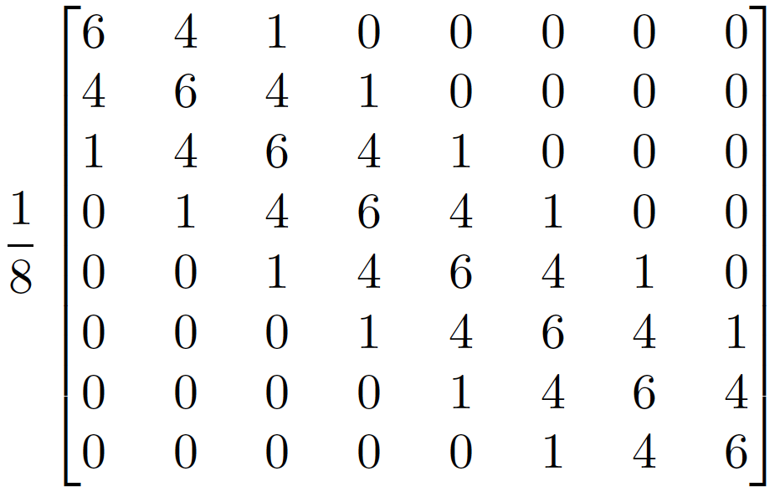
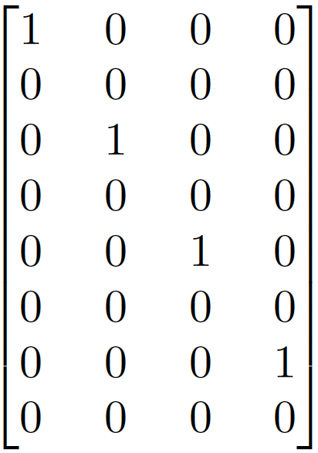
The Laplacian Pyramid
Blurring and downsampling:
(Downsampling by 2)
Upsampling and blurring:
(blur)
(blur)
(Upsampling by 2)

Slide 28
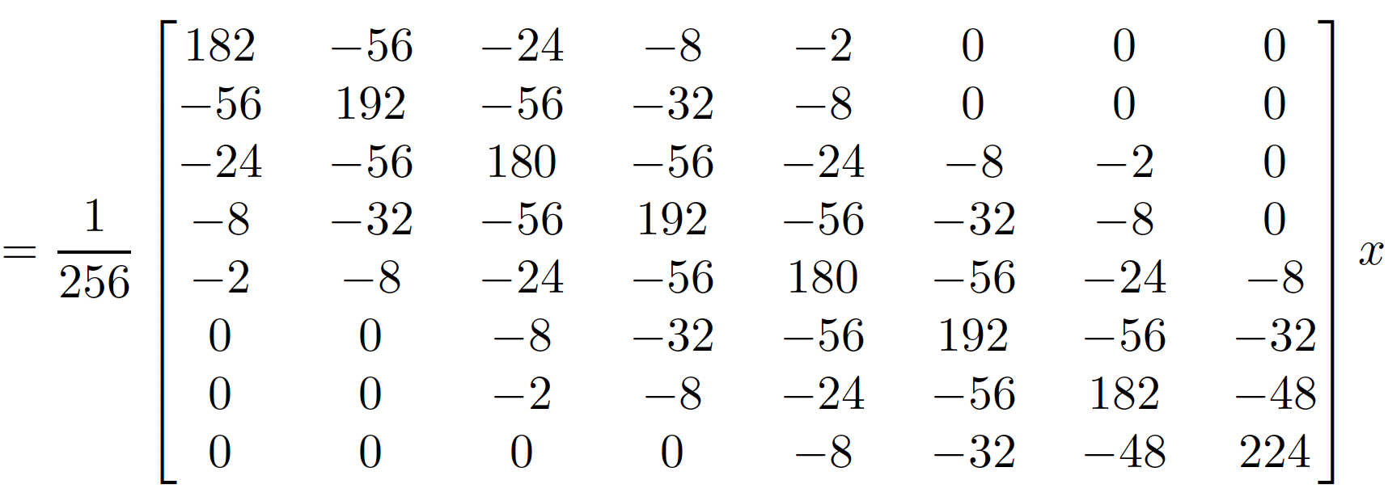
The Laplacian Pyramid

Slide 29
The Laplacian Pyramid
Gaussian pyramid
$$l_{0}$$
$$x$$
=
Laplacian pyramid
$$l_{1}$$
$$g_{2}$$

Slide 30
The Laplacian Pyramid
Gaussian
residual
Laplacian pyramid
Can we invert the Laplacian Pyramid?

Slide 31
The Laplacian Pyramid
Gaussian pyramid
Laplacian pyramid

Slide 32
The Laplacian Pyramid
Gaussian pyramid
Laplacian pyramid
Analysis/Encoder
Synthesis/Decoder

Slide 33
The Laplacian Pyramid
Laplacian pyramid
Gaussian residual
Laplacian pyramid
Gaussian residual

Slide 34
Laplacian pyramid applications
Image compression
Noise removal
Computing image features (e.g., SIFT)

Slide 35
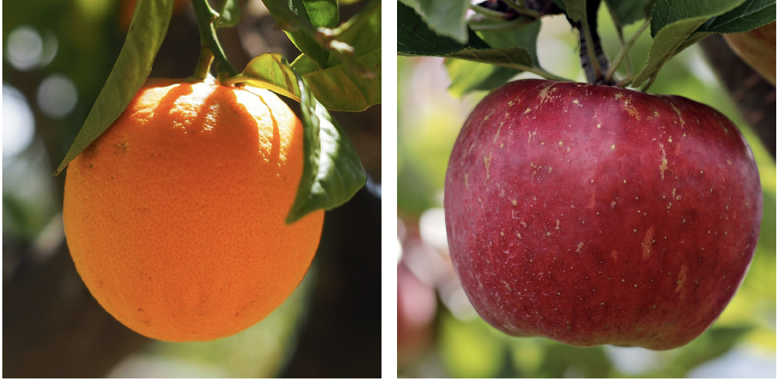
Image Blending

Slide 36
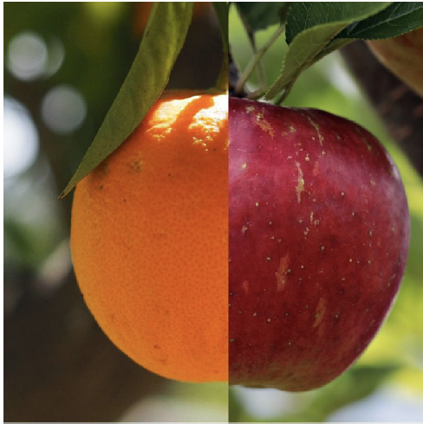
Image Blending

Slide 37
Image Blending
$$I^{A}$$
$$I^{B}$$
$$m$$
$$I$$
$$I=m*I^{A}+(1-m)*I^{B}$$

Slide 38
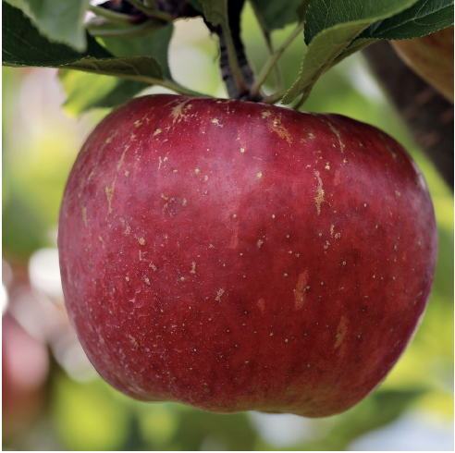
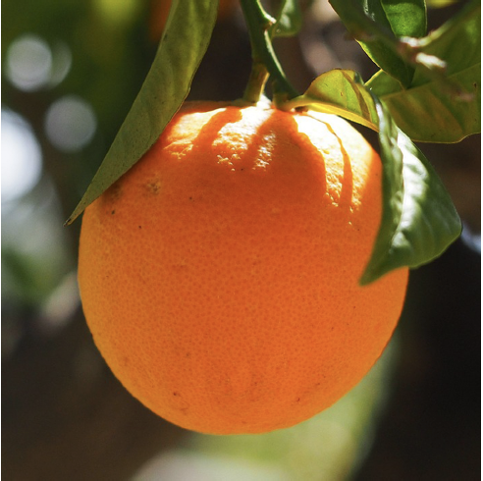
Image Blending with the Laplacian Pyramid

Slide 39
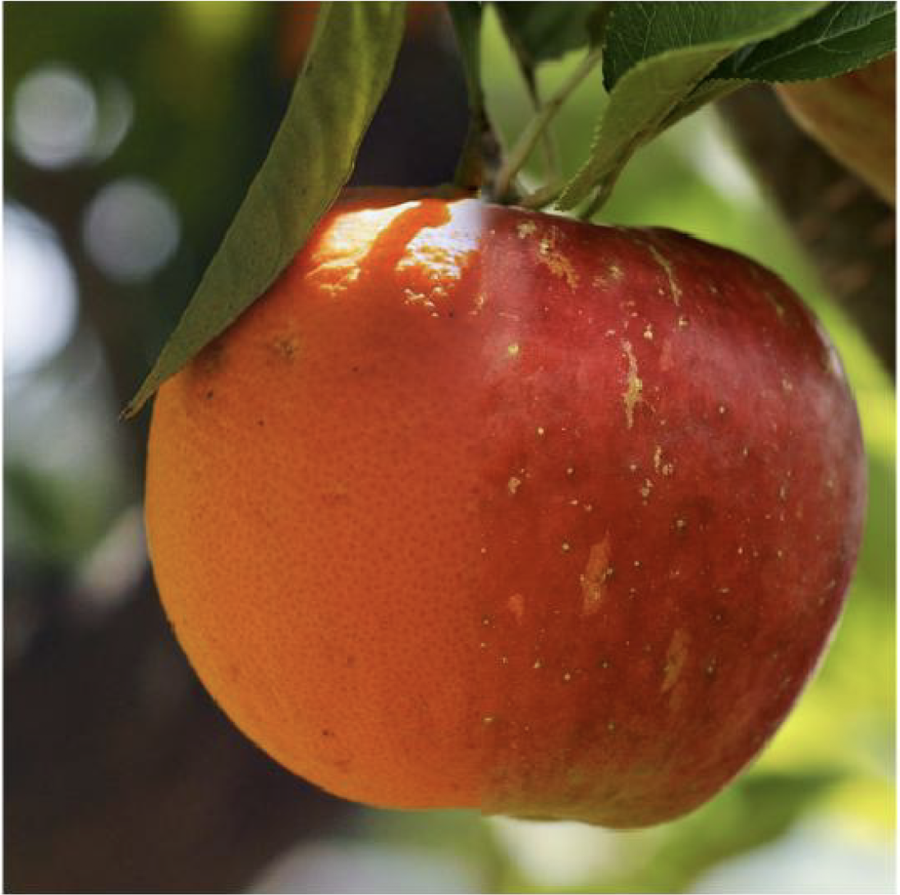
Image Blending with the Laplacian Pyramid

Slide 40
Image Blending with the Laplacian Pyramid
Build Laplacian pyramid for both images: LA, LB
Build Gaussian pyramid for mask: G
Build a combined Laplacian pyramid:
Collapse L to obtain the blended image
http://persci.mit.edu/pub_pdfs/pyramid83.pdf

Slide 41
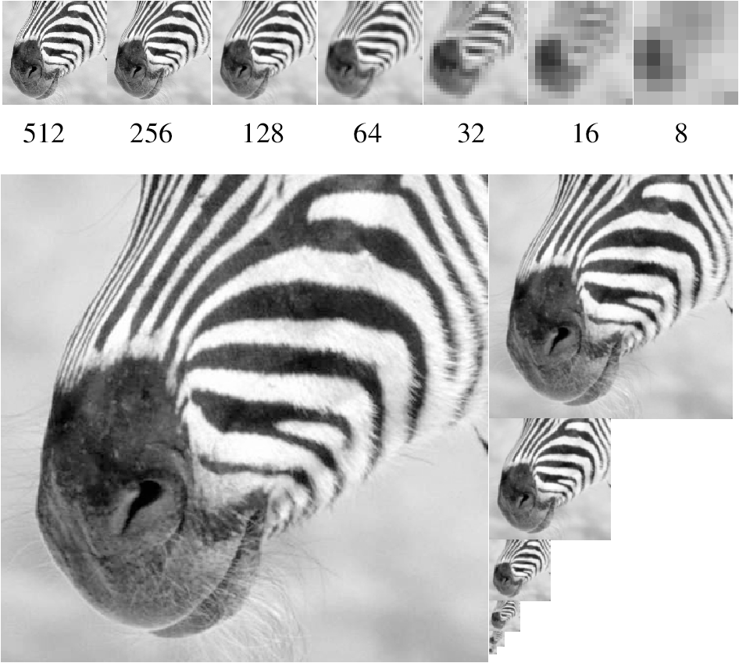
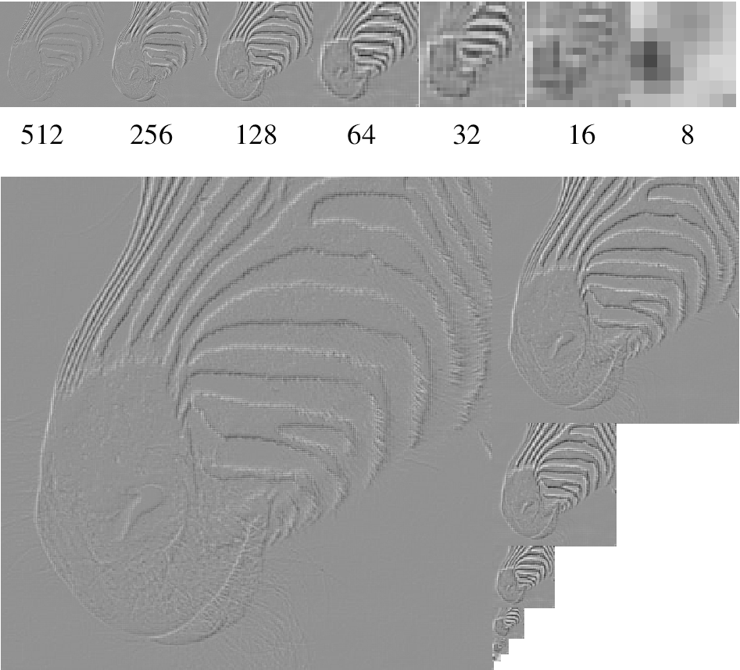
Image pyramids
Gaussian Pyr
Laplacian Pyr
And many more: QMF, steerable, …
Convnets!

Slide 42
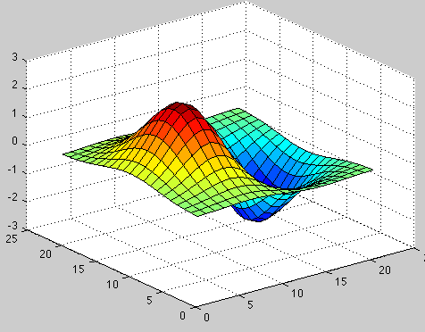
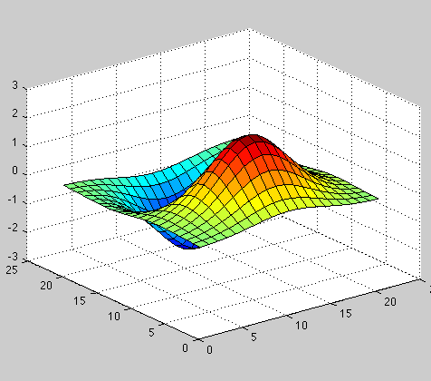
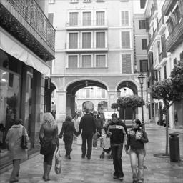
Orientations

Slide 43
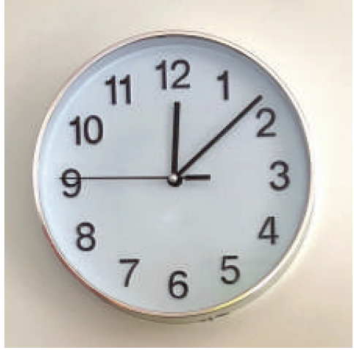
Orientations

Slide 44
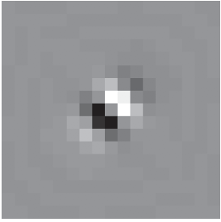
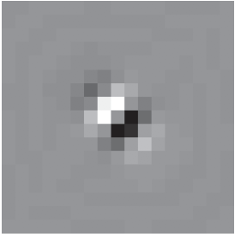
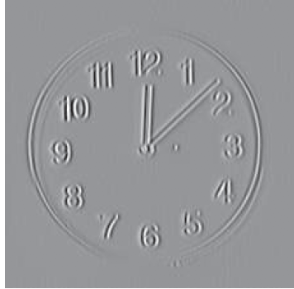
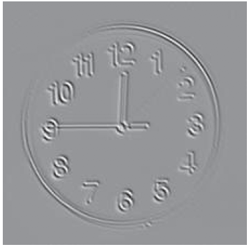
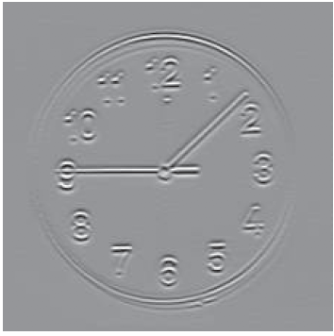
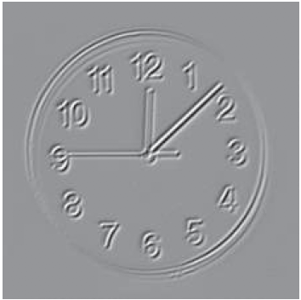
Steerable Pyramid
Low pass residual

Slide 45
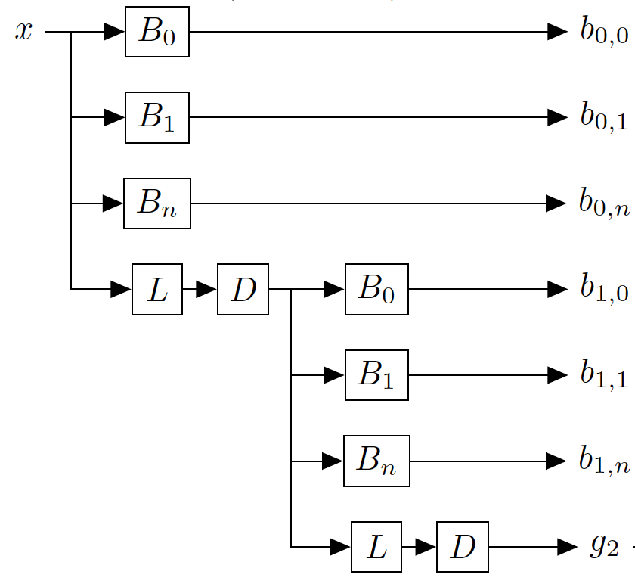
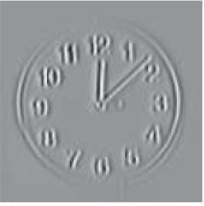
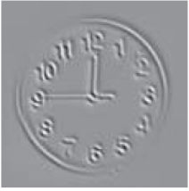
Steerable Pyramid
=
$$x$$
…
Oriented filters
Blur
Downsampling
…

Slide 46
Steerable Pyramid
3 scales, 4 orientations

Slide 47
Steerable Pyramid
Analysis/Encoder
Synthesis/Decoder

Slide 48
Visual summary: Linear Image Transforms
1D
1D
1D
2D

Slide 49
Steerable pyramid applications
Texture recognition
Image compression
Noise removal
Computing image features (e.g., SIFT)
Object recognition

Slide 50
Dall-E 2
An astronaut riding a horse in a photorealistic style
https://openai.com/dall-e-2/

Slide 51
Making textures

Slide 52
Textures
Stationary
Stochastic

Slide 54
Pre-attentive texture discrimination
Bela Julesz, "Textons, the Elements of Texture Perception, and their Interactions". Nature 290: 91-97. March, 1981.

Slide 55
Pre-attentive texture discrimination
Bela Julesz, "Textons, the Elements of Texture Perception, and their Interactions". Nature 290: 91-97. March, 1981.

Slide 56
Pre-attentive texture discrimination
Bela Julesz, "Textons, the Elements of Texture Perception, and their Interactions". Nature 290: 91-97. March, 1981.

Slide 57
Pre-attentive texture discrimination
This texture pair is pre-attentively indistinguishable. Why?
Bela Julesz, "Textons, the Elements of Texture Perception, and their Interactions". Nature 290: 91-97. March, 1981.

Slide 58
Julesz - Textons
Textons: fundamental texture elements.
Textons might be represented by features such as terminators, corners, and intersections within the patterns…

Slide 59
Observation: the Xs look smaller than the Ls.
“We note here that simpler, lower-level mechanisms tuned for size may be sufficient to explain this discrimination.”

Slide 60
Ls 25% larger contrast adjusted to keep mean constant
Ls 25% shorter

Slide 61
https://www.cns.nyu.edu/heegerlab/content/publications/Heeger-siggraph95.pdf
SIGGRAPH 1995

Slide 62
Steerable Pyramid
Analysis/Encoder
Synthesis/Decoder
Representation
Can we use this representation to generate more samples from the same texture?

Slide 63
Steerable Pyramid
Analysis/Encoder
Representation =
Histograms of pixel values for each subband
Representation
Representation

Slide 64
Steerable Pyramid
Analysis/Encoder
Representation
Analysis/Encoder
Synthesis/Decoder

Slide 65
Overview of the algorithm
Two main tools:
1- steerable pyramid
2- matching histograms

Slide 66
1-The steerable pyramid
Steerable pyr
Input texture

Slide 67
Overview of the algorithm
Two main tools:
1- steerable pyramid
2- matching histograms

Slide 68
2-Matching histograms
Histogram
Cumulative distribution
9% of pixels have an intensity value
within the range[0.37, 0.41]
75% of pixels have an intensity value
smaller than 0.5
5% of pixels have an intensity value
within the range[0.37, 0.41]

Slide 69
2-Matching histograms
Z[n,m]
We look for a transformation
of the image Y
Y’ = f (Y)
Such that
Hist(Y) = Hist(f(Z))
?
Y[n,m]
There are infinitely many functions
that can do this transformation.
A natural choice is to use f being:
point-wise non linearity
stationary
monotonic (most of the time invertible)

Slide 70
2-Matching histograms
The function f is just a look up table: it says, change all the pixels of value Y into a value f(Y).
Y’ = f (Y)
Target histogram
Y[n,m]
Y= 0.8
Y’= 0.5
Original
intensity
New
intensity

Slide 71
2-Matching histograms
Y’ = f (Y)

Slide 72
Another example: Matching histograms
10% of pixels are black
and 90% are white
?
?
5% of pixels have an intensity value
within the range[0.37, 0.41]

Slide 73
Another example: Matching histograms
The function f is just a look up table: it says, change all the pixels of
value Y into a value f(Y).
Y’ = f (Y)
Y(x,y)
Y= 0.8
Y’= 1
Original
intensity
New
intensity

Slide 74
Another example: Matching histograms
Cumulative distribution
Y’ = f (Y)
In this example, f is a step function.

Slide 75
Matching histograms of a subband

Slide 76
Matching histograms of a subband
Y’ = f (Y)

Slide 77
Texture analysis
Steerable pyramid
(histogram)
Input texture
(histogram)
The texture is represented as a collection of
marginal histograms.

Slide 78
Heeger and Bergen, 1995
Texture synthesis
(histogram)
Input texture
(histogram)

Slide 79
Why does it work? (sort of)

Slide 80
Why does it work? (sort of)
The black and white
blocks appear by
thresholding (f) a
blobby image
Iteration 0
Filter bank
…

Slide 81
Why does it work? (sort of)
The black and white blocks appear by
thresholding (f) a blobby image

Slide 82
Why does it work? (sort of)
After 6 iterations
Histograms match ok
red = target histogram, blue = current iteration

Slide 83
Color textures
R
G
Three textures
B

Slide 84
Color textures
R
G
B

Slide 85
Color textures
R
This does not work
G
B

Slide 86
Color textures
Problem: we create new colors not present in the original image.
Why? Color channels are not independent.
R
G
B

Slide 87
PCA and decorrelation
R
G
B
In the original image, R and G are correlated, but, after synthesis,…
G
G
R
R

Slide 88
PCA and decorrelation
The texture synthesis algorithm assumes that the channels
are independent.
What we want to do is some rotation
G
U2
Rotation
U1
R
See that in this rotated space,
if I specify one coordinate the
other remains unconstrained.

Slide 89
PCA and decorrelation
G
correlation(R,G)
1.0000 0.9303 0.6034
0.9303 0.9438 0.6620
0.6034 0.6620 0.5569
C =
R
PCA finds the principal directions of variation of the data.
It gives a decomposition of the covariance matrix as:
0.6347 0.6072 0.4779
0.6306 -0.0496 -0.7745
0.4466 -0.7930 0.4144
C = D D’
D =
By transforming the original data (RGB) using D we get:
U1
U2
U3
=
D’
R
G
B
U2
3 x Npixels
3 x 3
3 x Npixels
U1
The new components (U1,U2,U3) are decorrelated.

Slide 90
Color textures
R
G
Rotation
Matrix
(3x3)
B
D’
These three textures
look similar
(high dependency)
These three textures
Look less similar
(lower dependency)

Slide 91
Color textures
R
Inverse
Rotation
Matrix
G
D
B

Slide 92
Color textures
R
R
G
Inverse
Rotation
G
Rotation
Matrix
D
B
D’
B
These three textures
look similar
(high dependency)
These three textures
Look less similar
(lower dependency)

Slide 93
Color channels
Without PCA
With PCA

Slide 94
Color channels

Slide 95
Color channels

Slide 96
Examples from the paper
Heeger and Bergen, 1995

Slide 97
Examples from the paper

Slide 98
Examples not from the paper
Input
texture
Synthetic
texture
But, does it really work even when it seems to work?

Slide 99
The main idea: it works by ‘kind of’ projecting a random image into the set of equivalent textures
Set of equivalent textures
Set of perceptually
equivalent textures
Space of all images

Slide 100
But, does it really work??? How to measure how well the representation constraints the set of equivalent textures?
?
All the textures in this
set have the same
parameters.
?
?
?
?

Slide 101
How to identify the set of equivalent textures?
?
This does not reveal how poor
the representation actually is.

Slide 102
How to identify the set of equivalent textures?
These trajectories are
more perceptually
salient
This set is huge

Slide 103
Portilla and Simoncelli
Parametric representation, based on Gaussian scale mixture prior model for images.
About 1000 numbers to describe a texture.
Ok results; maybe as good as DeBonet.

Slide 104
Portilla and Simoncelli

Slide 105
Portilla & Simoncelli
Heeger & Bergen
Portilla & Simoncelli

Slide 106
How to identify the set of equivalent textures?
Now they look good, but maybe
they look too good…
Portilla & Simoncelli

