Slide 1
ONLINE SUBJECT EVALUATIONS ARE NOW OPEN
http://web.mit.edu/subjectevaluation
You have until Monday, December 15 at 9 AM
Please evaluate all subjects in your list
Don’t forget your TAs
Write comments
Your feedback is read and valued!

Slide 2
Course Announcements
Final project presentations
support your fellow students and stay after your presentation to listen to their presentations.
Submit your slides to us on Stellar no later than two hours before the beginning of all the talks. We’ll copy your slides onto a common computer, so we don’t need to spend your presentation time swapping laptops.
2 minutes per person, including set-up. Each member of the group should speak.

Slide 3
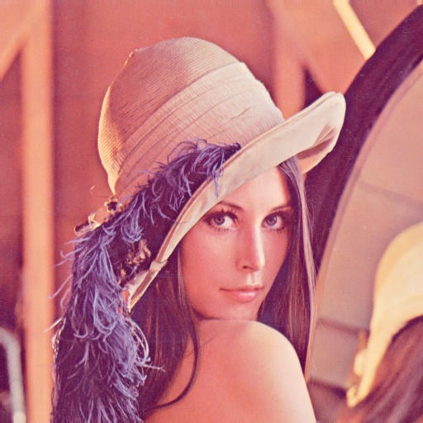
Course Announcements
Retiring Lena
Still pervasive in image processing literature.

Slide 4
Lecture 22
How to write papers and give talks.
May 2, 20223

Slide 5
Outline
writing technical papers
giving technical talks

Slide 6
A paper’s impact on your career
Lots of impact
Effect on your career
nothing
Bad
Ok
Pretty good
Creative, original and good.
Paper quality

Slide 7
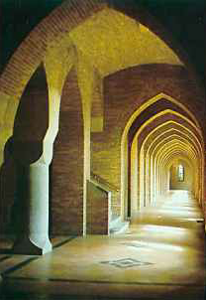
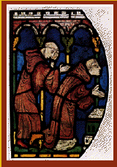
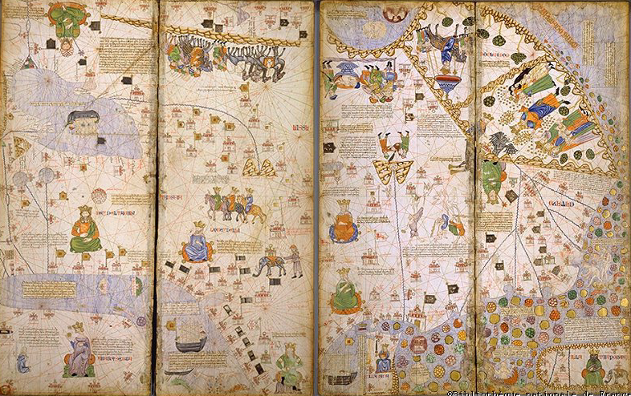
Our image of the research community
Scholars, plenty of time on their hands, pouring over your manuscript.

Slide 8
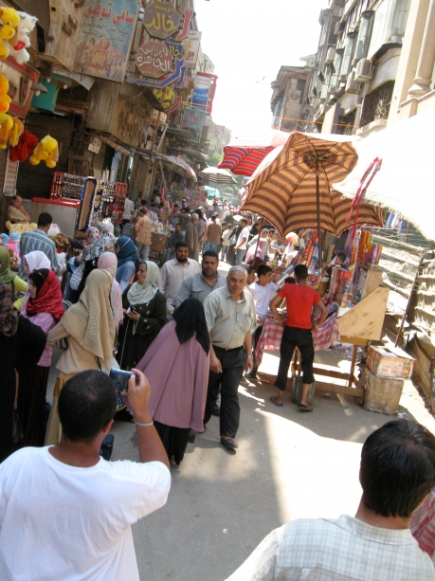
The reality:
more like a large, crowded marketplace
http://ducksflytogether.wordpress.com/2008/08/02/looking-back-khan-el-khalili/

Slide 9
Ted Adelson on how to write a good paper
(1) Start by stating which problem you are addressing, keeping the
audience in mind. They must care about it, which means that sometimes
you must tell them why they should care about the problem.
(2) Then state briefly what the other solutions are to the problem, and why they aren't satisfactory. If they were satisfactory, you wouldn't need to
do the work.
(3) Then explain your own solution, compare it with other
solutions, and say why it's better.
(4) At the end, talk about related work where similar techniques and experiments have been used, but applied to a different problem.
Since I developed this formula, it seems that all the papers I've written have been accepted. (told informally, in conversation, 1990).

Slide 10
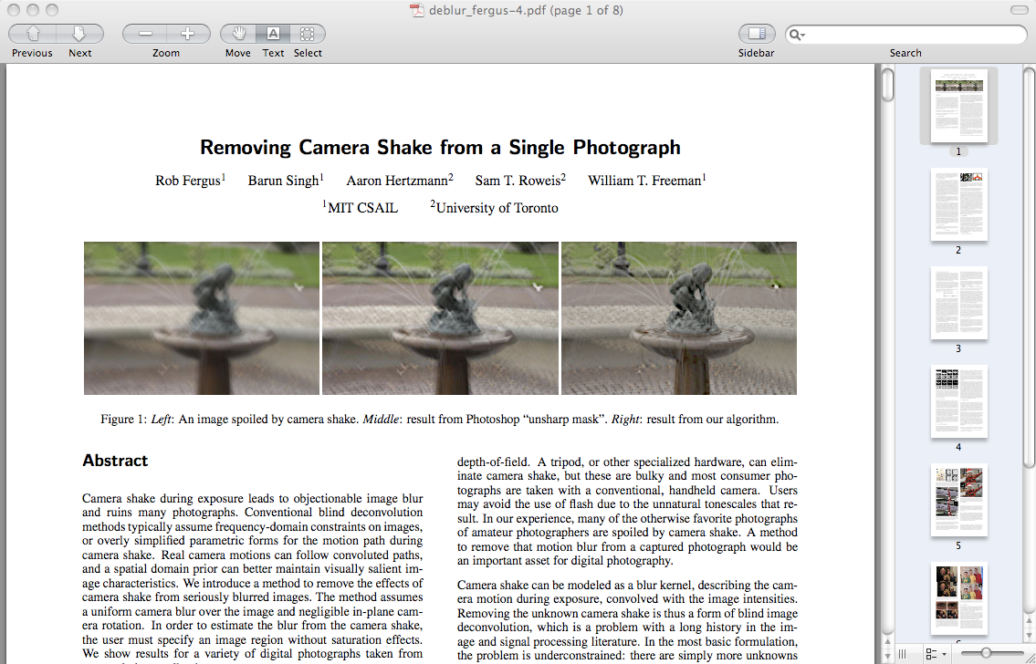
Example paper organization: removing camera shake from a single photograph
1 Introduction
2 Related work
3 Image model
4 Algorithm
Estimating the blur kernel
Multi-scale approach
User supervision
Image reconstruction
5 Experiments
Small blurs
Large blurs
Images with significant saturation
6 Discussion

Slide 11
The introduction
1 Introduction
2 Related work
3 --Main idea--
4 Algorithm
Estimating the blur kernel
Multi-scale approach
User supervision
Image reconstruction
5 Experiments
Small blurs
Large blurs
Images with significant saturation
6 Discussion

Slide 12
Jim Kajiya: write a dynamite introduction
You must make your paper easy to read. You've got to make it easy for anyone to tell what your paper is about, what problem it solves, why the problem is interesting, what is really new in your paper (and what isn't), why it's so neat. And you must do it up front. In other words, you must write a dynamite introduction.

Slide 13
Underutilized technique: explain the main idea with a simple, toy example.
1 Introduction
2 Related work
3 Main idea
4 Algorithm
Estimating the blur kernel
Multi-scale approach
User supervision
Image reconstruction
5 Experiments
Small blurs
Large blurs
Images with significant saturation
6 Discussion
Often useful here.

Slide 14
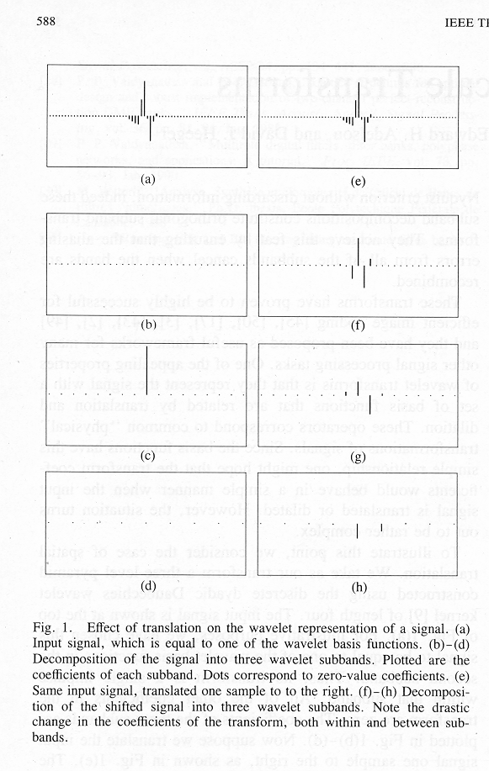
Show simple toy examples to let people get the main idea
Two different signals to be represented—both have the same shape, but one is by 1 pixel relative to the other.
Three different frequency bands of the resulting wavelet representations. Note the big change in the signal representation caused by shifting it by 1 pixel!
From
“Shiftable multiscale transforms”

Slide 15
Experimental results are critical now at CVPR
1 Introduction
2 Related work
3 Image model
4 Algorithm
Estimating the blur kernel
Multi-scale approach
User supervision
Image reconstruction
5 Experiments
Small blurs
Large blurs
Images with significant saturation
6 Discussion
Gone are the days of, “We think this is a great idea and we expect it will be very useful in computer vision. See how it works on this meaningless, contrived problem?”

Slide 16
How to end a paper
1 Introduction
2 Related work
3 Image model
4 Algorithm
Estimating the blur kernel
Multi-scale approach
User supervision
Image reconstruction
5 Experiments
Small blurs
Large blurs
Images with significant saturation
6 Discussion
Conclusions, or what this opens up, or how this can change how we approach computer vision problems.

Slide 17
How not to end a paper
I can’t stand “future work” sections. It’s hard to think of a weaker way to end a paper.
“Here’s a list all the ideas we wanted to do but couldn’t get to work in time for the conference submission deadline. We didn’t do any of the following things: (1)…
(2)…”
(You get no “partial credit” from reviewers and readers for neat things you wanted to do, but didn’t.)
“Here’s a list of good ideas that you should now go and do before we get a chance.”
Better: to end with a conclusion or a summary, or you can say in general terms where the work may lead.
1 Introduction
2 Related work
3 Image model
4 Algorithm
Estimating the blur kernel
Multi-scale approach
User supervision
Image reconstruction
5 Experiments
Small blurs
Large blurs
Images with saturation
6 Discussion
7 Future work?

Slide 18
General writing tips

Slide 19
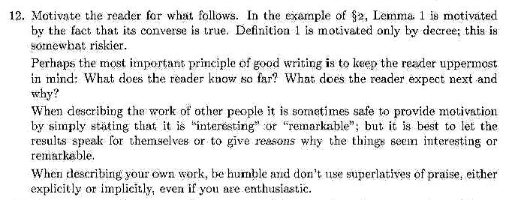
Knuth: keep the reader upper-most in your mind.

Slide 20
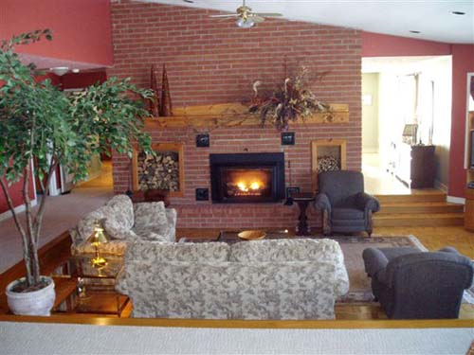
Treat the reader as you would a guest in your house
Anticipate their needs: would you like something to drink? Something to eat? Perhaps now, after eating, you’d like to rest?

Slide 21
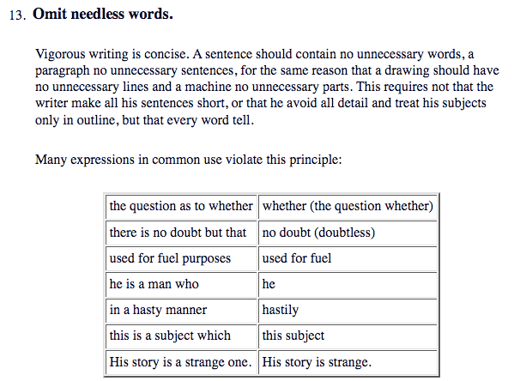
Writing style, from the elements of style, Stunk and White

Slide 22
Re-writing exercise
The underlying assumption of this work is that the estimate of a given
node will only depend on nodes within a patch: this is a locality
assumption imposed at the patch-level. This assumption can be
justified in case of skin images since a pixel in one corner of the
image is likely to have small effect on a different pixel far away
from itself. Therefore, we can crop the image into smaller windows,
as shown in Figure 5, and compute the inverse J matrix of the cropped
window. Since the cropped window is much smaller than the input
image, the inversion of J matrix is computationally cheaper. Since we
are inferring on blocks of image patches (i.e. ignoring pixels outside
of the cropped window), the interpolated image will have blocky
artifacts. Therefore, only part of xMAP is used to interpolate the
image, as shown in Figure 5.
We assume local influence--that nodes only depend on other nodes
within a patch. This condition often holds for skin images, which
have few long edges or structures. We crop the image into small
windows, as shown in Fig. 5, and compute the inverse J matrix of each
small window. This is much faster than computing the inverse J matrix
for the input image. To avoid artifacts from the block processing,
only the center region of xMAP is used in the final image, as shown in
Fig. 5.
Before
After
This editing benefits you twice: (1) you have 50% more space to tell your story, and (2) the text is easier for the reader to understand.

Slide 23
The readership of your paper
1.0
The “read every word” readers are your most important ones. But you should make the paper “work” for all the other readers, too.
Conjectured relative readership
0.5
0.0
Read title
Read abstract
Look over figures
Read every word

Slide 24
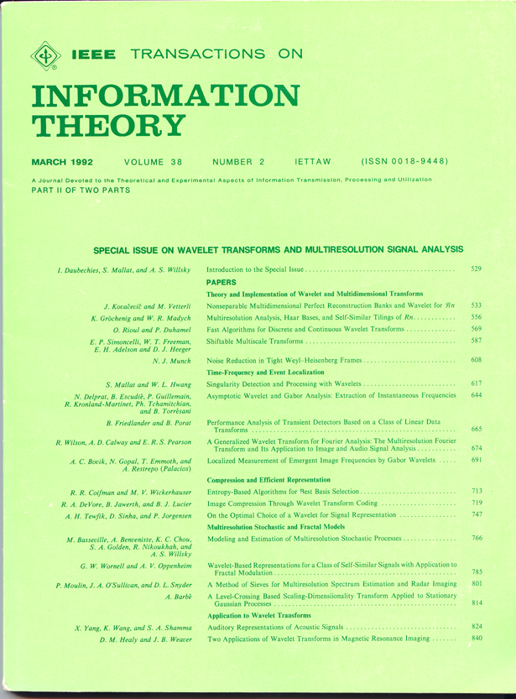
Title?

Slide 25
Our title
Was:
Shiftable Multiscale Transforms.
Should have been:
What’s Wrong with Wavelets?
Some classic papers with memorable titles:
What makes Paris look like Paris?
What the frog’s eye tells the frog’s brain.
An unbiased look at dataset bias.

Slide 26
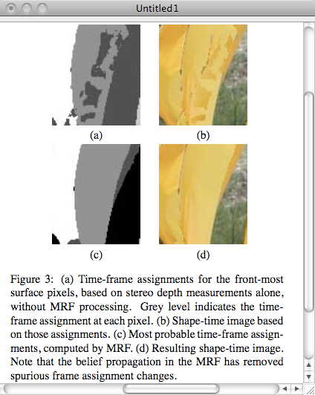
It should be easy to read the paper in a big hurry and still learn the main points. Probably most of your readers will be skimming the paper.
Figures and captions
The figures and captions can help tell the story.
So the figure captions should be self-contained and the caption should tell the reader what to notice about the figure.

Slide 27
Knuth on equations

Slide 28
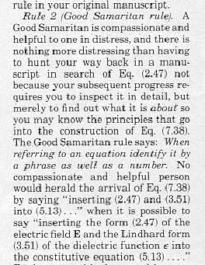
Mermin on equations

Slide 29
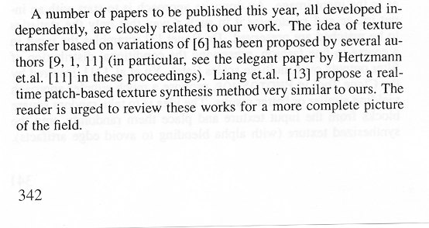
Efros’s comments within our texture synthesis paper about competing methods.
Tone: be kind and gracious
Written from a position of security, not competition

Slide 30
Develop a reputation for being clear and reliable (and for doing creative, good work…)
There are perceived pressures to over-sell, hide drawbacks, and disparage others’ work. Don’t succumb. (That’s in both your long and short-term interests).
“because the author was Fleet, I knew I could trust the results.” [a conference chair discussing some of the reasons behind a best paper prize selection].

Slide 31
Be honest, scrupulously honest
Convey the right impression of performance.
MAP estimation of deblurring. We didn’t know why it didn’t work, but we reported that it didn’t work. Now we think we know why. Others have gone through contortions to show why they worked.
Another example: Comparison of graph cuts with belief propagation for stereo, using identical MRF parameters

Slide 32
Author list
My rule of thumb: All that matters is how good the paper is. If more authors make the paper better, add more authors. If someone feels they should be an author, and you trust them and you’re on the fence, add them
It’s much better to be one of many authors on a great paper than to be one of just a few authors on a mediocre paper.
The benefit of a paper to you is a very non-linear function of its quality:
A mediocre paper is worth nothing.
Only really good papers are worth anything.

Slide 33
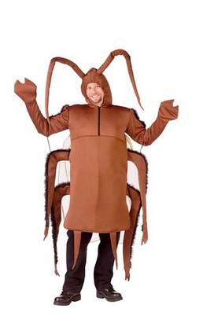
From an area chair’s point of view, the two types of borderline papers...
You try, but you can’t find a way to kill this paper. While there’s nothing too exciting about it, it’s pretty well written, the reviews are ok, the results show an incremental improvement. Yet another kind of boring CVPR paper. Probably 2/3 of these papers get accepted as posters, and 1/3 get rejected.
http://www.amazon.com/Fun-World-Costumes-Cockroach-Costume/dp/B0038ZQYRC
The Cockroach
The Puppy with 6 toes
A delightful paper, but with some easy-to-point-to flaw. This flaw may not be important (like 6 toes on a puppy), but makes it easy to reject the paper, even though it’s so fresh and wonderful. Maybe 2/3 of these get rejected (sadly), and 1/3 get in as posters. If you have a rejected puppy, address the flaws, resubmit next time, and then perhaps it will be accepted and selected for an oral presentation.
http://www.imgion.com/white-cute-puppy/

Slide 34
From an area chair’s point of view, the two types of borderline papers...
You try, but you can’t find a way to kill this paper. While there’s nothing too exciting about it, it’s pretty well written, the reviews are ok, the results show an incremental improvement. Yet another kind of boring CVPR paper. Probably 2/3 of these papers get accepted as posters, and 1/3 get rejected.
http://www.amazon.com/Fun-World-Costumes-Cockroach-Costume/dp/B0038ZQYRC
The Cockroach
The Puppy with 6 toes
A delightful paper, but with some easy-to-point-to flaw. This flaw may not be important (like 6 toes on a puppy), but makes it easy to reject the paper, even though it’s so fresh and wonderful. Maybe 2/3 of these get rejected (sadly), and 1/3 get in as posters. If you have a rejected puppy, address the flaws, resubmit next time, and then perhaps it will be accepted and selected for an oral presentation.
http://www.imgion.com/white-cute-puppy/

Slide 35
Quick and easy reasons to reject a paper
With the task of rejecting 75-80% of the submissions, area chairs are groping for reasons to reject a paper. Here’s a summary of reasons that are commonly used:
Do the authors not deliver what they promise?
Are important references missing (and therefore one suspects the authors not up on the state-of-the-art for this problem)?
Are the results too incremental (too similar to previous work)?
Are the results believable (too different than previous work)?
Is the paper poorly written?
Are there mistakes or incorrect statements?
Don’t give them any of these easy reasons to reject your paper!

Slide 36
Sources on writing technical papers
How to Get Your SIGGRAPH Paper Rejected, Jim Kajiya, SIGGRAPH 1993 Papers Chair, https://www.siggraph.org/sites/default/files/kajiya.pdf
Ted Adelson's Informal guidelines for writing a paper, 1991. http://www.ai.mit.edu/courses/6.899/papers/ted.htm
Notes on technical writing, Don Knuth, 1989.
What's wrong with these equations, David Mermin, Physics Today, Oct., 1989. http://www.ai.mit.edu/courses/6.899/papers/mermin.pdf
Notes on writing by Fredo Durand, people.csail.mit.edu/fredo/PUBLI/writing.pdf and Aaron Hertzmann, http://www.dgp.toronto.edu/~hertzman/advice/writing-technical-papers.pdf
Three sins of authors in computer science and math, Jonathan Shewchuck, http://www.cs.cmu.edu/~jrs/sins.html
Ten Simple Rules for Mathematical Writing, Dimitri P. Bertsekas http://www.mit.edu:8001/people/dimitrib/Ten_Rules.html
http://www.ai.mit.edu/courses/6.899/papers/knuthAll.pdf

Slide 37
Outline
writing technical papers
giving technical talks

Slide 38
Original photograph

Slide 39
How to give talks
Giving good talks is important for a researcher.
You might think, “the work itself is what really counts. Giving the talk is secondary”.
But the ability to give a good talk is like having a big serve in tennis—by itself, it doesn’t win the game for you. But it sure helps. And the very best tennis players all have great serves.
Researchers as little corporations (see http://people.csail.mit.edu/billf/publications/How_To_Do_Research.pdf).
http://imagesource.allposters.com/images/pic/SSPOD/superstock_294-341c_b~Tennis-Serve-Posters.jpg

Slide 40
Sources on giving talks
Patrick Winston’s recorded IAP talk on how to give talks: https://vimeo.com/101543862
Books on speaking.
Suggestions from your advisor or helpful audience members.
Analyzing good talks that others give.

Slide 41
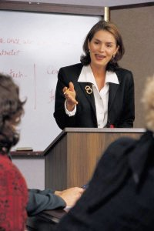
High order bit: prepare
Practice by yourself.
Give practice versions to your friends.
Think through your talk.
You can write out verbatim what you want to say in the difficult parts.
Ahead of time, visit where you’ll be giving the talk and identify any issues that may come up.
Preparation is a great cure for nervousness.
http://tbn0.google.com/images?q=tbn:pfwAIhkEy8t0EM:http://www.itcstirlingspeaking.org.uk/images/woman%2520speaker.jpg

Slide 42
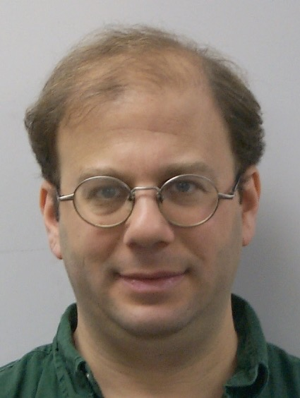
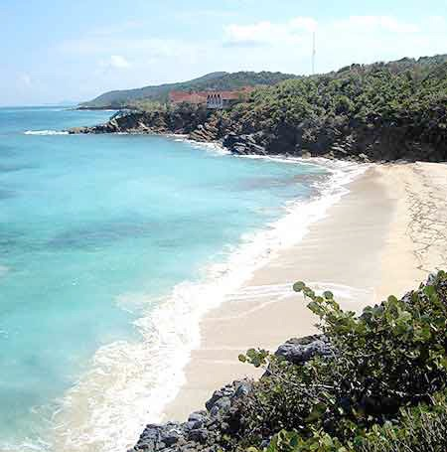
David Jacob’s bad news
The more you work on a talk, the better it gets: if you work on it for 3 hours, the talk you give will be better than if you had only worked on it for 2 hours. If you work on it for 5 hours, it will be better still. 7 hours, better yet…
(told to me by David on a beach in Greece, a few hours before my oral presentation at ICCV. That motivated me to leave the beach and go back to my room to work more on my talk, which paid off).

Slide 43
A tip to not be nervous that I found useful
Get over it. They’re not there to see you, they’re there to hear the information. Just convey the information to them.

Slide 44
The different kinds of talks you’ll have to give as a researcher
2-5 minute talks
Longer talks (10 -20 minute conference presentations, or 30-60 minute colloquia)

Slide 45
The different kinds of talks you’ll have to give as a researcher
2-5 minute talks
Longer talks (10 -20 minute conference presentations, or 30-60 minute colloquia)

Slide 46
Recommendation
For your five-minute talks, write down:
what problem did you address?
why is it interesting?
why is it hard?
what was the key to your approach?
how well did it work?

Slide 47
The different kinds of talks you’ll have to give as a researcher
2-5 minute talks
Longer talks (10 -20 minute conference presentations, or 30-60 minute colloquia)

Slide 48
Figure out how one part follows from another
Ahead of time, think through how each part motivates the next, and point that out during the talk. If one part doesn’t motivate the next, consider re-ordering the talk until it has that feel.

Slide 49
Your audience
Your image of your audience:
Paying attention, listening to every word
Your audience in reality:
Tired, hungry, not wanting to sit through yet another talk at the conference…

Slide 50
Layering the talk. When we read a paper, headings and sections help us follow the paper. You should provide the verbal equivalents of headings to the listener.
The probability of an observation has three terms to it. Blah blah blah blah blah blah blah blah blah blah blah blah blah blah blah blah blah blah blah blah blah blah blah blah blah blah blah blah blah blah blah blah blah blah blah blah blah blah blah
So that gives us the objective function we want to optimize. Now, how do we find the optimal value? There are two approaches you can take. blah blah blah blah blah blah blah blah blah blah blah blah blah blah blah blah blah blah blah blah blah blah blah blah blah blah blah blah blah blah blah blah
So now, with these tools in hand, we can apply this methods to real images. blah blah blah blah blah blah blah blah blah blah blah blah blah blah blah blah blah blah
http://tbn0.google.com/images?q=tbn:4oWYOjaSp4vopM:http://bakery.grillsforallseasons.com/photos/wedding_cake3.jpg

Slide 51
You tell the story at several different levels of detail
The main idea
Then come up for air, summarize, and say what this leads to next,
Then dive into lots of details describing what you’ve done,
Then more details or equations fleshing that next part out,

Slide 52
Ways to engage the audience
So you’ve been talking on and on. You want to break things up and keep the audience engaged. Can you think of a way to bring the audience into the talk?
Demos can also help.
Or add audience participation components to the talk. For human or computer vision talks, you can often present to the audience what the task is that the human or computer has to solve.
The audience loves to figures things out, to solve puzzles, to make guesses. Feed those desires.

Slide 53
Ted Adelson
“people like to see a good fight”
The flat earth theory predicts that ships will appear on the horizon as small versions of the complete ship. Under that theory, you’d expect approaching ships to look like this:

Slide 54
Present a fight
Whereas the round earth theory predicts that the top of the sails will appear first, then gradually the rest of the ship below it.

Slide 55
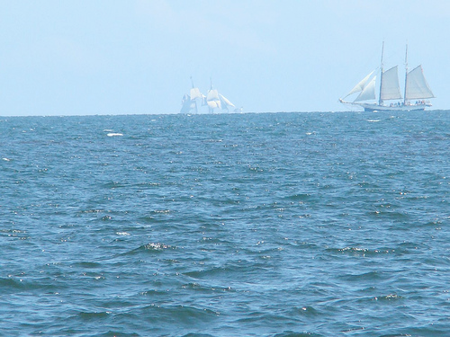
Then reveal the evidence that resolves the fight…
http://www.flickr.com/photos/mnsomero/2738807250/

Slide 56
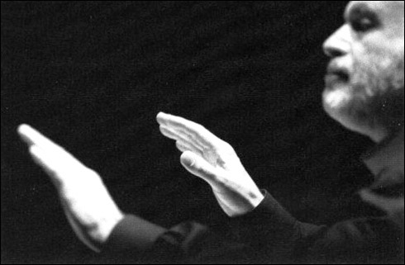
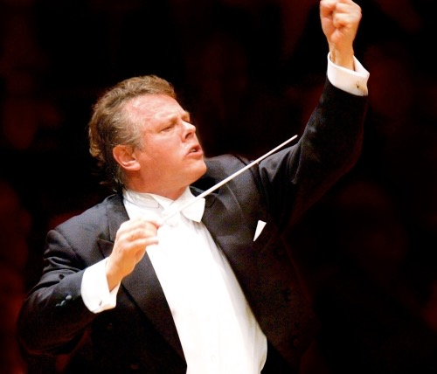
Add dynamics to the talk
http://www.nch.ie/dynamic/img/Mariss%20Jansons%20%20new.jpg
A talk is a story. As in a story, there can be different levels of excitement or tension in different parts of the talk. This makes it easier for the audience to pay attention to what you’re saying. Perhaps move to another location.
I like to find some part of the work that really grabs me, that I’m really excited about, and let that show through. (The audience loves to see you be excited. Not all the time, but when appropriate).
http://images.google.com/imgres?imgurl=http://operachic.typepad.com/photos/uncategorized/ulster01.jpg&imgrefurl=http://operachic.typepad.com/opera_chic/2007/01/index.html&h=321&w=490&sz=57&hl=en&start=2&tbnid=6seUYhUX6x2DrM:&tbnh=85&tbnw=130&prev=/images%3Fq%3Dconductor%2Borchestra%2Bquiet%26gbv%3D2%26svnum%3D10%26hl%3Den%26safe%3Doff%26sa%3DG

Slide 57
“I love this problem; it’s beautifully underdetermined. There are lots of different ways we can explain the observed blurry image. It could be that that’s what was there in the world, and we took a sharp picture of it….”

Slide 58
What I think the audience of a technical talk wants
To have everything follow and make sense.
To learn something, to develop their intuition.
To connect with the speaker, to share their excitement.
They want to watch you love something!
Alan Alda: https://www.youtube.com/watch?v=j4XgjkXDxss, and others

Slide 59
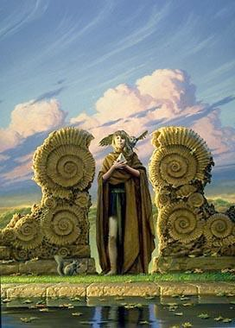
Let the audience see your personality
They want to see you enjoy yourself.
They want to see what you love about the work.
People really respond to the human parts of a talk. Those parts help the audience with their difficult task of listening to an hour-long talk on a technical subject. What was easy, what was fun, what was hard about the work?
Don’t be afraid to be yourself and to be quirky.
http://is3.okcupid.com/users/112/250/11225140098321842389/mt1112532356.jpg

Slide 60
How to end a talk
People often say “are there any questions?” but then people don’t know whether to applaud or to raise their hand.
If you say “thank you”, then everyone knows that they’re supposed to applaud now. After that is over, then you can ask for questions.

