Slide 1
Lecture 13
Temporal Processing, RNNs, Attention and Transformers

Slide 2
13. Temporal Processing and RNNs
Sequence problems
Temporal convnets
Recurrent Neural Networks (RNNs)
LSTMs
Attention
Example problems:
Image captioning
Sound prediction
Transformers

Slide 3
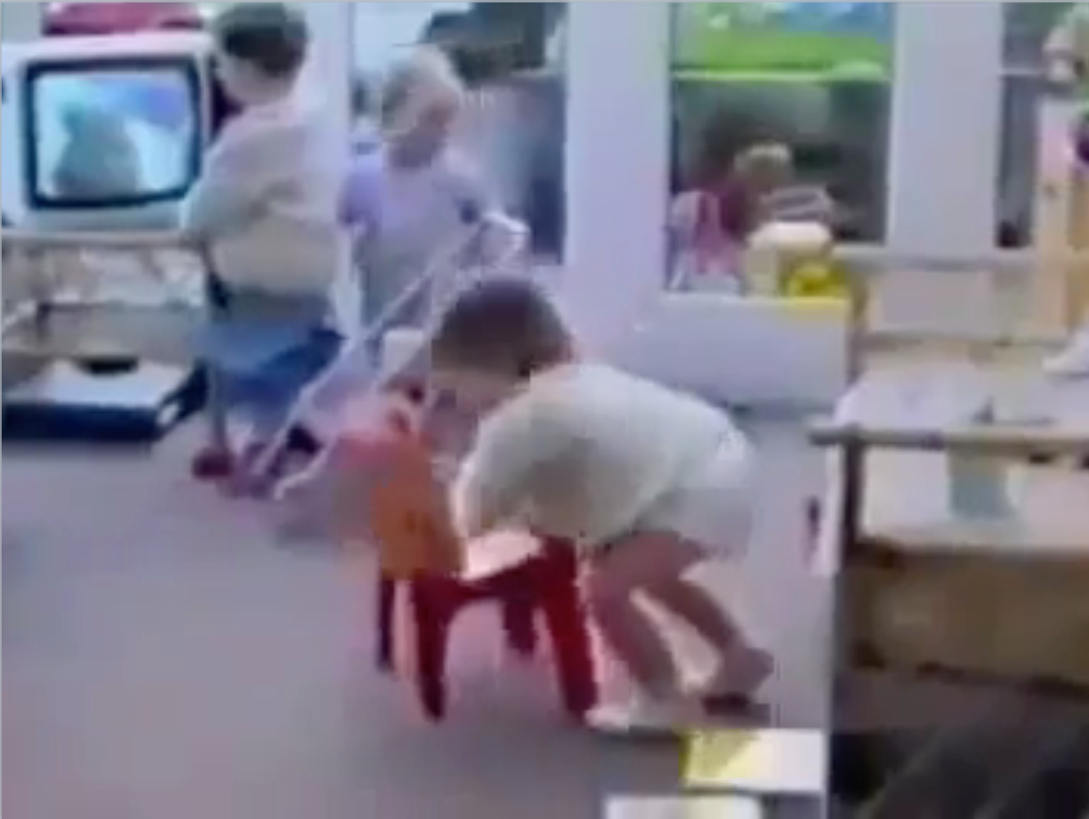
Notes:
Computer vision can understand many things in this video - recognize scene, objects, actions, reconstruct room geometry
But the video also reveals what vision algorithms do not yet understand, such as predicting that the girl is about to fall, what the girl believes, why the girl believes that, whether the audience will laugh, what the girl intended to do, but did not

Slide 4
kindergarden classroom
Notes:
Computer vision can understand many things in this video - recognize scene, objects, actions, reconstruct room geometry
But the video also reveals what vision algorithms do not yet understand, such as predicting that the girl is about to fall, what the girl believes, why the girl believes that, whether the audience will laugh, what the girl intended to do, but did not

Slide 5
person
television
chair
Notes:
Computer vision can understand many things in this video - recognize scene, objects, actions, reconstruct room geometry
But the video also reveals what vision algorithms do not yet understand, such as predicting that the girl is about to fall, what the girl believes, why the girl believes that, whether the audience will laugh, what the girl intended to do, but did not

Slide 6
“What color is the chair?”
Notes:
Computer vision can understand many things in this video - recognize scene, objects, actions, reconstruct room geometry
But the video also reveals what vision algorithms do not yet understand, such as predicting that the girl is about to fall, what the girl believes, why the girl believes that, whether the audience will laugh, what the girl intended to do, but did not

Slide 7
“What color is the chair?”
red
Notes:
Computer vision can understand many things in this video - recognize scene, objects, actions, reconstruct room geometry
But the video also reveals what vision algorithms do not yet understand, such as predicting that the girl is about to fall, what the girl believes, why the girl believes that, whether the audience will laugh, what the girl intended to do, but did not

Slide 8
“What will the girl do next?”
Notes:
Computer vision can understand many things in this video - recognize scene, objects, actions, reconstruct room geometry
But the video also reveals what vision algorithms do not yet understand, such as predicting that the girl is about to fall, what the girl believes, why the girl believes that, whether the audience will laugh, what the girl intended to do, but did not

Slide 9
Notes:
Computer vision can understand many things in this video - recognize scene, objects, actions, reconstruct room geometry
But the video also reveals what vision algorithms do not yet understand, such as predicting that the girl is about to fall, what the girl believes, why the girl believes that, whether the audience will laugh, what the girl intended to do, but did not

Slide 10
Sequences
time
“An”, “evening”, “stroll”, “through”, “a”, “city”, “square”
time
time

Slide 11
How do we model sequences?
Input: No sequence
Output: No sequence
Input: No sequence
Input: Sequence
Input: Sequence
Output: No sequence
Output: Sequence
Output: Sequence
Example: sentence classification, multiple-choice question answering
Example: machine translation, video captioning, open-ended question answering, video question answering
Example: “standard” classification
/ regression problems
Example: Im2Caption
http://karpathy.github.io/2015/05/21/rnn-effectiveness/
Credit: Dhruv Batra, Andrej Karpathy

Slide 12
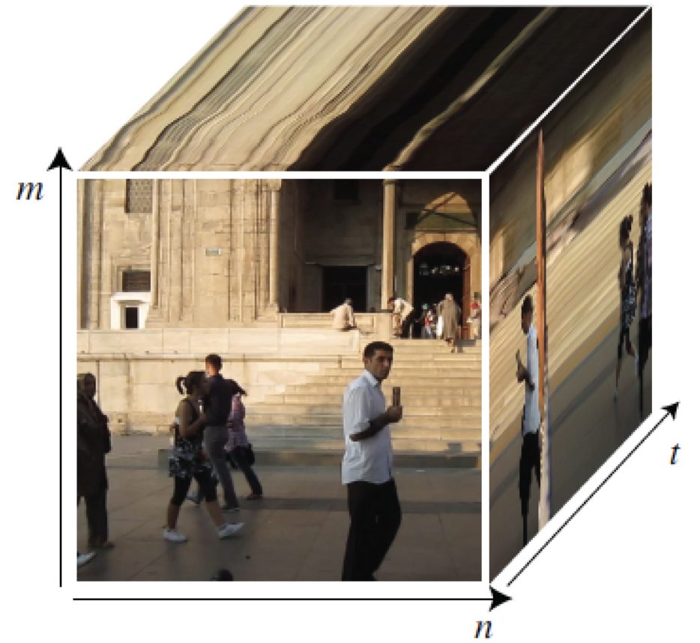

Slide 13
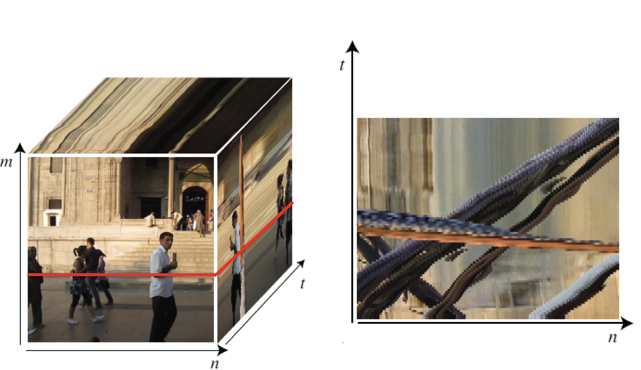

Slide 14
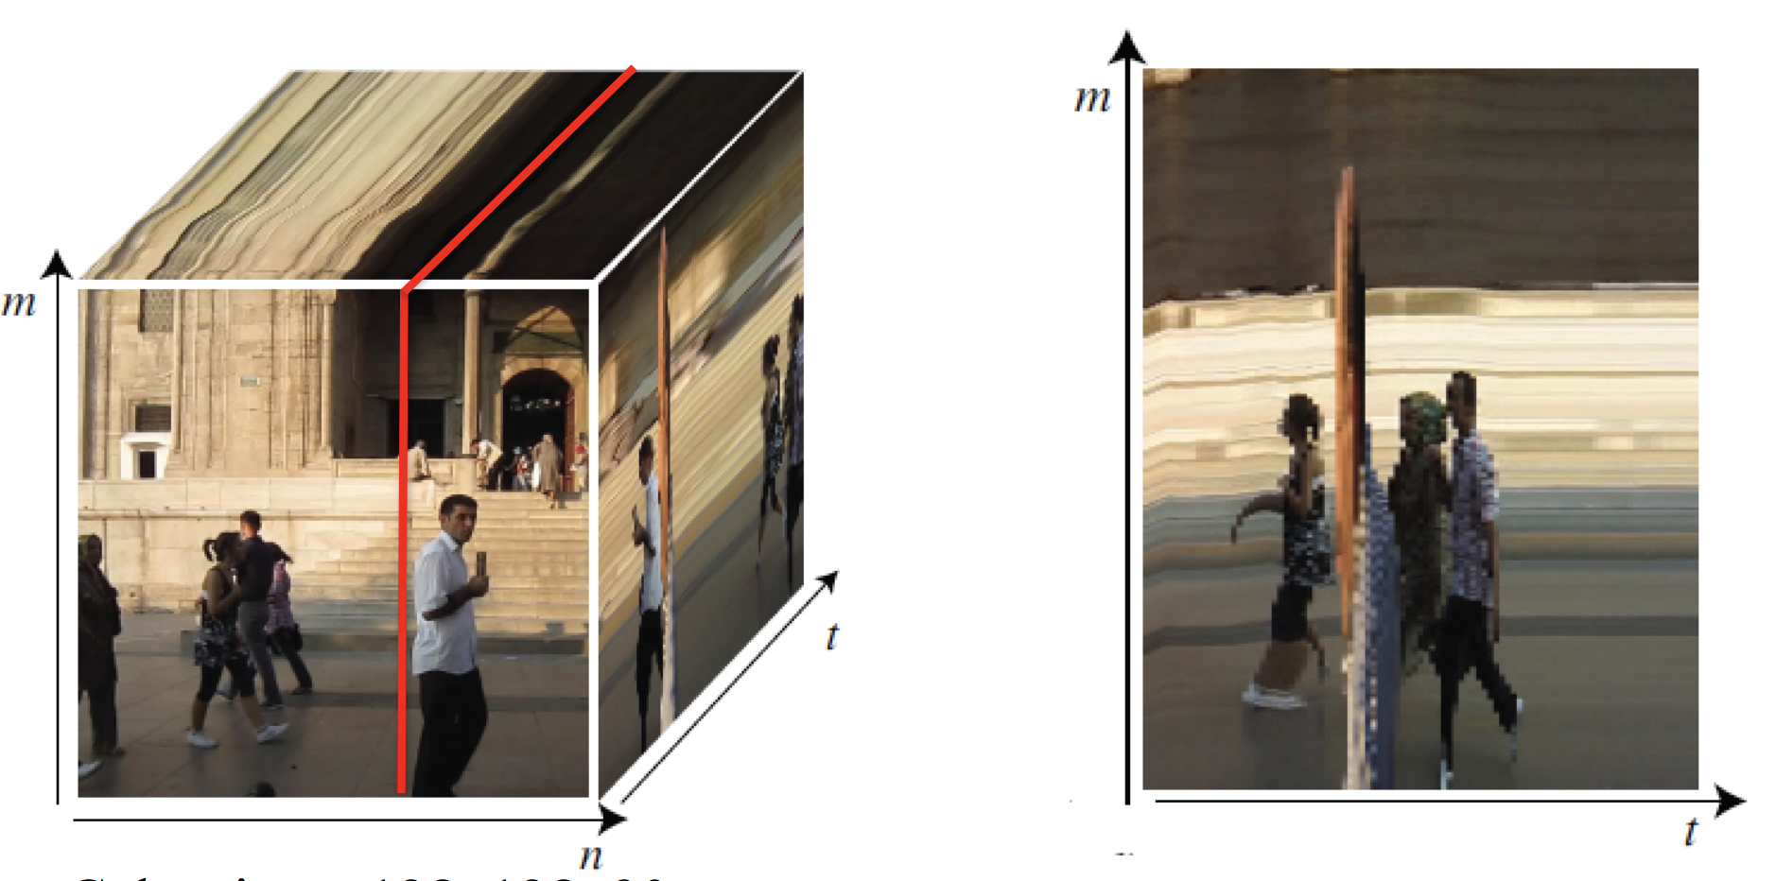

Slide 15
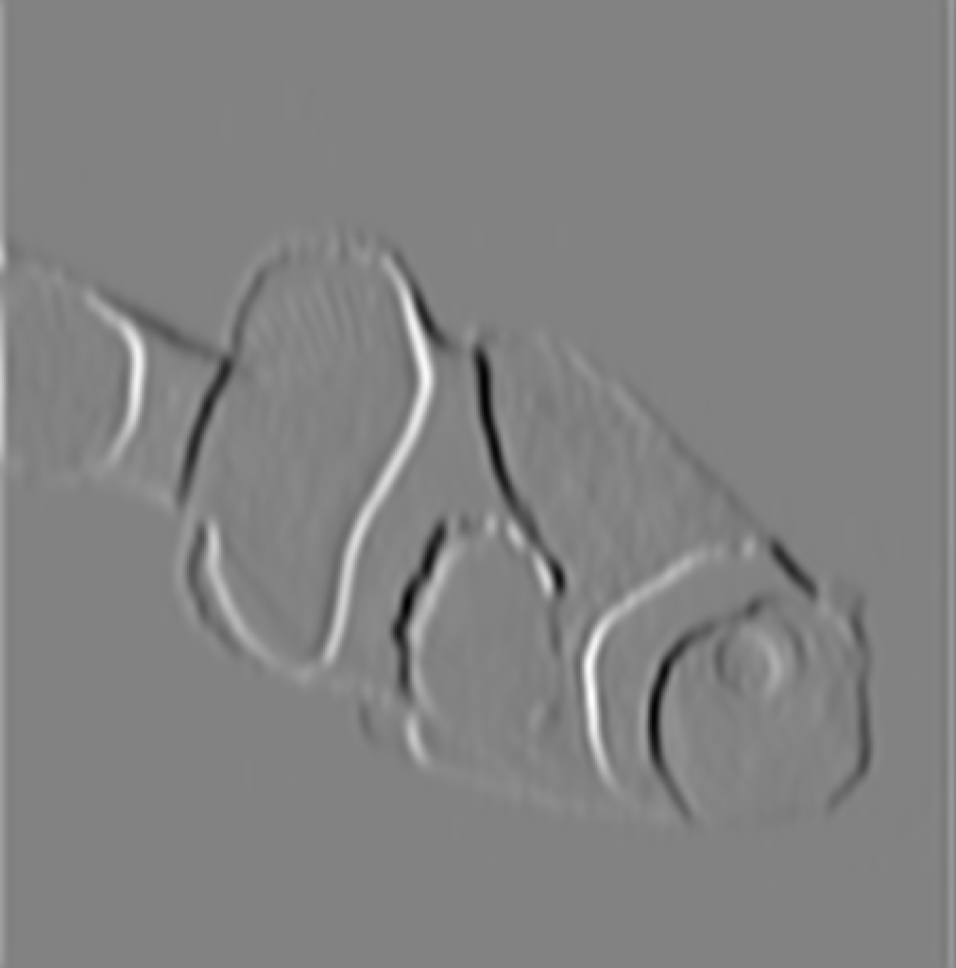
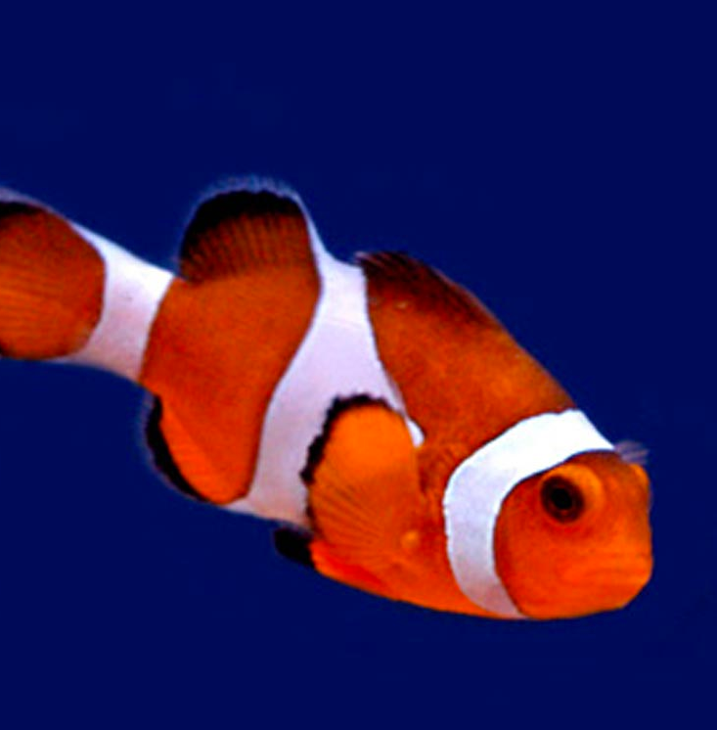
filter

Slide 16
Convolutions in time
time

Slide 18
[fig from FeatureNet: Machining feature recognition based on 3D Convolution Neural Network]

Slide 19
time
[http://moviebarcode.tumblr.com/]
Notes:
Blade Runner 2049

Slide 20
“The Persistence of Memory”, Dali 1931
It bothered him that the dog at three fourteen (seen from the side) should have the same name as the dog at three fifteen (seen from the front).
— “Funes the Memorius”, Borges 1962

Slide 21
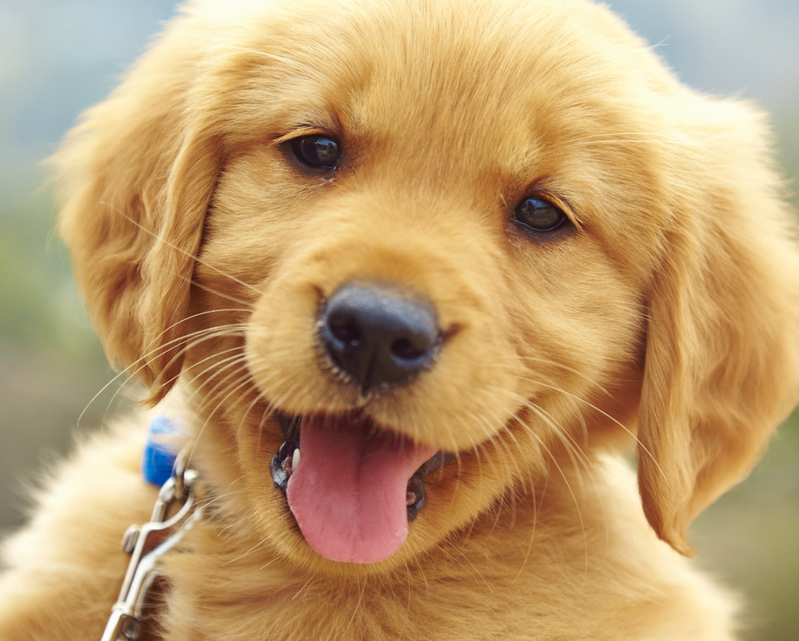
Rufus
time
Notes:
photo url: https://www.mensjournal.com/wp-content/uploads/mf/main-national-puppy-day-_0.jpg?w=1600&h=900&crop=1

Slide 22
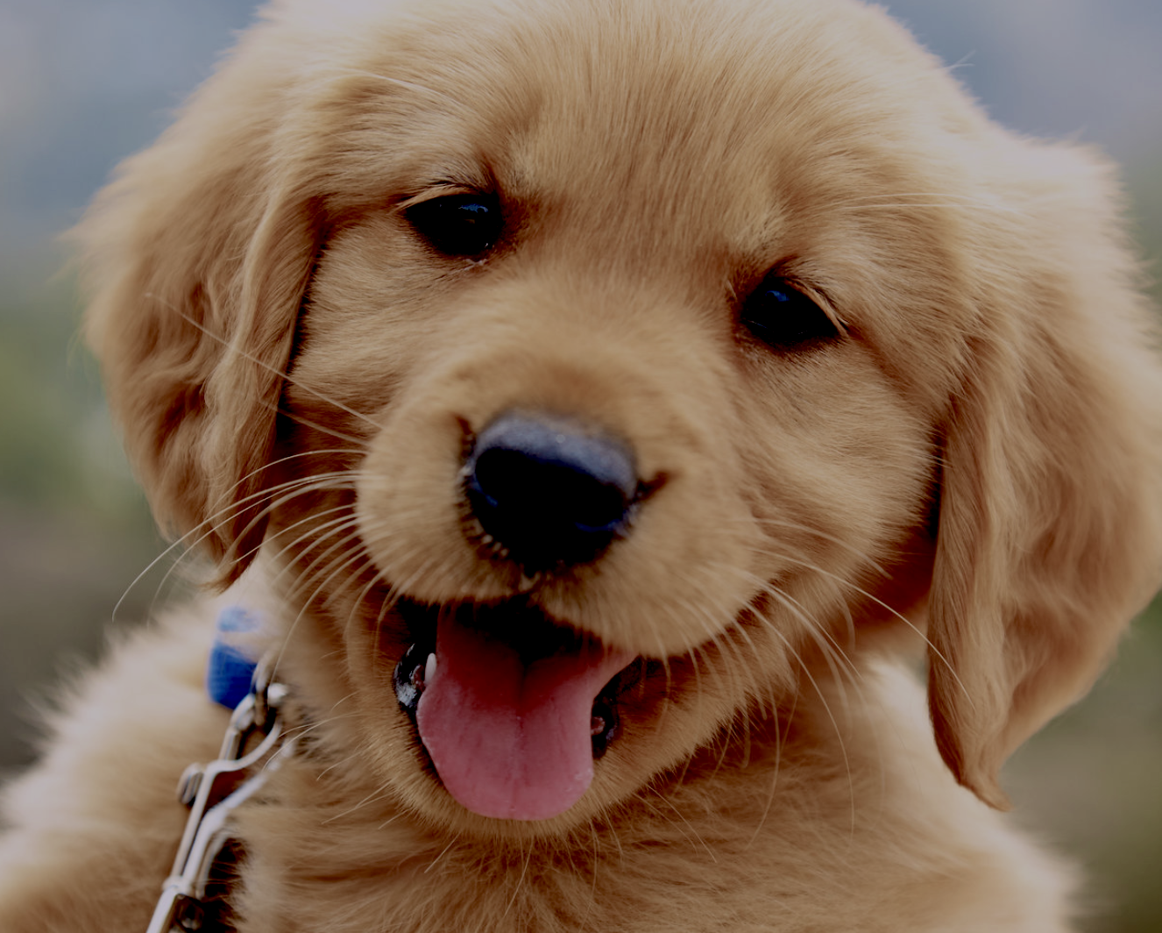
Douglas
time
Notes:
photo url: https://www.mensjournal.com/wp-content/uploads/mf/main-national-puppy-day-_0.jpg?w=1600&h=900&crop=1

Slide 23
Memory unit
Rufus
time
Notes:
photo url: https://www.mensjournal.com/wp-content/uploads/mf/main-national-puppy-day-_0.jpg?w=1600&h=900&crop=1

Slide 24
Memory unit
Rufus
Rufus!
time
Notes:
photo url: https://www.mensjournal.com/wp-content/uploads/mf/main-national-puppy-day-_0.jpg?w=1600&h=900&crop=1

Slide 25
Recurrent Neural Networks (RNNs)
Outputs
Hidden
Inputs

Slide 26
Recurrent Neural Networks (RNNs)
Outputs
Hidden
Inputs
time

Slide 27
Recurrent Neural Networks (RNNs)
Outputs
Hidden
Inputs
time
Notes:
\mathbf{h}_t = f(\mathbf{h}_{t-1}, \mathbf{x}_t)
\mathbf{y}_t = g(\mathbf{h}_t)

Slide 28
Recurrent Neural Networks (RNNs)
Outputs
Hidden
Recurrent!
Inputs

Slide 29
Recurrent Neural Networks (RNNs)
Outputs
Hidden
Inputs
time
Notes:
\mathbf{a}_t = \mathbf{W}\mathbf{h}_{t-1} + \mathbf{U}\mathbf{x}_t + \mathbf{b}
\mathbf{h}_t = \tanh(\mathbf{a}_t)
\mathbf{o}_t = \mathbf{V}\mathbf{h}_t + \mathbf{c}
\hat{\mathbf{y}}^{(t)} = \texttt{softmax}(\mathbf{o}^{(t)})

Slide 30
Deep Recurrent Neural Networks (RNNs)
Outputs
Hidden
…
Inputs
time

Slide 31
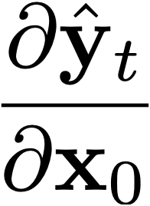
Backprop through time
Outputs
Hidden
Inputs
time
Notes:
\frac{\partial \hat{\mathbf{y}}_t}{\partial \mathbf{x}_0}
= \frac{\partial \hat{\mathbf{y}}_t}{\partial \mathbf{h}_t} \frac{\partial \mathbf{h}_t}{\partial \mathbf{h}_{t-1}} \cdots \frac{\partial \mathbf{h}_1}{\partial \mathbf{h}_0} \frac{\partial \mathbf{h}_0}{\partial \mathbf{x}_0}

Slide 32
Outputs
Hidden
Inputs
time
Notes:
\frac{\partial J}{\partial \mathbf{W}} = \sum_{t=0}^T \frac{\partial \mathcal{L}(\hat{\mathbf{y}_t}, \mathbf{y}_t)}{\partial \mathbf{W}}

Slide 33
Outputs
Hidden
Inputs
time
Notes:
\frac{\partial J}{\partial \mathbf{W}} = \sum_{t=0}^T \frac{\partial \mathcal{L}(\hat{\mathbf{y}_t}, \mathbf{y}_t)}{\partial \mathbf{W}}

Slide 34
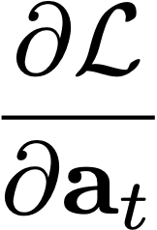
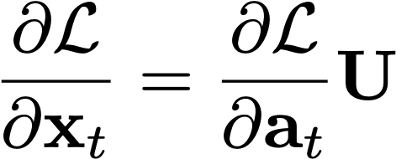
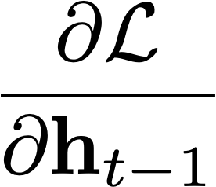
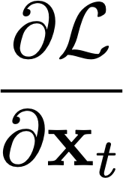
Recurrent linear layer
Notes:
\frac{\partial \mathcal{L}}{\partial \mathbf{x}_{t}} = \frac{\partial \mathcal{L}}{\partial \mathbf{a}_t}\mathbf{U}
\frac{\partial \mathcal{L}}{\partial \mathbf{W}} = \frac{\partial \mathcal{L}}{\partial \mathbf{h}_{t-1}}\frac{\partial \mathbf{h}_{t-1}}{\partial \mathbf{W}}

Slide 35
The problem of long-range dependences
Why not remember everything?
Memory size grows with t
This kind of memory is nonparametric: there is no finite set of parameters we can use to model it
RNNs make a Markov assumption — the future hidden state only depends on the immediately preceding hidden state
By putting the right info in to the hidden state, RNNs can model depedences that are arbitrarily far apart

Slide 36
The problem of long-range dependences
Outputs
Hidden
Inputs
time
Capturing long-range dependences requires propagating information through a long chain of dependences.
Old observations are forgotten
Stochastic gradients become high variance (noisy), and gradients may vanish or explode

Slide 37
LSTMs
Long Short Term Memory
[Hochreiter & Schmidhuber, 1997]
A special kind of RNN designed to avoid forgetting.
This way the default behavior is not to forget an old state. Instead of forgetting by default, the network has to learn to forget.

Slide 38
[Slide derived from Chris Olah: http://colah.github.io/posts/2015-08-Understanding-LSTMs/]

Slide 39
[Slide derived from Chris Olah: http://colah.github.io/posts/2015-08-Understanding-LSTMs/]

Slide 40
Ct = Cell state
[Slide derived from Chris Olah: http://colah.github.io/posts/2015-08-Understanding-LSTMs/]

Slide 41
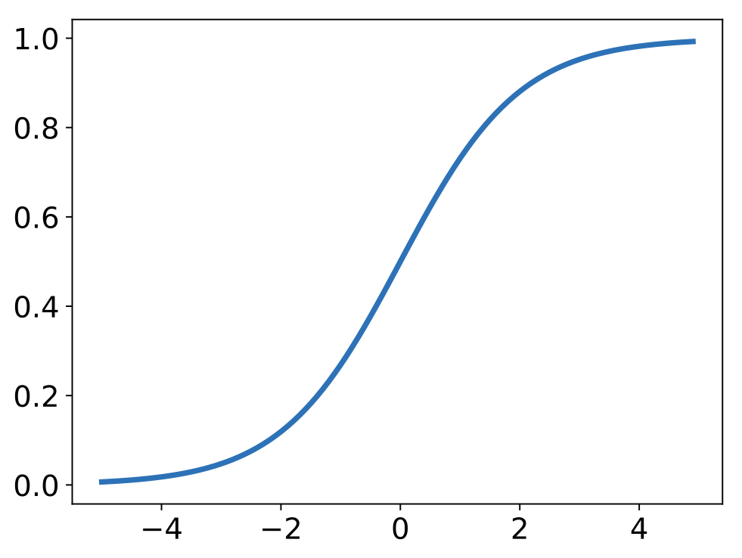
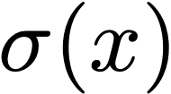
Decide what information to throw away from the cell state.
Each element of cell state is multiplied by ~1 (remember) or ~0 (forget).
[Slide derived from Chris Olah: http://colah.github.io/posts/2015-08-Understanding-LSTMs/]

Slide 42
which indices to write to
what to write to those indices
Decide what new information to add to the cell state.
[Slide derived from Chris Olah: http://colah.github.io/posts/2015-08-Understanding-LSTMs/]

Slide 43
Forget selected old information, write selected new information.
[Slide derived from Chris Olah: http://colah.github.io/posts/2015-08-Understanding-LSTMs/]

Slide 44
After having updated the cell state’s information, decide what to output.
[Slide derived from Chris Olah: http://colah.github.io/posts/2015-08-Understanding-LSTMs/]

Slide 45
Image Captioning
[Example above from: Vinyals, Toshev, Bengio, Erhan, CVPR 2015, https://arxiv.org/abs/1411.4555]

Slide 46
Recipe for deep learning in a new domain
Transform your data into numbers (e.g., a vector)
Transform your goal into a numerical measure (objective function)
#1 and #2 specify the “learning problem”
Use a generic optimizer (SGD) and an appropriate architecture (e.g., CNN or RNN) to solve the learning problem

Slide 47
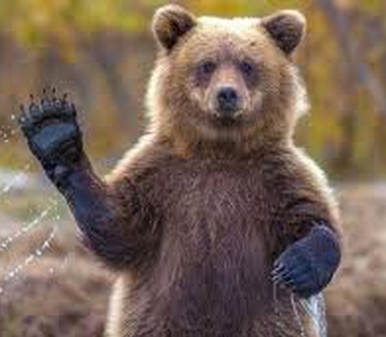
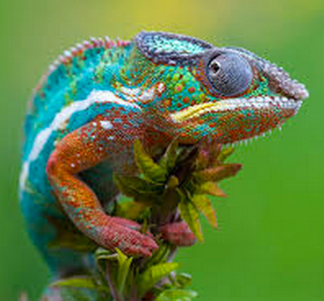
How to represent words as numbers?
One-hot vector
Training data
Training data
Training data
“Fish”
1
[0,0,1]
“Grizzly”
2
[0,1,0]
“Chameleon”
3
[1,0,0]
…
…
…

Slide 48
How to represent words as numbers?
Prediction
dolphin
cat
grizzly bear
angel fish
chameleon
clown fish
iguana
elephant
…
0
1

Slide 49
How to represent words as numbers?
Prediction
a
aardvark
Rather than having just a handful of possible object classes, we can represent all words in a large vocabulary using a very large K
(e.g., K=100,000).
absolve
accurate
adapt
aether
after
aghast
…
0
1

Slide 50
How to represent words as numbers?
Prediction
a
b
Or, represent each character as a class (e.g., K=26 for English letters),
and represent words as a sequence of characters.
c
d
e
f
g
h
…
0
1

Slide 51
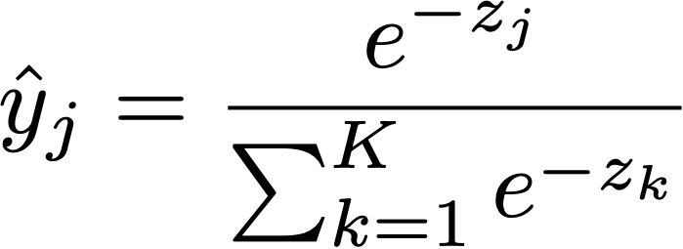
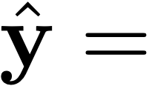
Softmax regression (a.k.a. multinomial logistic regression)
logits: vector of K scores, one for each class
squash into a non-negative vector that sums to 1 — i.e. a probability mass function!
dolphin
cat
grizzly bear
angel fish
chameleon
clown fish
iguana
elephant
…
…
0
1
Notes:
\mathbf{z} = f_{\theta}(\mathbf{x})
\equiv \texttt{softmax}(\mathbf{z})_j
\mathcal{L}(\mathbf{x}, \mathbf{y}) = H(\mathbf{y}, \texttt{softmax}(f_{\theta}(\mathbf{x})))

Slide 52
“swimming”
“clown”
“fish”
“open”
“seas”
“A”
“in”
Outputs
Hidden
Inputs
This problem is called image captioning

Slide 53
“swimming”
“clown”
“fish”
“open”
“seas”
Outputs
“A”
“in”
END
Hidden
LSTM
LSTM
LSTM
LSTM
LSTM
LSTM
LSTM
LSTM
CNN
“A”
“in”
“open”
“seas”
“clown”
“fish”
“swimming”
Input

Slide 54
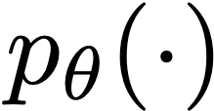
“swimming”
“clown”
“fish”
“open”
“seas”
END
Targets
“A”
“in”
Outputs
Hidden
LSTM
LSTM
LSTM
LSTM
LSTM
LSTM
LSTM
LSTM
CNN
“A”
“in”
“open”
“seas”
“clown”
“fish”
“swimming”
Max-likelihood objective: maximize probability the model assigns to each target word:
Input

Slide 55
Targets
Outputs
Hidden
LSTM
LSTM
LSTM
LSTM
LSTM
LSTM
LSTM
LSTM
CNN
Input
Max-likelihood objective: minimize cross-entropy between model outputs and one-hot encoded targets.

Slide 56
“swimming”
“clown”
“fish”
“open”
“seas”
END
Samples
“A”
“in”
Outputs
Hidden
LSTM
LSTM
LSTM
LSTM
LSTM
LSTM
LSTM
LSTM
CNN
“A”
“in”
“open”
“seas”
“clown”
“fish”
“swimming”
Sample from predicted distribution over words.
Input
Alternatively, sample most likely word.

Slide 57
It was very popular a few years ago

Slide 58
Show and Tell: A Neural Image Caption Generator
[Vinyals et. al., CVPR 2015]

Slide 59
Show and Tell: A Neural Image Caption Generator
[Vinyals et. al., CVPR 2015]

Slide 61
The problem of long-range dependences
Why not remember everything?
Memory size grows with t
This kind of memory is nonparametric: there is no finite set of parameters we can use to model it
RNNs make a Markov assumption — the future hidden state only depends on the immediately preceding hidden state
By putting the right info in to the hidden state, RNNs can model depedences that are arbitrarily far apart

Slide 62
Memory unit
Rufus
Rufus!
time
Notes:
photo url: https://www.mensjournal.com/wp-content/uploads/mf/main-national-puppy-day-_0.jpg?w=1600&h=900&crop=1

Slide 63
Memory units
…
time
Notes:
photo url: https://www.mensjournal.com/wp-content/uploads/mf/main-national-puppy-day-_0.jpg?w=1600&h=900&crop=1

Slide 64
The problem of long-range dependences
Other methods exist that do directly link old “memories” (observations or hidden states) to future predictions:
Temporal convolutions
Attention / Transformers (see https://arxiv.org/abs/1706.03762)
Memory networks (see https://arxiv.org/abs/1410.3916)

Slide 65
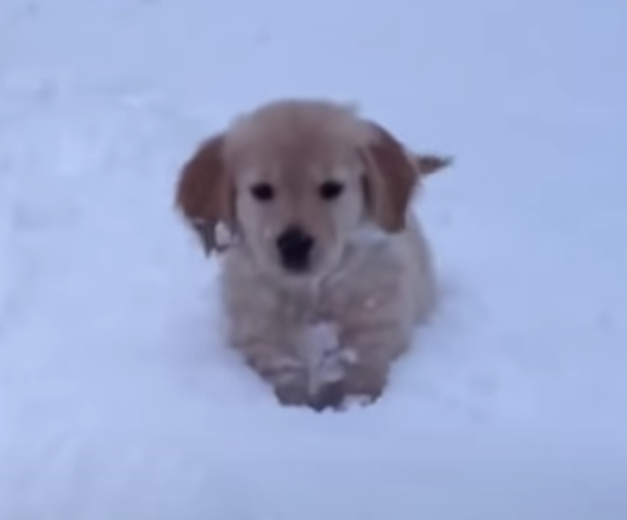
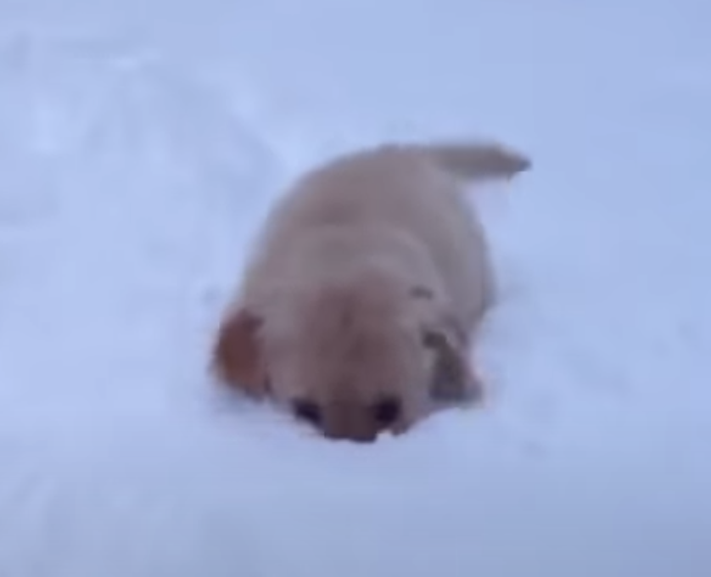
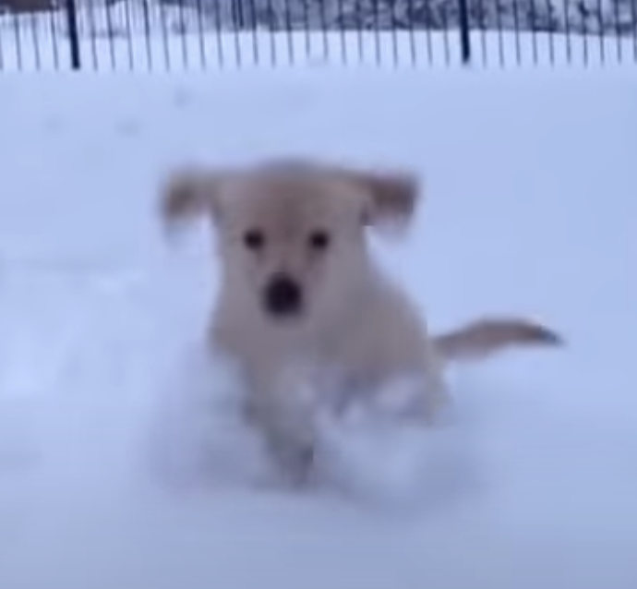
Pooling
Outputs
“dog”
“playing”
“snow”
“A”
“in”
“the”
LSTM
LSTM
LSTM
LSTM
LSTM
LSTM
Hidden
Input

Slide 66
Pooling
Outputs
Hidden
Input
“A”
“fish”
“in”
“seas”
“clown”
“open”
“swimming”

Slide 67
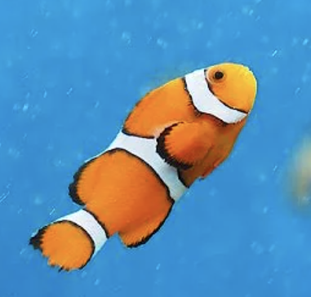
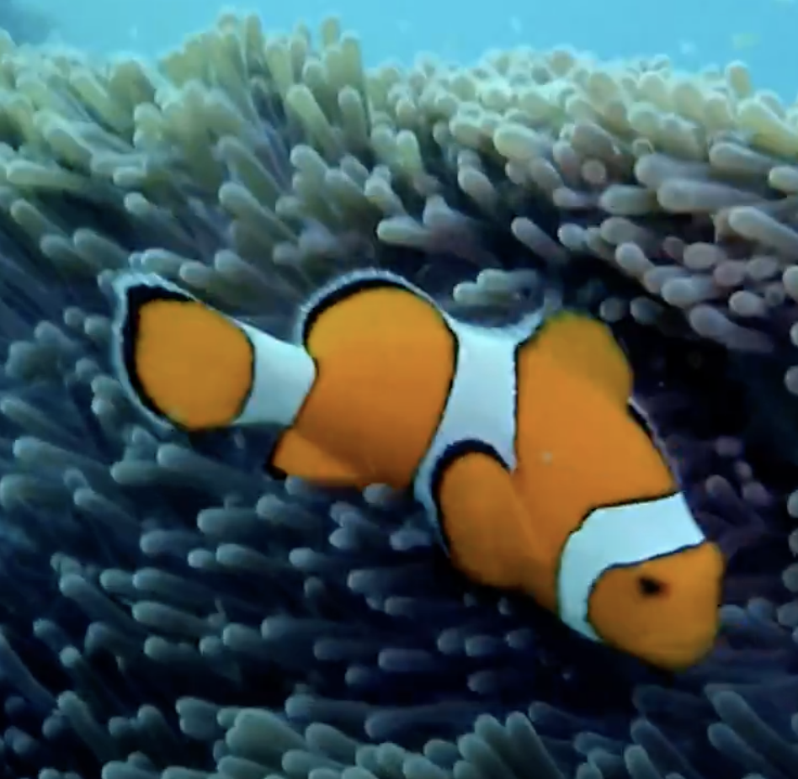
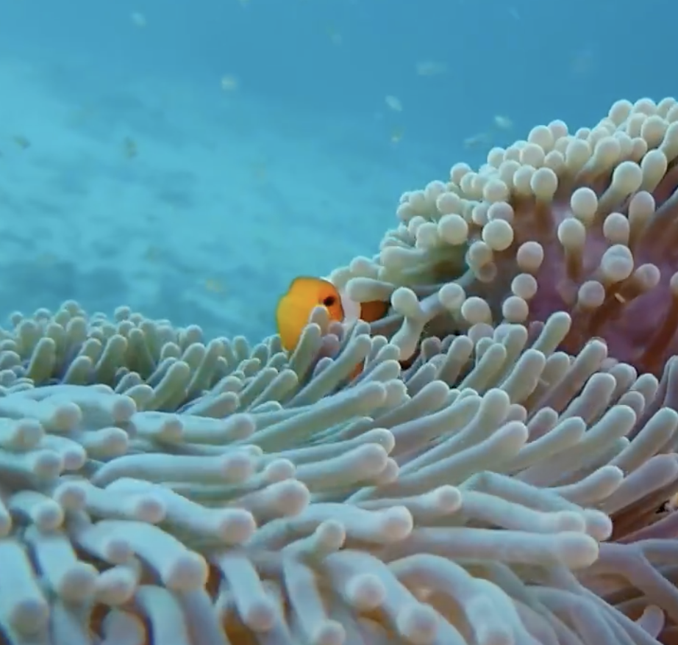
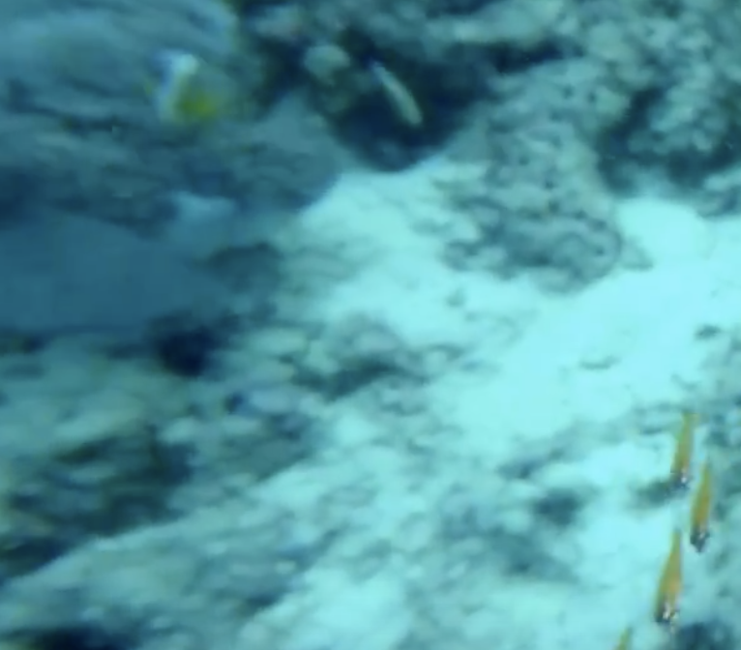
Pooling
Outputs
“clownfish”
“swimming”
“an”
“A”
“by”
“anenome”
LSTM
LSTM
LSTM
LSTM
LSTM
LSTM
Hidden
Input
…
…
…

Slide 68
Attention
Outputs
“clownfish”
“swimming”
“an”
“A”
“by”
“anenome”
LSTM
LSTM
LSTM
LSTM
LSTM
LSTM
Hidden
Input
…
…
…

Slide 69
Attention
Outputs
“clownfish”
“swimming”
“an”
“A”
“by”
“anenome”
LSTM
LSTM
LSTM
LSTM
LSTM
LSTM
Hidden
Input
…
…
…

Slide 70
Attention
“clownfish”
“swimming”
“an”
“anenome”
“A”
“by”
LSTM
LSTM
LSTM
LSTM
LSTM
LSTM
Hidden
Input
…
…
…

Slide 71
Attention
Weights are determined by similarity between query and key
“clownfish”
“swimming”
“an”
“anenome”
“A”
“by”
LSTM
LSTM
LSTM
LSTM
LSTM
LSTM
=
query
key
Input
…
…
…

Slide 72
Attention
Weights are determined by similarity between query and key
“clownfish”
“swimming”
“an”
“anenome”
“A”
“by”
LSTM
LSTM
LSTM
LSTM
LSTM
LSTM
summation is over weights * value
query
value
key
Input
…
…
…

Slide 73
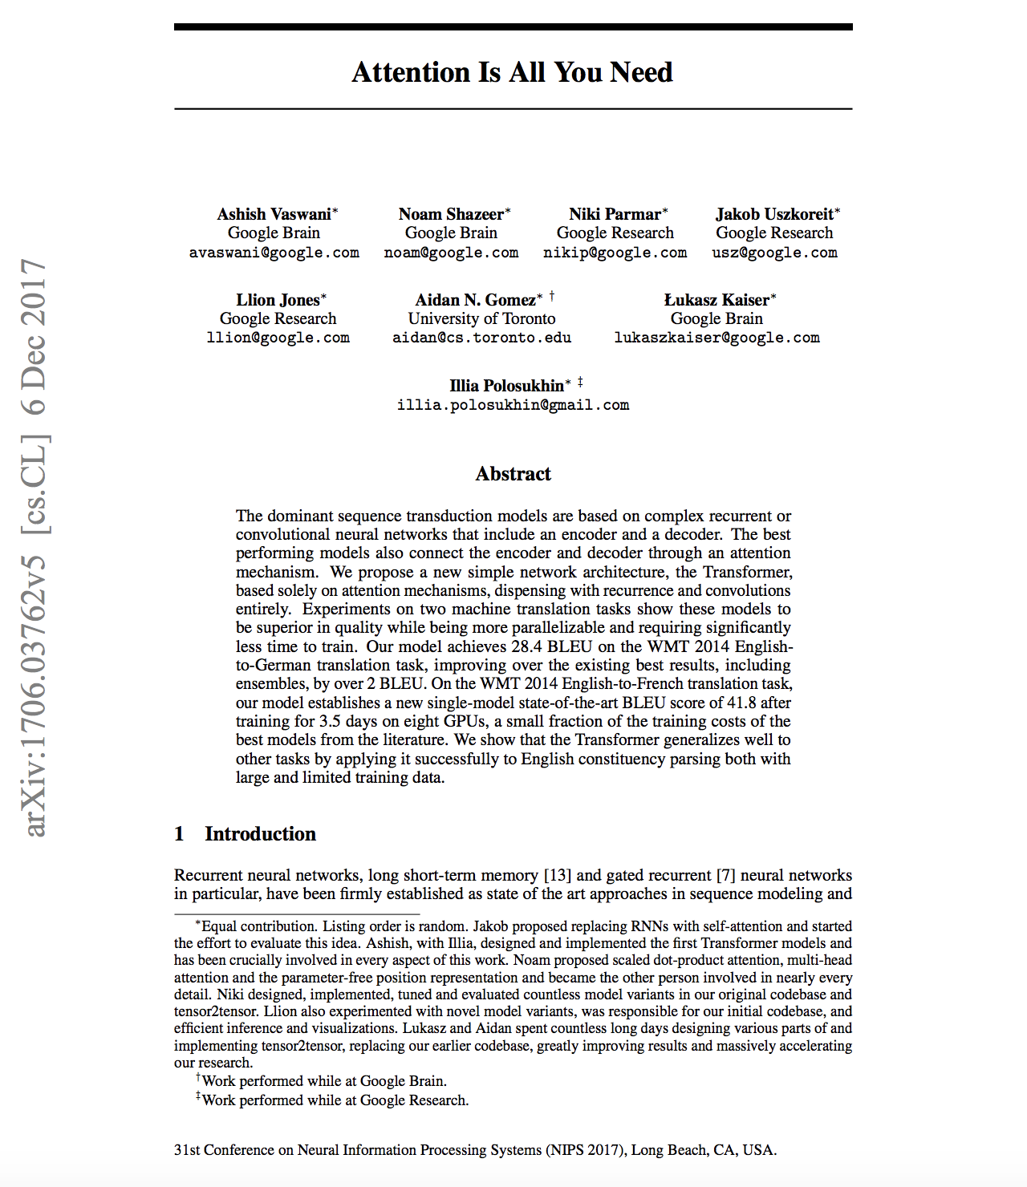
Problems with Recurrent Architectures
Long sequences still tricky, exploding / vanishing gradients
Inherently sequential: Need to generate word after word…
Regularly do not remember long-ago events.

Slide 74
Encoding Sequences with Attention
Output Tokens
$$O_{0}$$
$$O_{1}$$
$$O_{2}$$
$$O_{3}$$
$$O_{4}$$
$$O_{5}$$
N Self-Attention Blocks
Input
Embedding
$$I_{0}$$
$$I_{1}$$
$$I_{2}$$
$$I_{3}$$
$$I_{4}$$
$$I_{5}$$
A
clownfish
swimming
by
an
anemone

Slide 75
Encoding Sequences with Attention
$$O_{2}$$
N Self-Attention Blocks
Input
Embedding
$$I_{2}$$
A
clownfish
swimming
by
an
anemone

Slide 76
Core component: Dot-product Attention (drastically simplified)
$$O_{2}$$
K
V
K
V
Q
K
V
K
V
K
V
$$I_{2}$$
A
clownfish
swimming
by
an
anemone

Slide 77
Core component: Dot-product Attention (drastically simplified)
O
$$O_{2}$$
$$α_{1}$$
$$α_{2}$$
$$α_{3}$$
$$α_{4}$$
$$α_{5}$$
K
V
K
V
Q
K
V
K
V
K
V
$$I_{2}$$
A
clownfish
swimming
by
an
anemone

Slide 78
Core component: Dot-product Attention (drastically simplified)
O
$$O_{2}$$
$$\sum_{i}{α_{i}}{\text{V}}_{i}$$
$$α_{1}$$
$$α_{2}$$
$$α_{3}$$
$$α_{4}$$
$$α_{5}$$
K
V
K
V
Q
K
V
K
V
K
V
$$I_{2}$$
A
clownfish
swimming
by
an
anemone

Slide 79
Core component: Dot-product Attention (drastically simplified)
O
$$O_{2}$$
$$\sum_{i}{α_{i}}{\text{V}}_{i}$$
$$α_{1}$$
$$α_{2}$$
$$α_{3}$$
$$α_{4}$$
$$α_{5}$$
K
V
K
V
Q
K
V
K
V
K
V
$$I_{2}$$
A
clownfish
swimming
by
an
anemone

Slide 80
Scaled Dot-Product Attention
$${\text{K}}_{i},{\text{V}}_{i},{\text{Q}}_{i}=$$
linear
$$(I_{i}),{\text{K}}_{i},{\text{V}}_{i},{\text{Q}}_{i}∈R^{k}$$
Inspired by Alammar, J (2018). The Illustrated Transformer [Blog post]. Retrieved from https://jalammar.github.io/illustrated-transformer/

Slide 81
Scaled Dot-Product Attention
$${\text{K}}_{i},{\text{V}}_{i},{\text{Q}}_{i}=$$
linear
$$(I_{i}),{\text{K}}_{i},{\text{V}}_{i},{\text{Q}}_{i}∈R^{k}$$
$${\text{Q}}_{j}$$
$${\text{K}}_{i}^{T}$$
(
)
$$α_{i}^{j}=$$
softmax
$$\sqrt{d_{k}}$$
Inspired by Alammar, J (2018). The Illustrated Transformer [Blog post]. Retrieved from https://jalammar.github.io/illustrated-transformer/

Slide 82
Scaled Dot-Product Attention
$${\text{K}}_{i},{\text{V}}_{i},{\text{Q}}_{i}=$$
linear
$$(I_{i}),{\text{K}}_{i},{\text{V}}_{i},{\text{Q}}_{i}∈R^{k}$$
$${\text{Q}}_{j}$$
$${\text{K}}_{i}^{T}$$
(
)
$$α_{i}^{j}=$$
softmax
$$\sqrt{d_{k}}$$
$$O_{j}=\underset{i}{∑}α_{i}^{j}{\text{V}}_{i}$$
Inspired by Alammar, J (2018). The Illustrated Transformer [Blog post]. Retrieved from https://jalammar.github.io/illustrated-transformer/

Slide 83
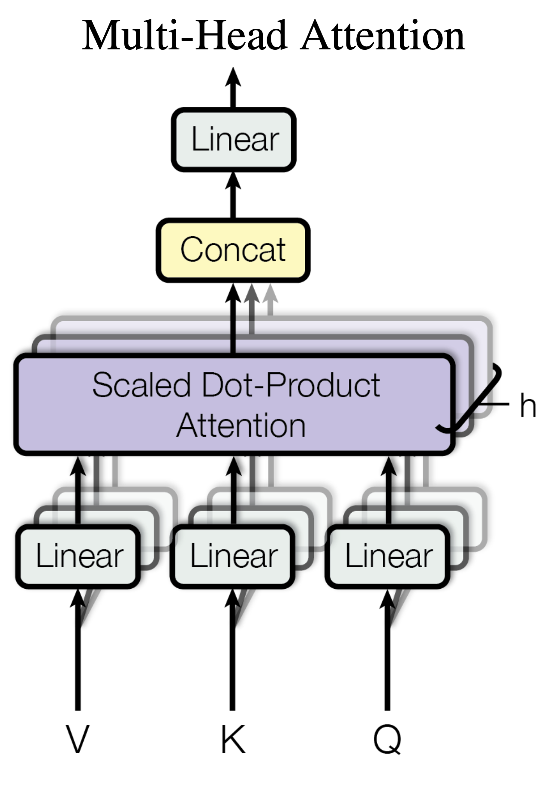
Multi-Head Attention
$${\text{K}}_{i},{\text{V}}_{i},{\text{Q}}_{i}=$$
linear
$$(I_{i}),{\text{K}}_{i},{\text{V}}_{i},{\text{Q}}_{i}∈R^{k}$$
$${\text{Q}}_{j}$$
$${\text{K}}_{i}^{T}$$
(
)
$$α_{i}^{j}=$$
softmax
$$\sqrt{d_{k}}$$
$$O_{j}=\underset{i}{∑}α_{i}^{j}{\text{V}}_{i}$$
[“Attention is all you need”, Vaswani et al. 2017]

Slide 84
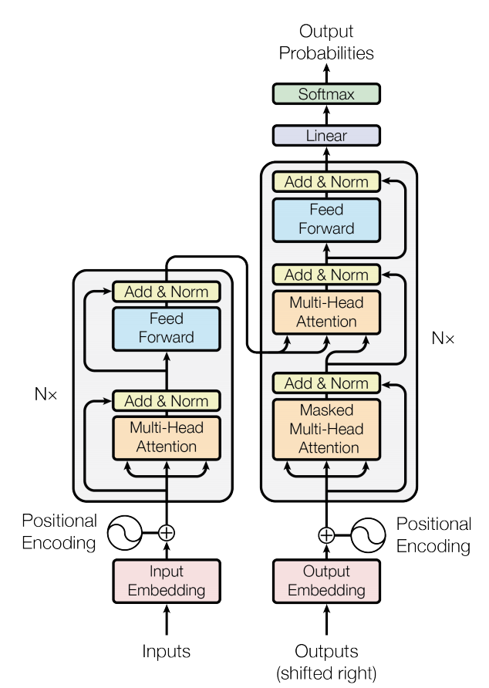
The Transformer
[“Attention is all you need”, Vaswani et al. 2017]

Slide 85
Not only for Seq2Seq: Vision Transformers
[“An Image is Worth 16x16 Words”, Dosovitskiy et al. 2021]

Slide 86
Not only for Seq2Seq: Vision Transformers
[“An Image is Worth 16x16 Words”, Dosovitskiy et al. 2021]

Slide 87
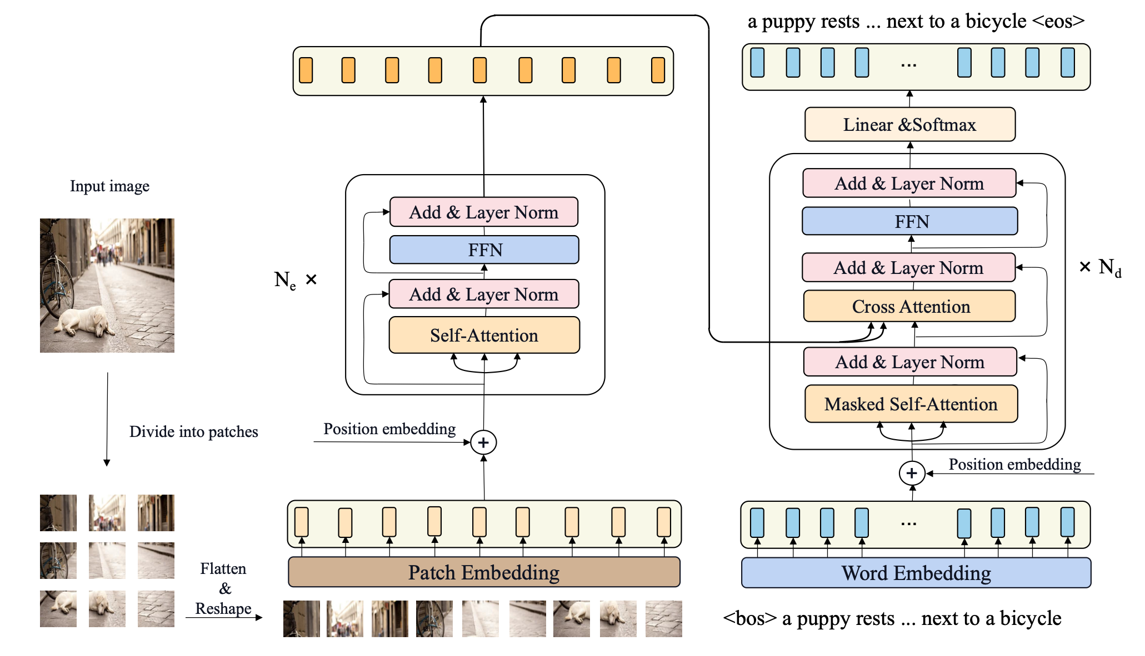
Image Captioning… with Transformers
[“CPTR: Multiscale Transformer Network for Image Captioning”, Liu et al. 2021]

Slide 88
Encoding Sequences with Attention
N Cross-Attention
N Self-Attention Blocks
N Self-Attention Blocks
A
clownfish
swimming
by
an
anemone
catches
a

Slide 89
Modeling arbitrarily long sequences
RNNs — recurrent weights are shared across time
Convolution — conv weights are shared across time
Attention — weights are dynamically determined

Slide 90
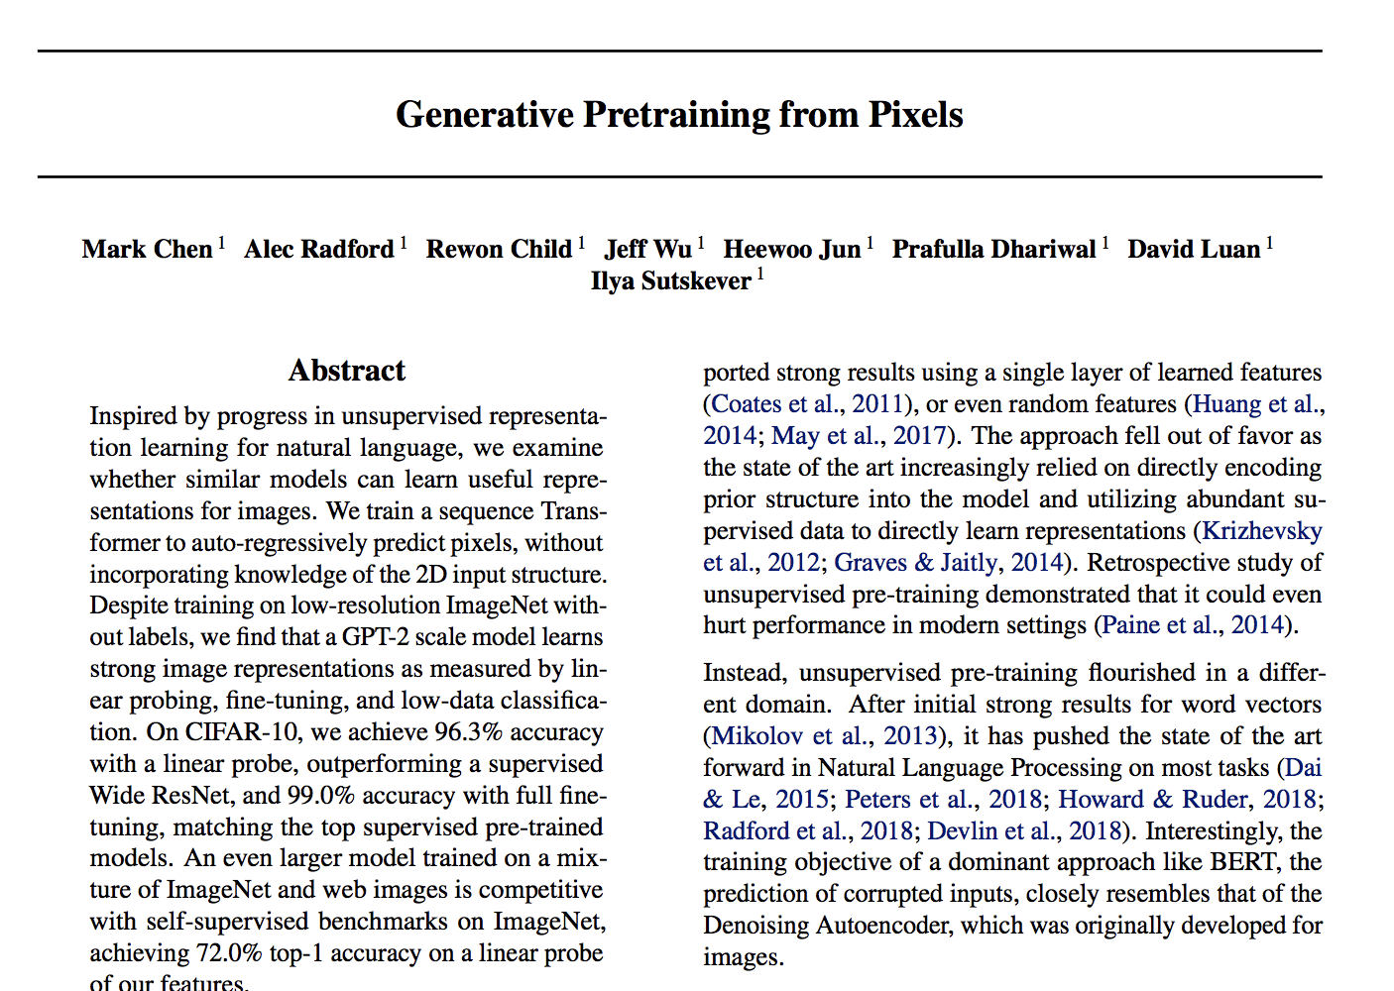
Anything you can do w.r.t. time, you can do w.r.t. space, and vice versa.
Popular right now: treat pixels as a sequence and then apply sequence modeling methods.

